Slide 1
SS7G12 The student will analyze the diverse cultures of the people who live in Southern and Eastern Asia.
a. Explain the differences between an ethnic group and a religious group.
b. Compare and contrast the prominent religions in Southern and Eastern Asia: Buddhism, Hinduism, Islam, Shintoism and the philosophy of Confucianism.

Slide 2


What describes a religious group?
  People who share belief in god or gods
  People who share same religion
What describes an ethnic group?
  People who share language, religion, or culture
  Examples: Kurds share language, religion and culture

Slide 3
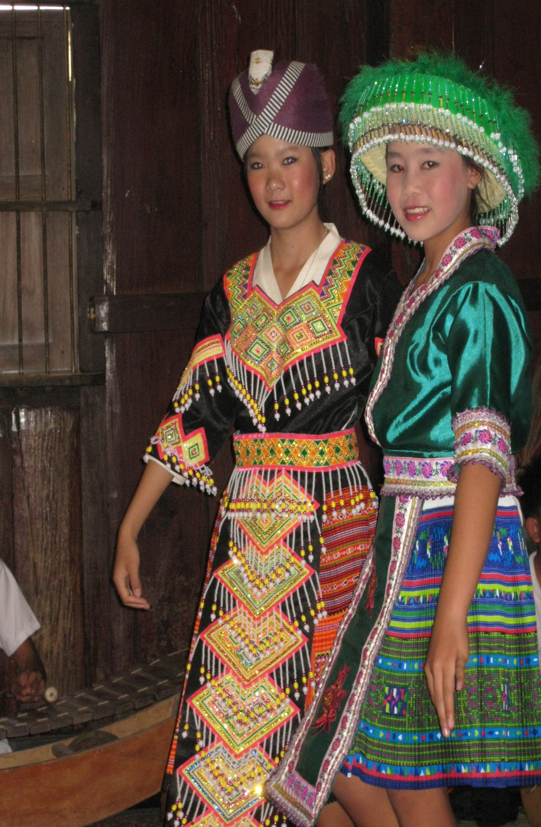
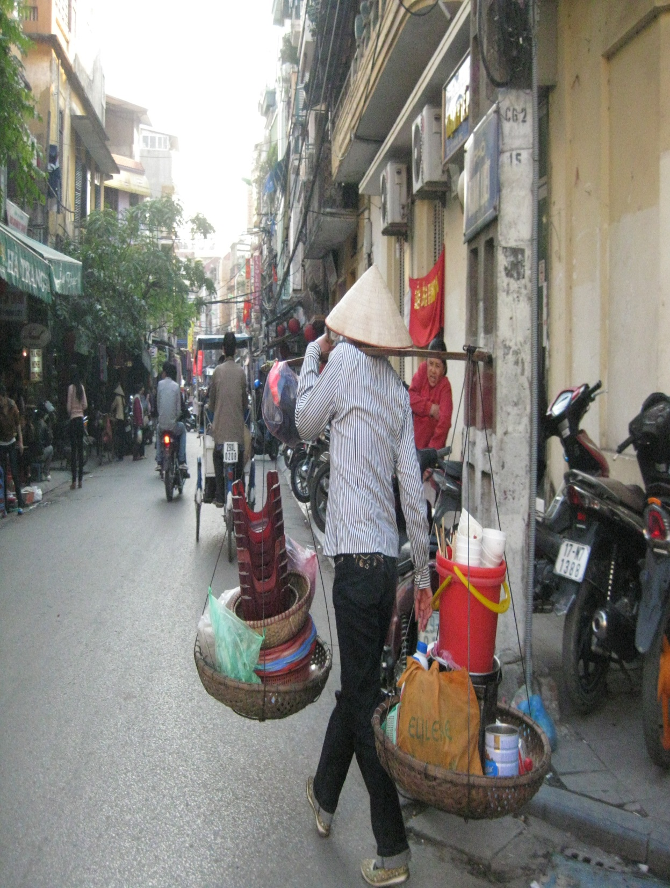

Slide 4
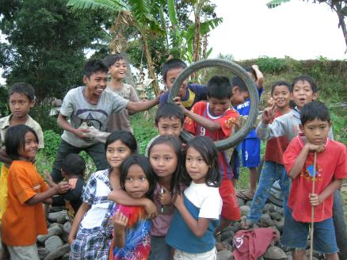




Slide 5

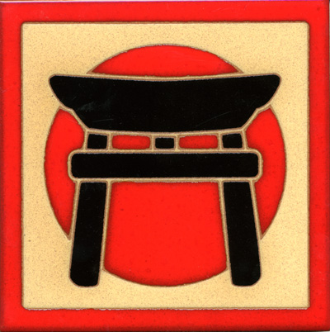
Predominate Asian Religions
Confucianism
Daoism
Islam
Christianity
Shintoism
Buddhism
Hinduism

Slide 7
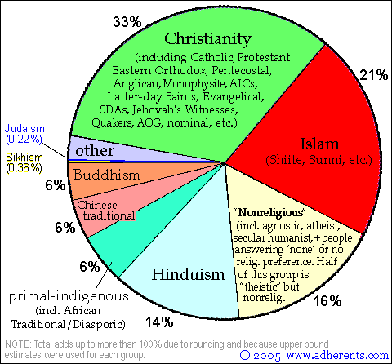

Slide 8
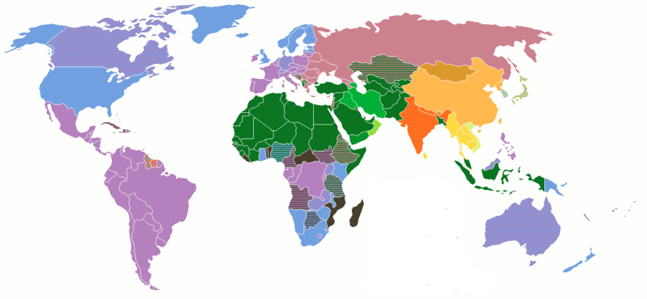
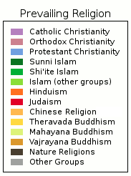

Slide 9
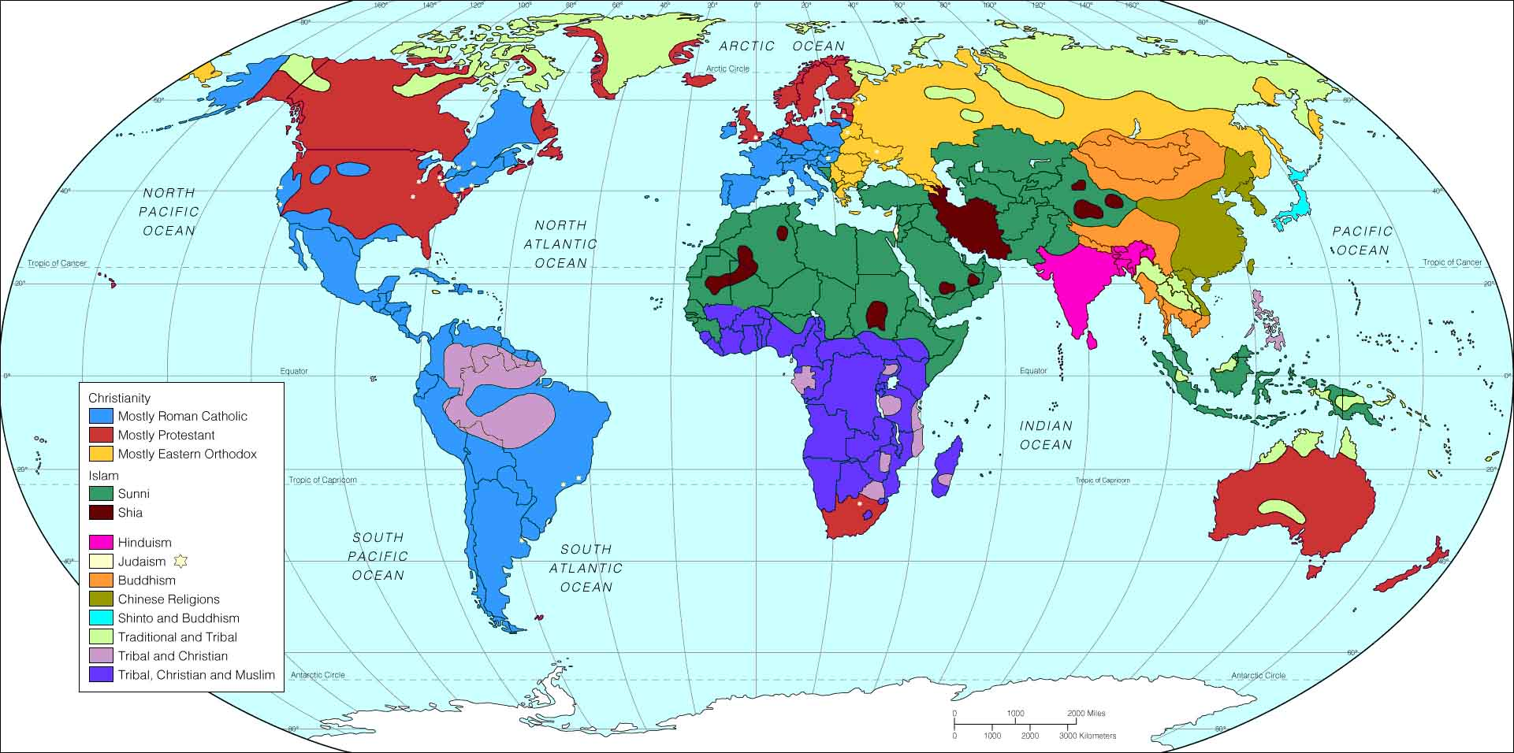

Slide 10
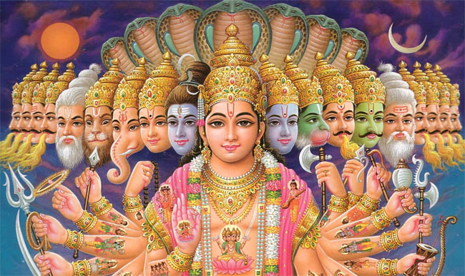
Hinduism
One of the oldest religions in world founded in India
Sacred Text is called the Vedas or Book of Knowledge and it was written in 1,500 BCE (3,500 years ago!)
Hinduism is Polytheistic or they believe in MANY gods.
The supreme god is Brahman, but has 3 main forms
  Brahma the Creator
  Siva the Destroyer
  Vishnu the Preserver
Hinduism is a very complex religion and does not include strict religions doctrine like most world religions.
Hinduism is the 3rd Largest religion in the world

Slide 11
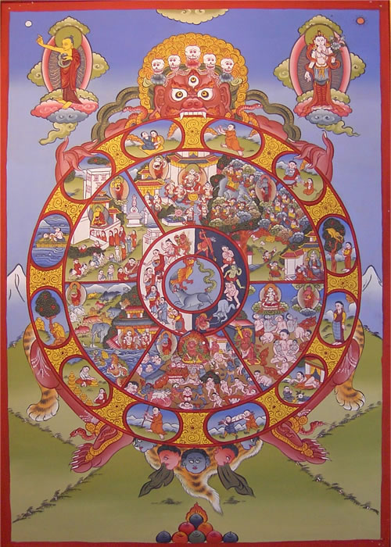
Reincarnation
Hindus believe all living beings have souls and many are vegetarians
Hindus also believe in reincarnation, or the belief that the soul returns to another body after life.
A good person will return to have a better life, a bad person will return to a worse life-this is called Karma
Karma is the belief actions (good or bad) determine ones fate
Ultimately the goal is to be removed from the Karmic cycle. If some is good enough, through many lifetimes, they can become united with Brahman

Slide 12
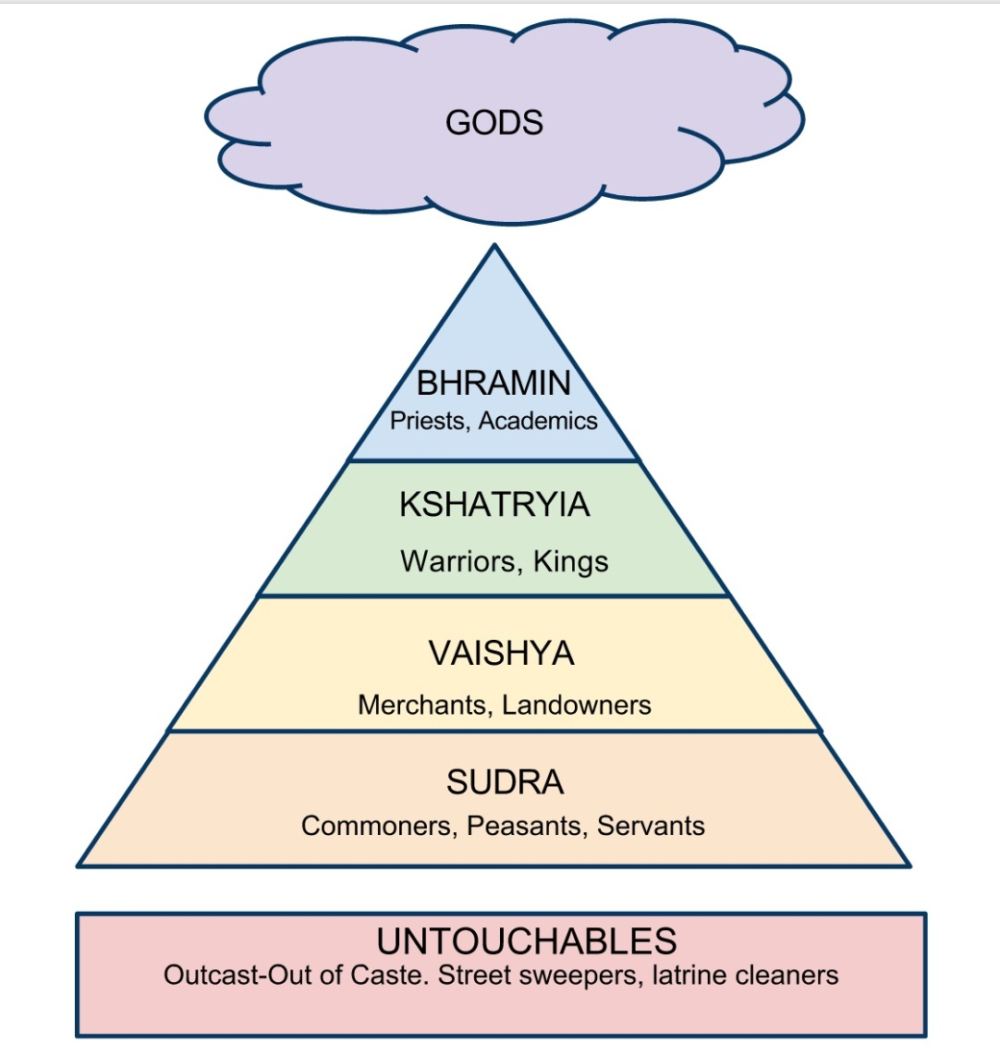
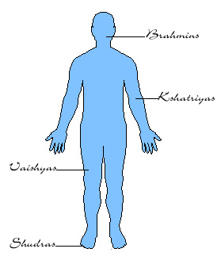
Caste system is another important part of Hinduism and the Caste System is part of Karma
Caste System means that your social class is inherited or determined at birth from the good of bad deeds in your previous life.

Slide 13
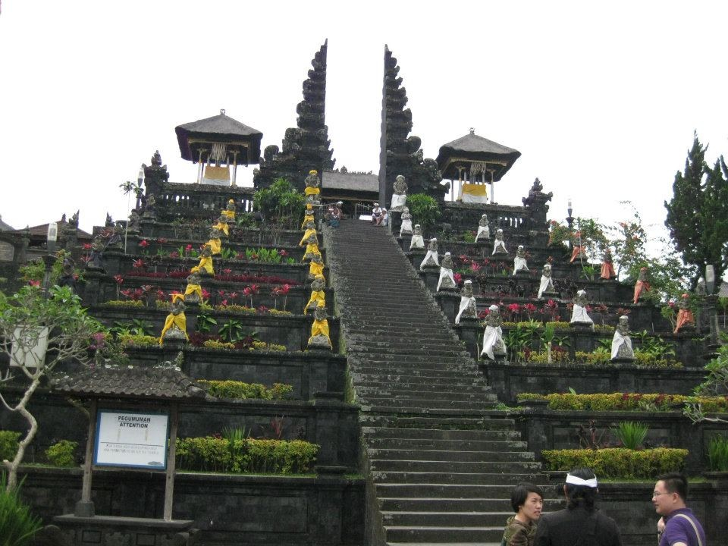
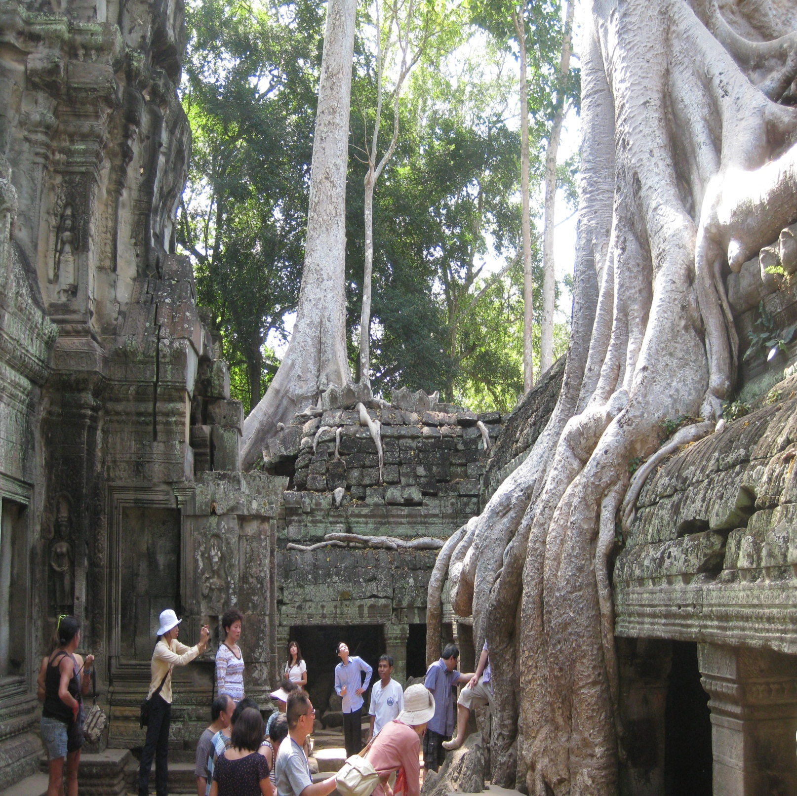

Slide 14
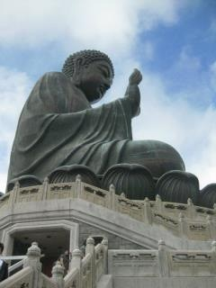
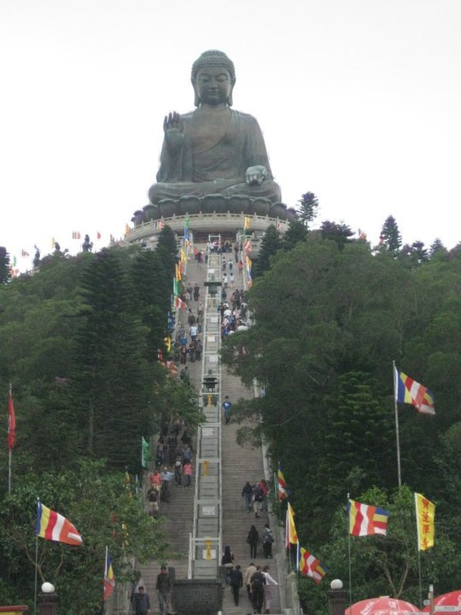
Buddhism
Buddhism also comes from India and was founded around 500 BCE
It’s founder is Siddhartha Gautama was born around a prince, but renounced (went away from) his life to find enlightenment and became known as the “Enlightened One” or Buddha.

Slide 15
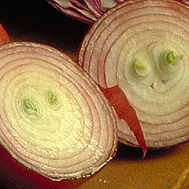
“No one saves us but ourselves. No one can and no one may. We ourselves must walk the path.”
The teachings of Buddha were written down in the Pali Canon and have become Buddhism.
Buddhism is found in many Asian countries, but only a few in India are Buddhists today.
Buddha tried to teach others enlightenment through the Four Noble Truths
  Life is Suffering
  Greed causes suffering
  Remove yourself and suffering ends (Nirvana)
  Follow the Eightfold to attain Nirvana
Pratītyasamutpāda
“Interdependant arising”

Slide 16
Eightfold Path is the way Buddhist should live.
  Right Speech – Speaking in a non hurtful, not exaggerated, truthful way.
  Right Action – Avoiding harmful actions.
  Right Livelihood - Not harming in any way oneself or others; directly or indirectly.
  Right Effort – Making constant effort to improve oneself.
  Right Mindfulness - Mental ability to see things for what they are with clear consciousness.
  Right View - Understanding reality as it is, not just as it appears to be.
  Right Contemplation - Being aware of the present reality within oneself, without any craving or aversion.
  Right Thought - Change in the pattern of thinking.
The Middle Way is part of the Eightfold path, but it is more a mindset of viewing the world. The Middle Way mindset is necessary for Buddhists to find peace.

Slide 17
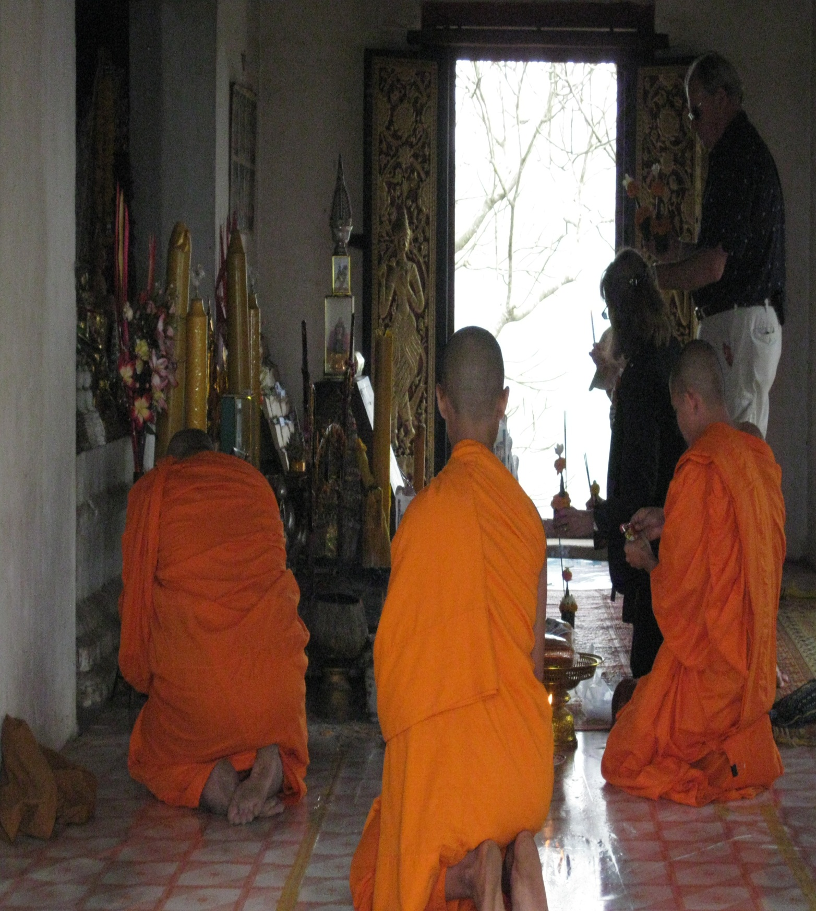
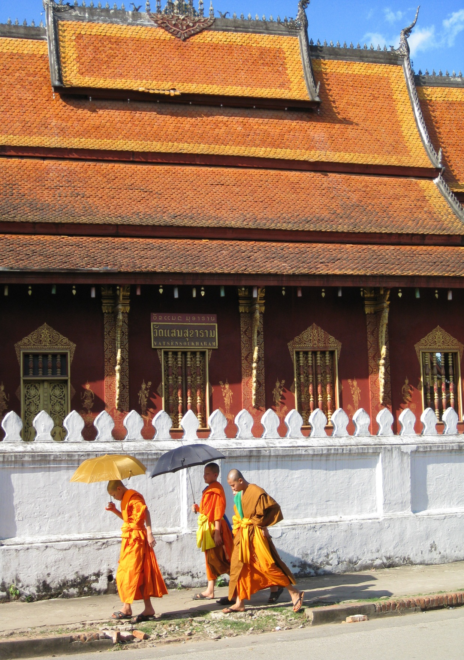

Slide 18
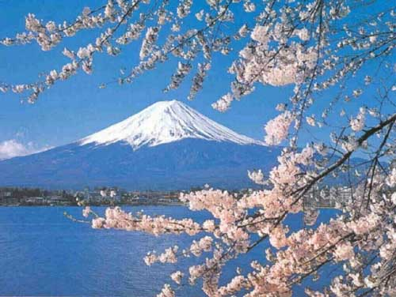
Shintoism
Shintoism was founded in Japan around 700 BCE
It is consider the first religion in Japan
It honors spirits in nature called Kami.
Kami are spirits found in all things. These are very important to Shinto followers
Followers pray at small alters in their homes or build alters in beautiful nature sites these honor the Kami
Shintoism merged with Buddhism after 700 CE and together these are the most important religions in Japan

Slide 19
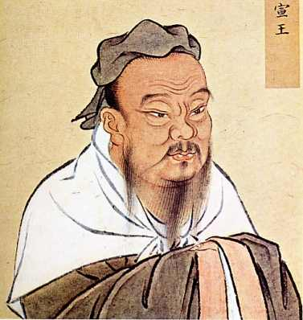
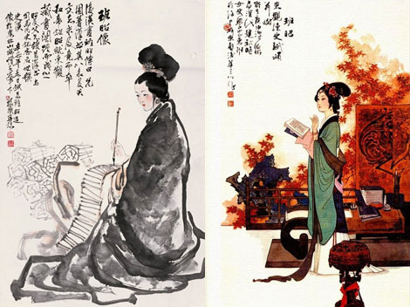
Confucianism
Confucianism is a Chinese way of life or philosophy taught by Confucian in 550 BCE
Confucianism is ethical way to live to build good character and virtue in people
Confucian’s Golden Rule was, “What you do not like when done to you, do not to others.”
Confucian thought strict ethical codes and behavior norms were key to social order and peace

Slide 20

Relationships were key to Confucianism.
The younger was supposed to give obedience to the elder and woman should give obedience to the man.
  Ruler-subject
  Father-Son
  Husband-wife
  Elder brother-younger brother
  Elder friend- younger friend
Confucianism is not a religion, but a way of life.
In 121 BC the Han Dynasty (rulers) had Confucian scholars as advisors, who help establish the Government in China
Insert Chinese garden image

Slide 21
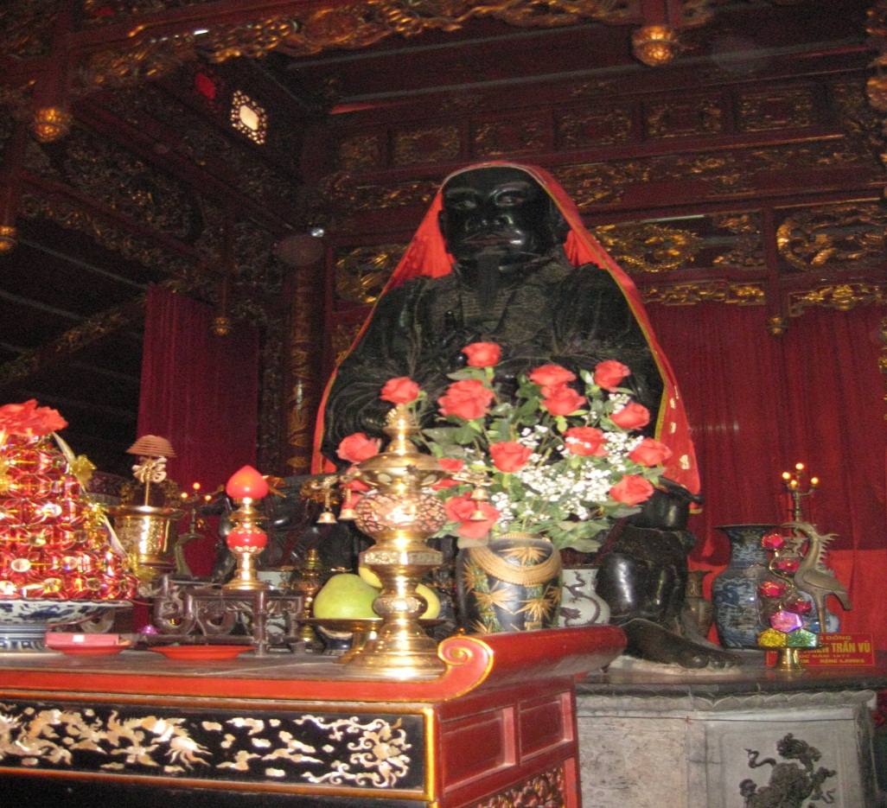
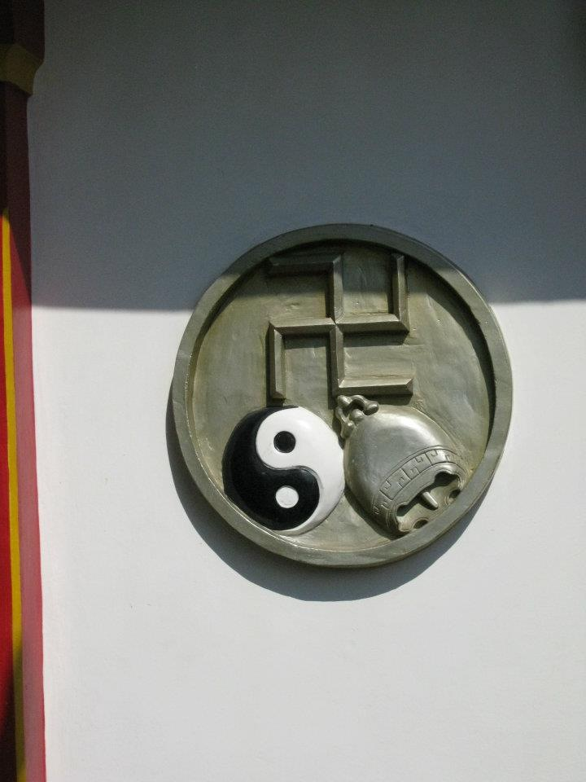
Tao or Daoism
Daoism is a complimentary religion to Confucian Philosophy that started in 600 BC China.
Dao or Tao means “The Way”
Daoism is a focus on balancing energies to attain happiness
Many people in Chinese society were Taoist and Confucian and later even Buddhist too!
Today some people still celebrate Taoism in China, Vietnam and other Southeast Asian Countries.
Insert image here

Slide 22

Islam
Islam came to East Asia mainly though trade.
Over a billion people in Asia are Muslim
Islam in these countries is slightly different than Middle Eastern Islam, but fundamentally it is the same
All Muslims follow the 5 pillars of Islam
  Declaration of Faith
  Pray 5 times a day
  Alms
  Ramadan
  Hajj
The 4 most populous Muslim countries in the world are in East Asia
  Indonesia
  Pakistan
  India
  Bangladesh
Insert image here

Slide 23
Hinduism
-3,500 years old
Vedas is holy book
Believe in reincarnation
-In India and worldwide today
India
East Asian Religions
Buddhism (2,500 years old)
-Eightfold Path and Middle Way are important way to live
In China (Tibet), Indochina-Vietnam, Laos, Cambodia, Thailand, Japan and many more
Confucianism
(2,500 years old)
Moral Code
Not a religion per se, but still highly influence relationship structure
China
Daoism (2,500 years old)
Religion that is complimentary to Confucianism
Shintoism (2,500 years old)
Traditional religion of Japan which merged with Buddhism
Still influential today
Japan

Slide 24
Predominate Asian Religions
Confucianism
Daoism
Islam
Christianity
Shintoism
Buddhism
Hinduism

