Slide 1
Historical Understanding SS7H3 The student will analyze continuity and change in Southern and Eastern Asia leading to the 21st century.
a. Describe how nationalism led to independence in India and Vietnam.
b. Describe the impact of Mohandas Gandhi’s belief in non-violent protest.
c. Explain the role of the United States in the rebuilding of Japan after WWII.
d. Describe the impact of Communism in China in terms of Mao Zedong, the Great Leap Forward, the Cultural Revolution, and Tiananmen Square.
e. Explain the reasons for foreign involvement in Korea and Vietnam in terms of containment of Communism.

Slide 2
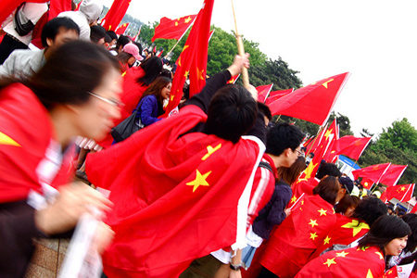

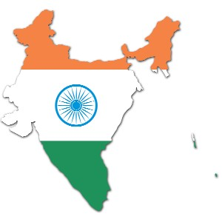
Nationalism
Nationalism becomes very important in the 1900s in Asia.
Nationalism is identification and loyalty to a group of people with a common language, history, and culture. It can also be an extreme pride in one’s nation.
Nationalism helped lead to independence in Africa and Asia from European control.

Slide 3
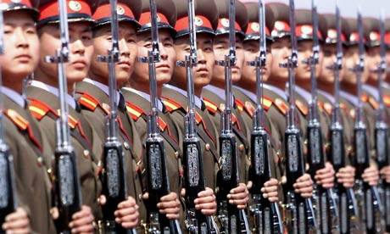
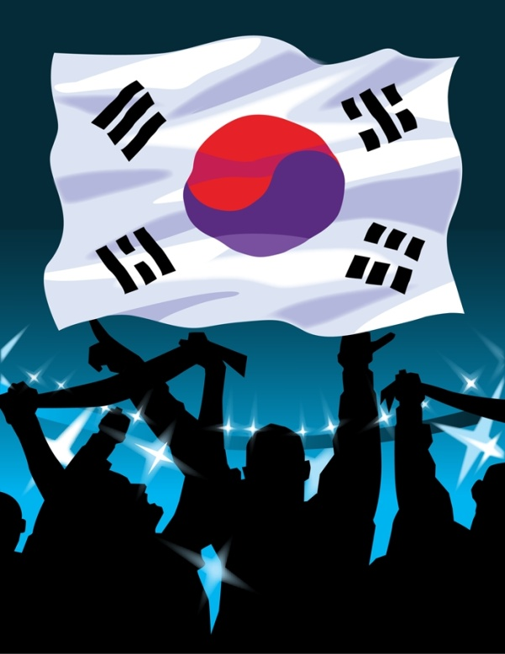
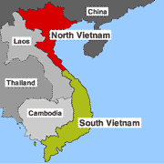
Asian Histories in PowerPoint
North Korea
India
China
South Korea
Japan
Vietnam

Slide 4
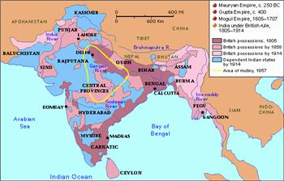
India
In the 1900s Great Britain controlled most of India.
Most Indians had little say in their government and few rights.
Starting in the 1800s Indians began to work for more independence from Britain. The Indian National Congress and the Muslim League were two important groups which wanted democracy in India.
Britain did not want to give up control of India.
In World War One (WWI) 1914-1919 India fought with Britain hoping for independence after the war was over.
In World War Two (WWII) 1939-1945 India decided not to choose sides and shortly after the war was given Independence.

Slide 5
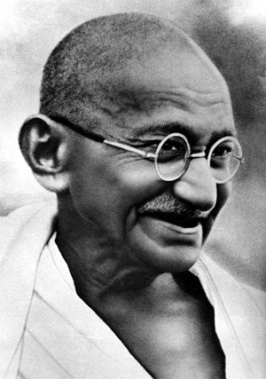
Independence movement
After WWI British control tightened in India and Indians did not get the freedom they hoped for
Britain created the Rowlatt Act which allowed Indians to be held in jail with no trial
In a protest to the Rowlatt Act called Amritsar 400 Indians were killed and 1200 were arrested.
Mohandas Gandhi began to led Non-violent Protests called Civil Disobedience.
The goal of Civil Disobedience and Non-Violent Protest is to peacefully remove British control in India by refusing to obey unfair laws.
Gandhi
1869-1948

Slide 6
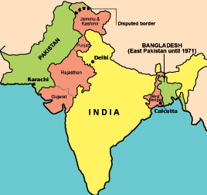
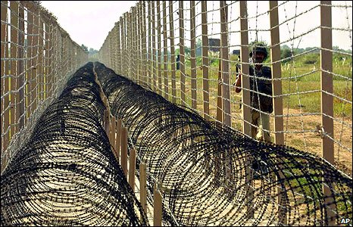
After WWII Indian did receive Independence, but due to conflict between the Muslims and Hindus in the country Britain decided to divide India between Muslim Northwest (Pakistan) and Hindu South (India)
As many 10 million people were forced to move and 1 million people died trying to move
Gandhi was very disappointed with the religious division of India and was assassinated by Hindu extremist in 1948
Today India is the world’s largest democracy and is still divided into two countries-Pakistan and India.

Slide 7
India is still a poor country, with 50% of it’s population being small scale farmers.
The Green Revolution in the 1960s helped increase food production, by using fertilizers, pesticides, and better seeds, however the Green Revolution has led to water pollution.
Today India has successful technology and service industries and is working to create more jobs.
Over population and growing pollution is one of the most pressing issues for the future of India because the government has put little regulations on factories and pollution is a problem.

Slide 8
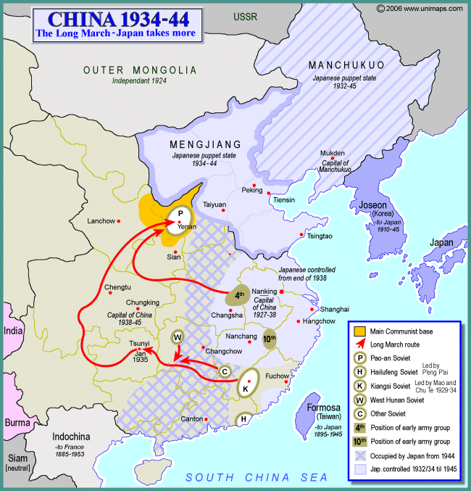
China
In the 1800s and 1900s China began to have a series of Civil Wars or war inside one country by opposing groups.
The Qing Dynasty had ruled China since the 1600s, but other groups began to want power, both European Nations and inside groups.
The Opium Wars, Taiping Rebellion, and Boxer Rebellion all put huge strain on the Chinese Empire and resulted in the lost of millions of lives.
The Nationalist Party led by Sun Yixian and the Communist Party led by Mao Zedong struggled for control in China.
In 1929 the Chinese Communist Party was attacked and force to go on the Long March, or 6,000 mile journey led by Mao Zedong.

Slide 9
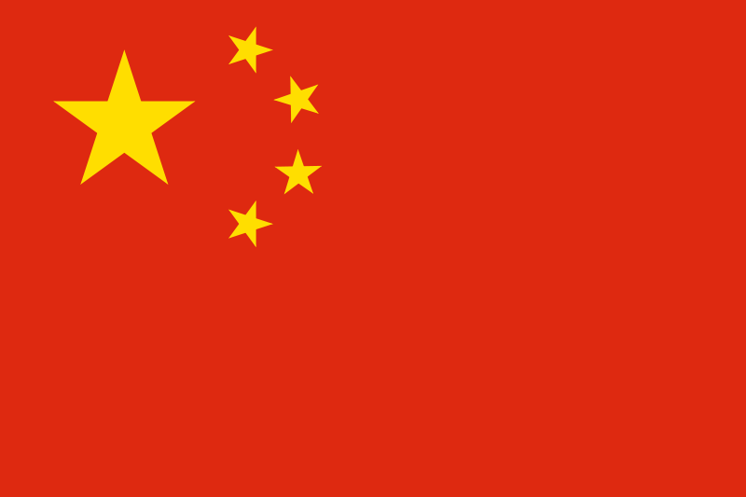
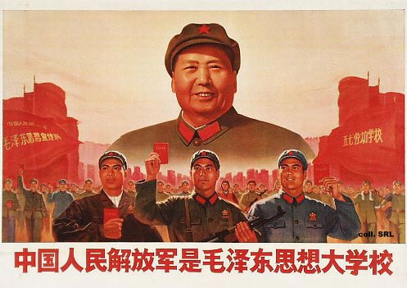
After WWII Mao Zedong and the Communist Party eventually began to rule China. The Communist wanted a country of farmers and workers.
Major Events
  Formation of the People’s Republic of China which is still the government of China
  Great Leap Forward
    Collective farming: Government owned farms from 1958-1963
    May have caused more than 20 million deaths
    Government regulated all farming and decided who lived where and what to grow
  Cultural Revolution
    Starting in 1966 Mao Zedong used the Red Guard or a student army to identify and remove anyone who disagreed with the government
    Religious identification was also strongly discouraged
  Tiananmen Square
    In 1989 the Soviet Union and China’s greatest ally collapsed. Students protested in Tiananmen Square to change the government. Soldier's fired on the crowd and thousands were arrested.

Slide 10
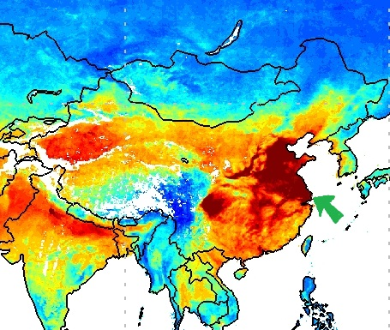
China Today
Mao Zedong died in 1976 and things in China began to change afterwards.
Today China has less Government control and is considered a Mixed Economy, even though it is much closer to being a command economy than Market.
In the 1980s the government began to allow production of consumer goods
The Four Modernizations decrease government control and invested in more modern technology
Special Economic Zones on the Eastern Coast have created Global Cities for international trade
Farmers now have more choice on what to produce and people can own small amounts of land.

Slide 11
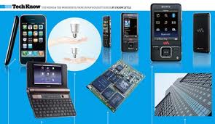
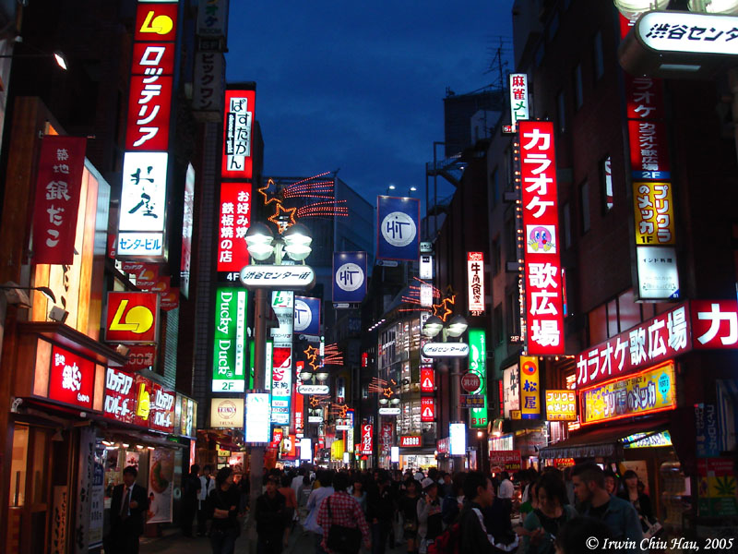
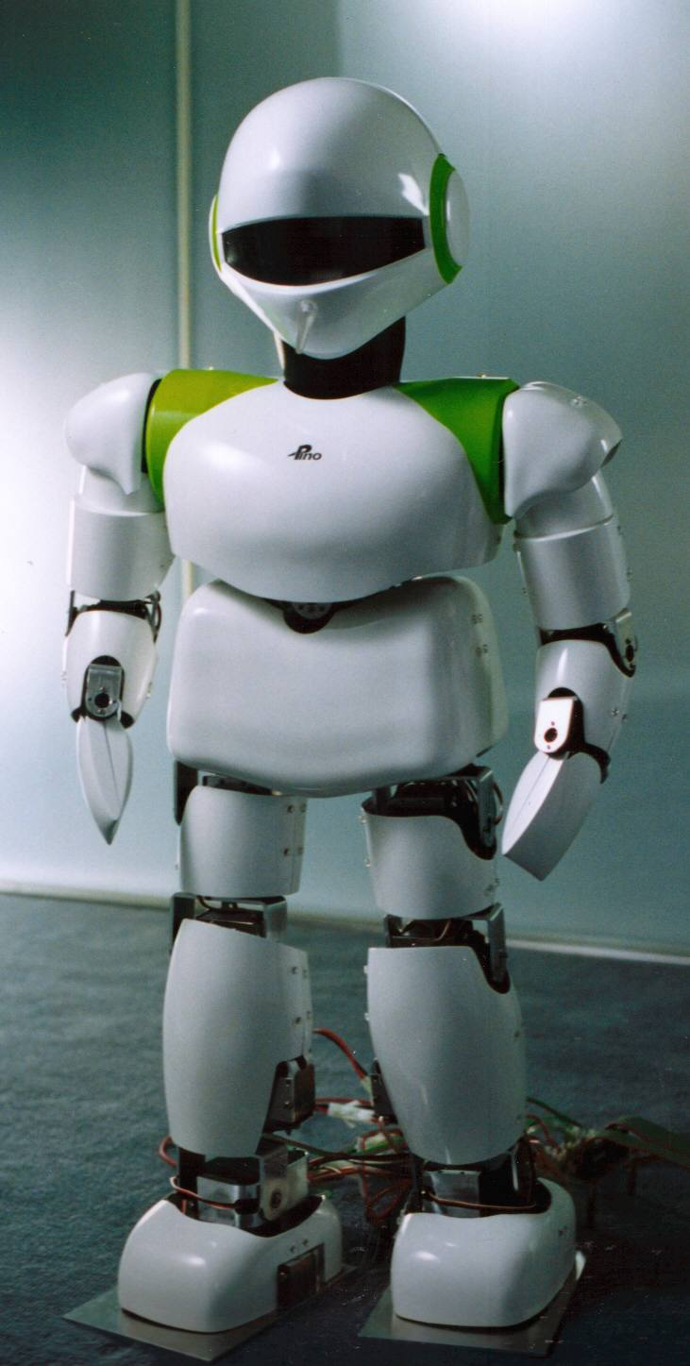
Japan
Japan fought the USA, China, and Russia in WWII and lost
After the War American General MacArthur was in charge of helping Japan set up a Constitutional Monarchy and Parliamentary Government
Japan’s Emperor was symbolically significant, but real power was given to the Diet or legislative body that was elected
Japan has invested heavily in technology after the war and considered one of the most technology advanced countries in the world with an extremely literate population
Japan has little fertile land, but terraces increase arable land and highly advance technology allows Japan to trade services and technology to buy food for its growing population

Slide 12
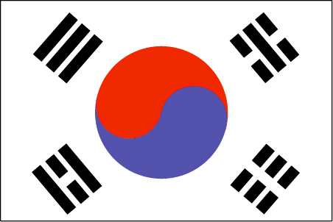
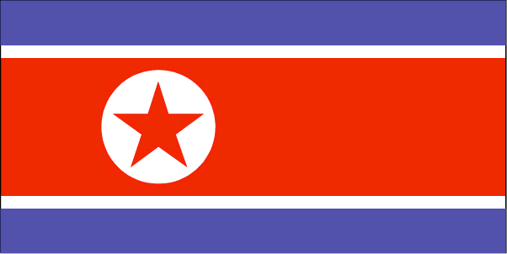
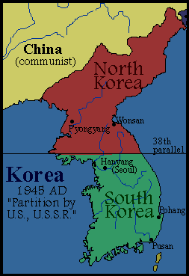
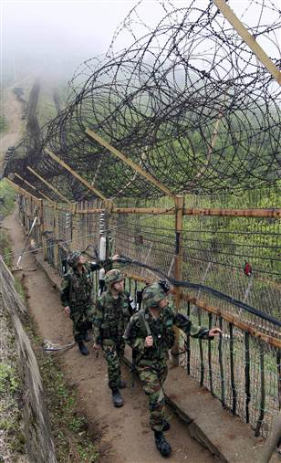
Korean Split
South Korea is a democratic Country.
Seoul, the capital has 25% of the population and attracts people with more job opportunities.
South Korea also has better farming and is less mountainous
North Korea and South Korea divided in the 1950s between Communist North Korea and Democratic South Korea
The People’s Republic of North Korea is an Autocratic Government and Premier Kim Jong-il ruled the country with Military control
North Korea is still a command economy with a Communist Government

Slide 13
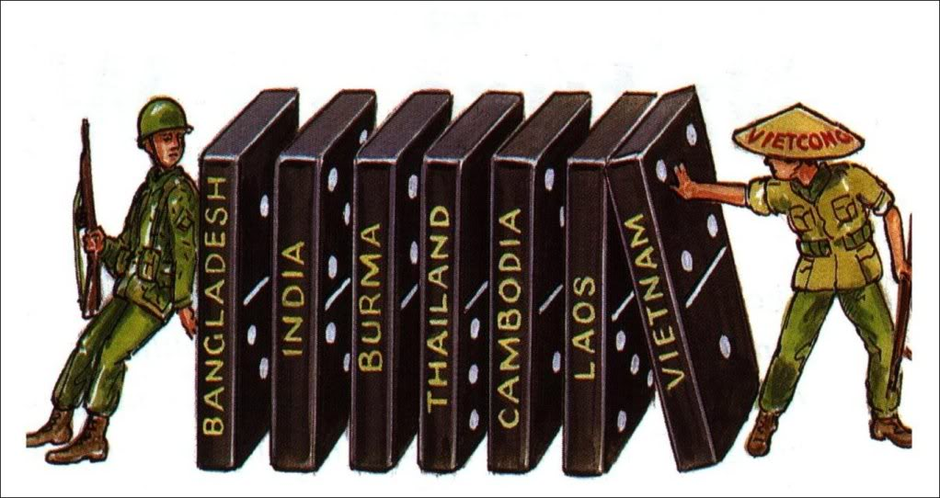
Domino Theory
Domino Theory was an Idea that if more Asian countries became Communists others would follow
Vietnam had tried to gain it’s independence from France since the early 1900s.
Ho Chi Ming began to led a communist rebellion after unsuccessful attempts for independence after WWI
In 1954 France withdrew from Vietnam and Vietnam was temporarily divided between Communist North and Democratic South
In 1964 the USA began to fight Ho Chi Ming and the Communists
In 1975 the USA left Vietnam because it became clear Ho Chi Ming and the communist party would not give up control of their country and wanted to rule without foreign influence.

