Slide 1
Bill of Rights
Amendments I-X

Slide 2

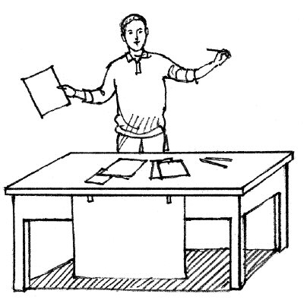
Amendment I
No more war!

Slide 3

Amendment II

Slide 4
Amendment III

Slide 5
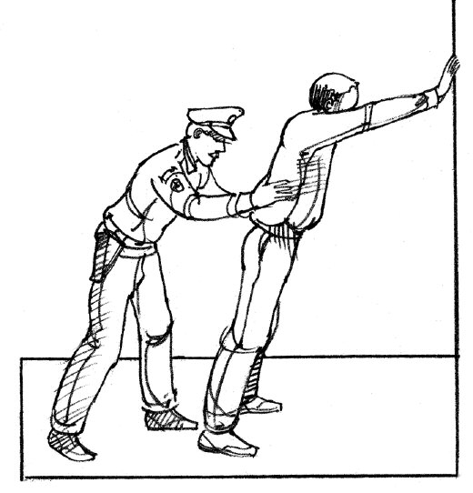
Amendment IV

Slide 6
Amendment V
Bring to trial.
Guilty we have no doubt.
Sorry. We need that land.

Slide 7
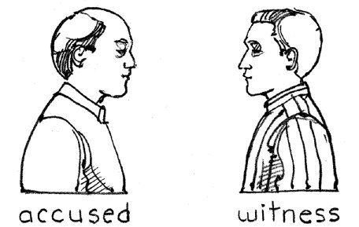
Amendment VI
You are accused of robbery.

Slide 8
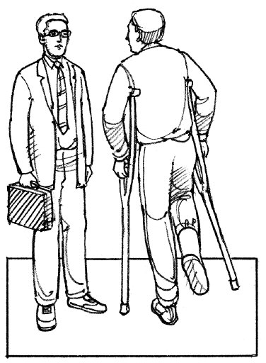
Amendment VII
Let the jury decide.
The jury made a mistake.
I am suing for damages.

Slide 9
Amendment VIII

Slide 10
Amendment IX

Slide 11

Amendment X
States’ Rights

Slide 12
