Slide 1
SS7G8 The student will describe the diverse cultures of the people who live in Southwest Asia (Middle East).
c. Compare and contrast the prominent religions in Southwest Asia (Middle East): Judaism, Islam, and Christianity.

Slide 2
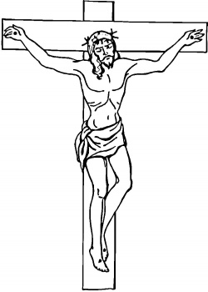
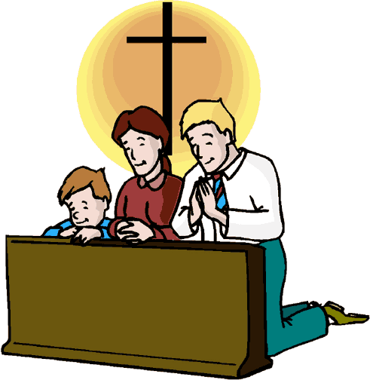
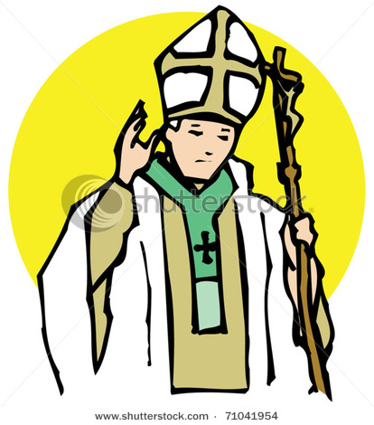
Christianity
People who believe Jesus (Christ) of Nazareth is the Son of God are called Christians.

Slide 3
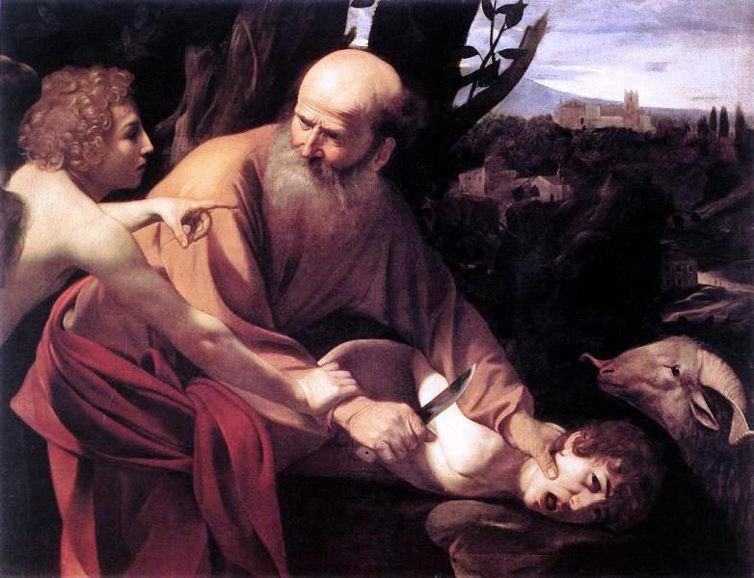
Like Jews, Christian believe that Abraham is the Founder of Judaism, however, Christianity also believes that around 32 BC a man, Jesus of Nazareth, was born to a woman from Nazareth, named Mary, and that he is the Son of God or Christ. This is the start of Christianity.

Slide 4
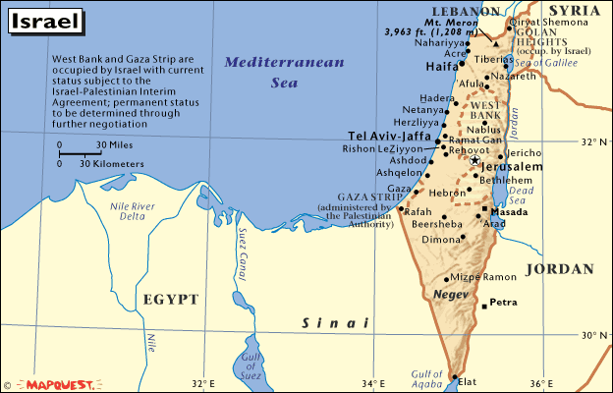
Abraham is considered the Patriarch of Judaism, Christianity, and Islam. And sometimes Judaism, Christianity and Islam are called the Abrahamic Religions.
Christianity developed in the Middle East around 32 BCE. This means Christianity is about 2,000 years old.

Slide 5


Abraham
Isaac
Jews
Jesus Christ
Ishmael
Muhammad
Muslims
Christians

Slide 6
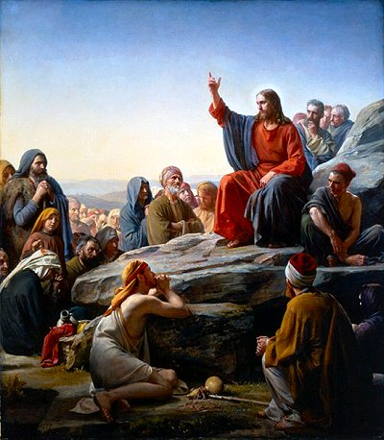
Christians believe that Jesus came to earth to forgive them their sins.
The teachings of Jesus became popular in Judea, a Roman Province, in what is now Israel.
Crowds of people followed Jesus wherever he went to hear his message. The Jews and Romans, however, did not like what Jesus was doing, because they did not understand his message. Jesus was killed on the Crucifix in 6AD by Pontius Pilot who was the Roman governor.

Slide 7
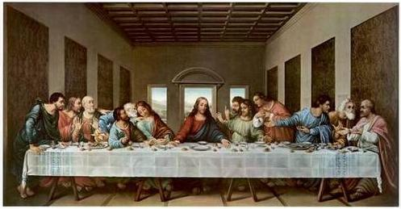
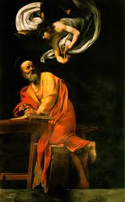
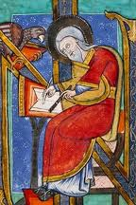
Jesus had 12 followers, called disciples, they helped spread the message of Jesus, even after he died.
Christians follow the Bible, which is made up of the Jewish Torah (the Old Testament) and the New Testament, which Christians believe was written by the Disciples Mark, Matthew, Luke and John.

Slide 8
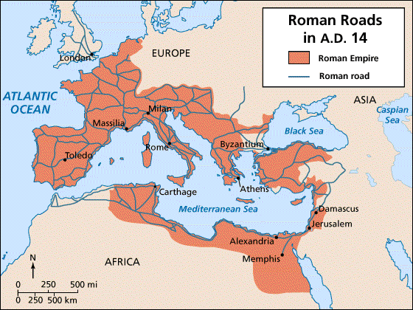
.
Roman Roads help spread Christianity. Now only a small part of the Middle East is Christian, but most of Europe became Christian by 900AD

Slide 9
What does it mean to be Christian?
Christians pray on Sunday
Christians pray in a Church
Although there are some guidelines, Christianity can be very different around the world.
Christianity is the most common religion by population of anywhere in the world.
The Roman Empire converted to Christianity in 333BC and helped spread Christianity.

Slide 10
Holidays | Meanings
Sunday | Sunday prayer and worship. Part of 10 commandments.
***Christmas | December 25th (most). Marks birth of Jesus, son of God.
Epiphany | January 6th. Marks day Wise men/kings found Jesus using star as guide.
Ash Wednesday | Uses Lunar calendar. Marks Christian season of Lent or 40 days of fasting and reflection.
Good Friday and Easter | Marks the end of Lent season. Christians Believe Jesus was kill on Good Friday and ascended into heaven on Easter Sunday.
Ascension of the Virgin | August 15th . Day mother of Jesus died and was taken to heaven.
Saints Day | Catholic Holiday. November 1st. Marks a day to honor holy people or saints in Catholic Church.

Slide 11
Types or Sects of Christianity
Protestant: Split from Catholic Church in 1517. Has many differences, both branches and practices. Methodist, Baptist, Episcopalian, Jehovah Witness, etc.
Orthodox: Split from Catholic Church in 1054. Most common in Eastern Countries-Greece, Russia, Ukraine. Uses different calendar than other Churches.
Catholic: Considered original Church. Common in Italy, Spain, Portugal, France, South America, North America, and parts of Africa.

Slide 12
There are about 2 billion Christians worldwide
There are 3 main sects or types of Christianity
Christianity Today
Christians live in most countries around the World
Many practice vary from group to group.

