Slide 1
Distribution:
SS7G6 The student will discuss environmental issues across Southwest Asia (Middle East).
a. Explain how water pollution and the unequal distribution of water impacts irrigation and drinking water.
SS7G7 The student will explain the impact of location, climate, physical characteristics, Distribution of natural resources and population distribution on Southwest Asia (Middle East).
a. Explain how the distribution of oil has affected the development of Southwest Asia (Middle East).
b. Describe how the deserts and rivers of Southwest Asia (Middle East) have affected the population in terms of where people live, the type of work they do, and how they travel.

Slide 2





Natural Resources: things, like trees, water, land, oil, or other good things that a place has naturally
Notes:
Begin Day 3

Slide 3


Fresh water: A liquid that humans need to survive. Fresh water is used to drink, feed crops, cook with, and other basic needs.
Natural Resources
Arable land: Land that can be used for farming.

Slide 4
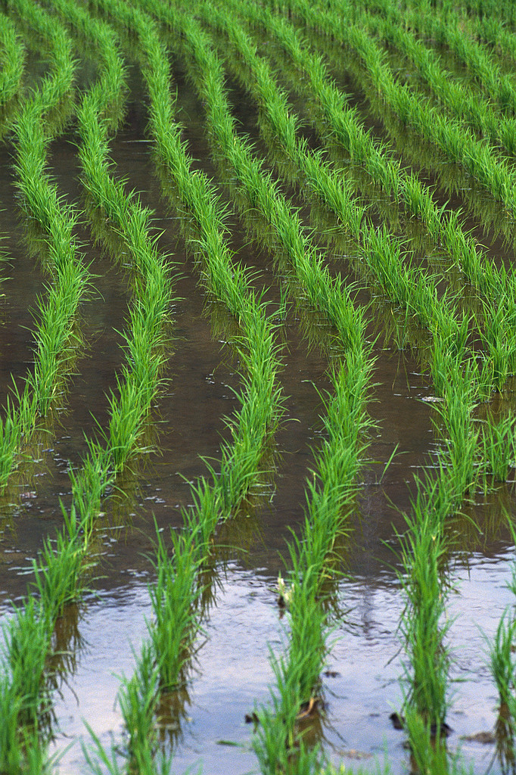
Irrigation: Irrigation is using canals or other methods to store and move water to grow crops. This is extremely important in founding early society and is still very important in dry regions of the world, like the Middle East.
Agriculture: The process of growing crops in one place, a farm.

Slide 5
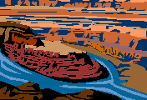


Distribution: How things are divided. Unequal distribution means some people have more than others.
The Middle East has unequal distribution of natural resources. The Middle East has roughly 60% of the world’s oil, but only about 4% of the world’s fresh water supply. Also only 25%, about ¼, of this area is Arable Land.

Slide 6
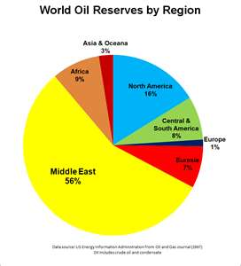
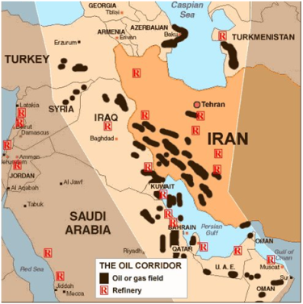
In the Middle East most important natural resource for the economy is oil. The Middle East is a very oil rich region of the world. Oil: A liquid that is used to fuel modern society by running things like cars and electricity

Slide 7
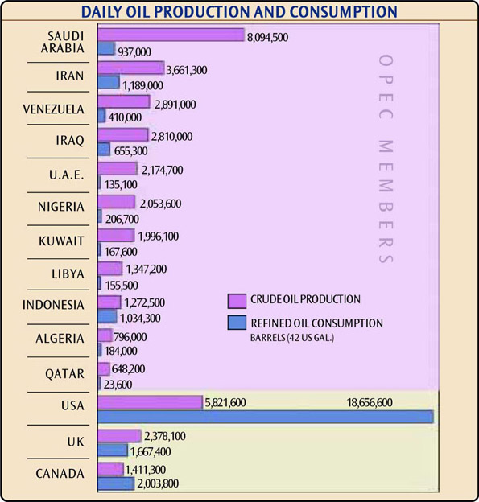
Organization of Oil Exporting Countries or OPEC is important in the Middle East, because so many countries produce oil. OPEC helps regulate the international price of oil.

Slide 8
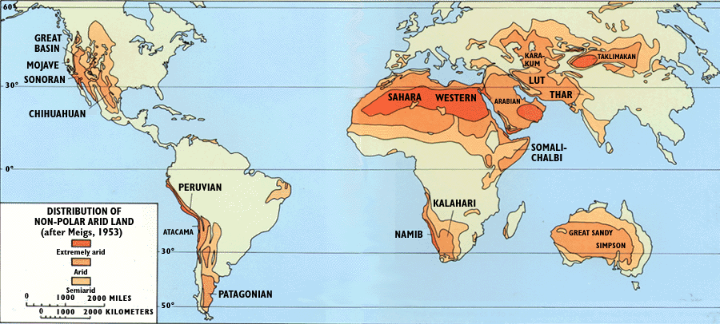
However, even though the Middle East has about 2/3rds the worlds supply of oil it does not has very much of two other important natural resources fresh water and arable land. The Middle East is a very arid region of the world and most of the Middle East is Arid (less than 10 inches of rain a year) or Semi-Arid (less than 20 inches of rain a year).
Notes:
Desert Map

Slide 9
How do people live in the Middle East with so little water?
Irrigation:
Most farmers must use irrigation to water crops
Irrigation is expensive, so people must work together
Drip Irrigation
Is much more effective in dry areas because the dry air does not cause as much water to evaporate. Unfortunately it is too expensive for most to use in the Middle East.
Desalinization
Some countries like Israel and Qatar use desalinization.
This process removes salt from the water and makes it drinkable
It is very expensive and a large cooperation or government must sponsor the project
Few countries in the Middle East can afford Desalinization

Slide 10
Water Issues
Not only does the Middle East have limited water, but often poor people and people in rural areas must carry their water.
Even when water is available it is not always clean.
http://www.youtube.com/watch?v=HW5eBfZhE4M
http://www.youtube.com/watch?v=_R_vpNQ0fJc

