Slide 1
Middle East Geography
Standard SS7G7
SS7G6 The student will discuss environmental issues across Southwest Asia (Middle East).
a. Explain how water pollution and the unequal distribution of water impacts irrigation and drinking water.
SS7G7 The student will explain the impact of location, climate, physical characteristics, Distribution of natural resources and population distribution on Southwest Asia (Middle East).
b. Describe how the deserts and rivers of Southwest Asia (Middle East) have affected the population in terms of where people live, the type of work they do, and how they travel.

Slide 2
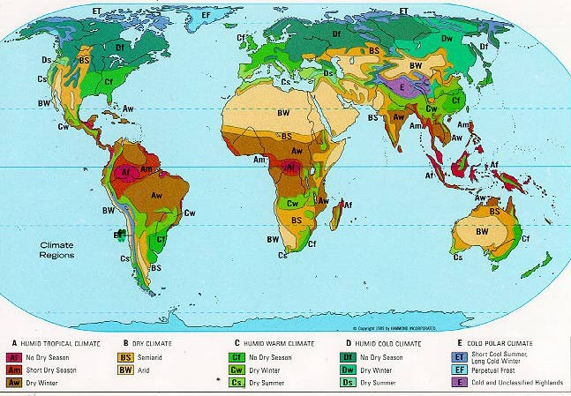

Slide 3
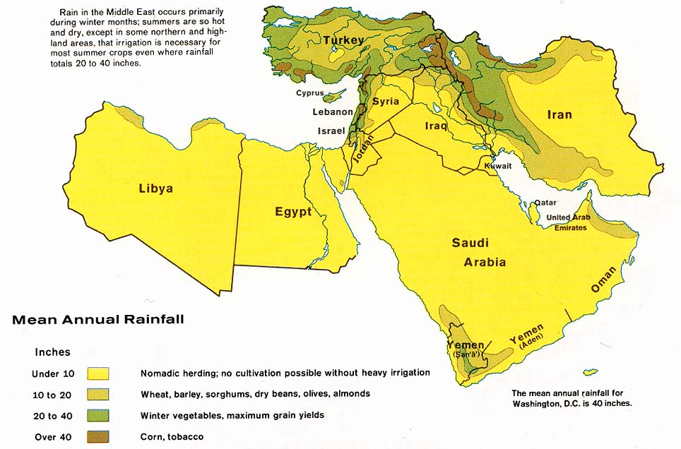

Slide 4
Mediterranean
Some places in the Middle East have what is called Mediterranean climate
Mediterranean Climate has between 20-40 inches of rain a year
Summer are hot and dry
Winter are cool or mild and wet
Notes:
Turkey. Mediterranean Climate.

Slide 5
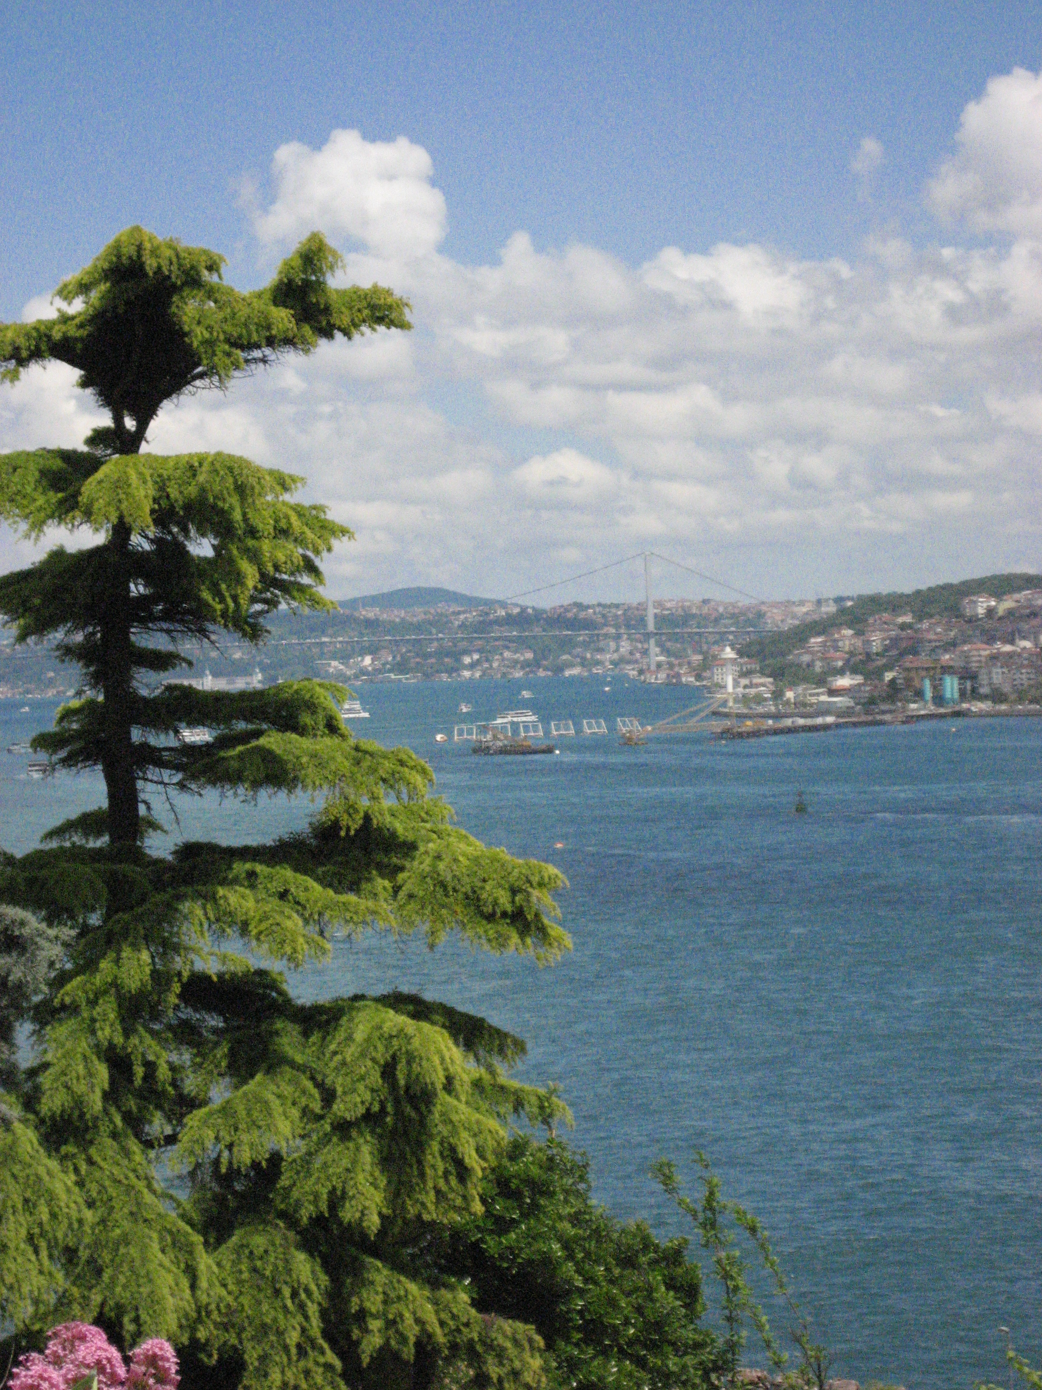
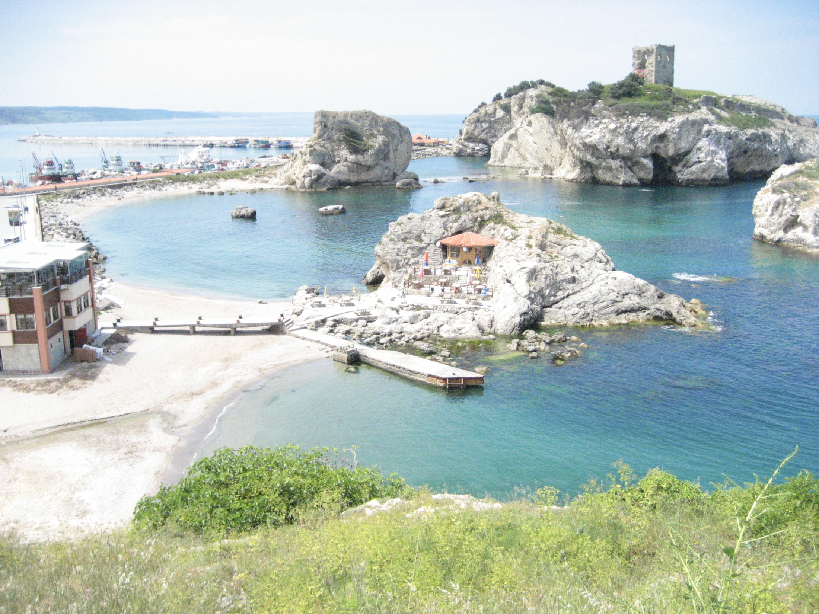
Notes:
Turkey on Black Sea. Mediterranean Climate.

Slide 6
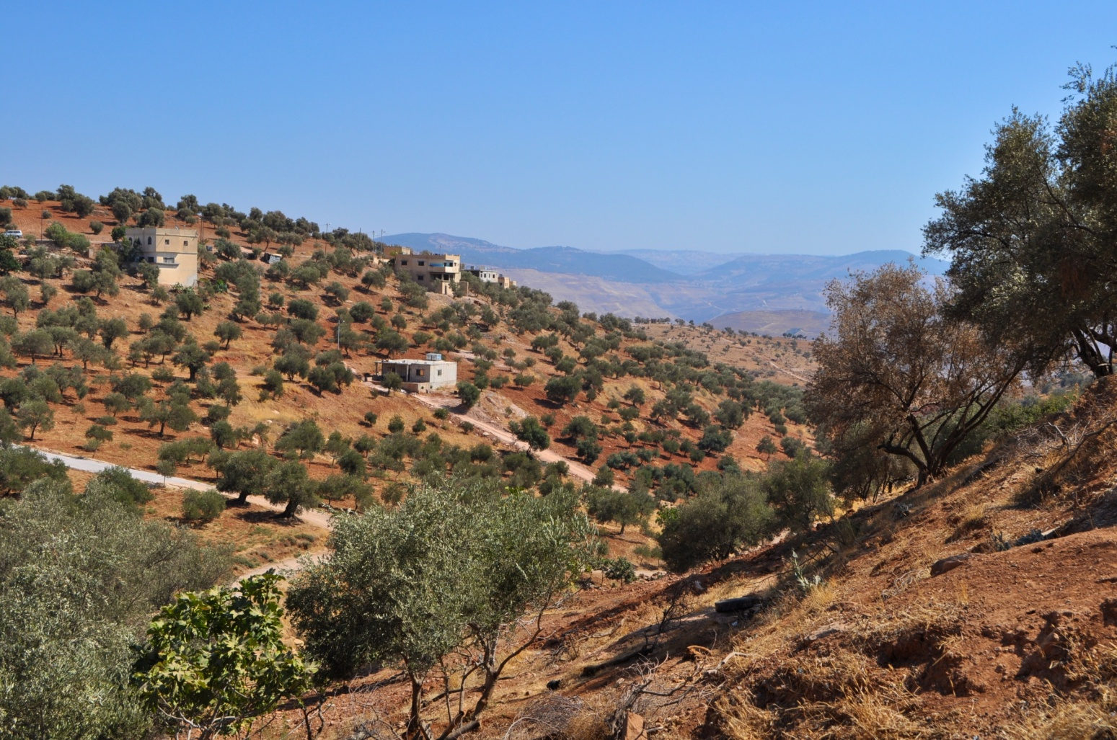
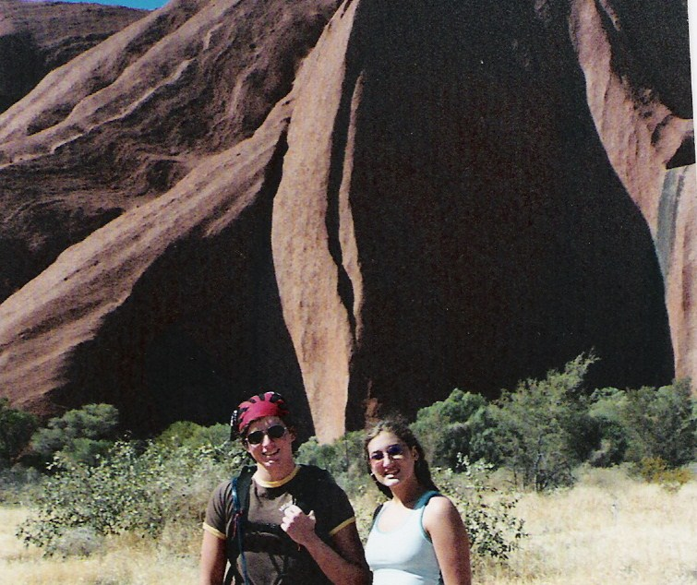
Semi Arid
Semi Arid means 10-20 inches of rain a year
Irrigation is normally needed to grow plants
Notes:
Ayers Rock (Australia) -Semi Arid.

Slide 7
Arid
Most of the Middle East is Arid
Arid is less than 10 inches of rain a year
Some of the Middle East is extremely Arid which is less than 5 inches of rain a year
Another name for Arid is dry or desert
Arid regions can be hot or cold, but most in the Middle East are hot
Temperatures change drastically in arid regions between day and night
Notes:
Egypt Arid and without irrigation.

Slide 8
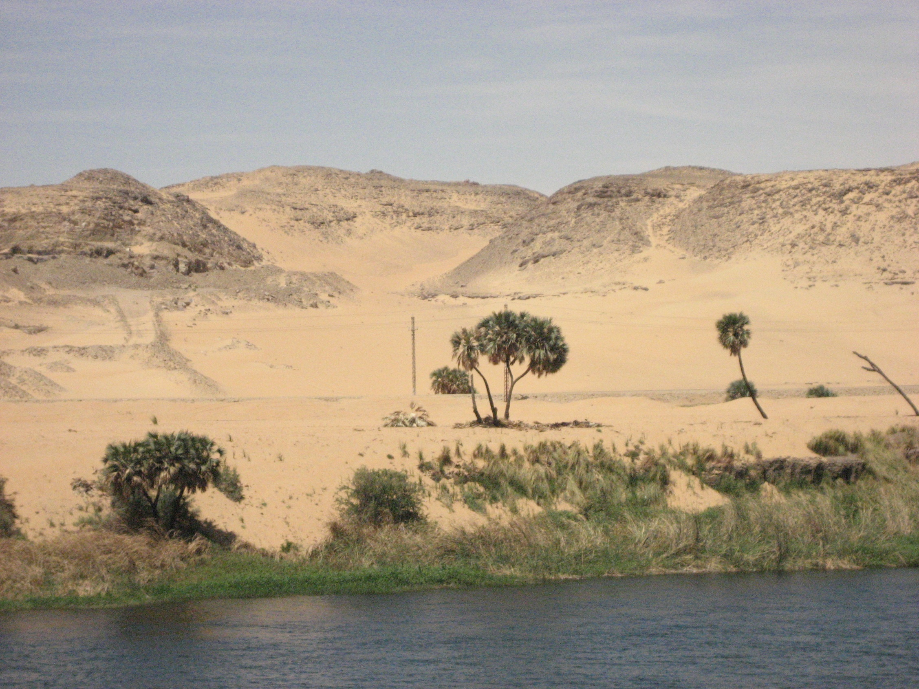
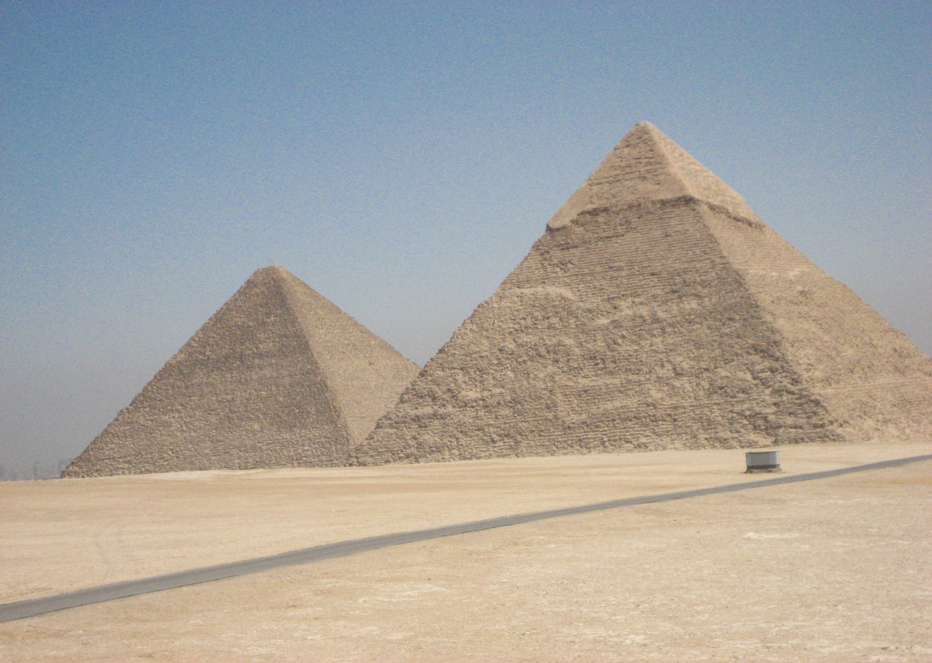
Notes:
Egypt Arid

Slide 9
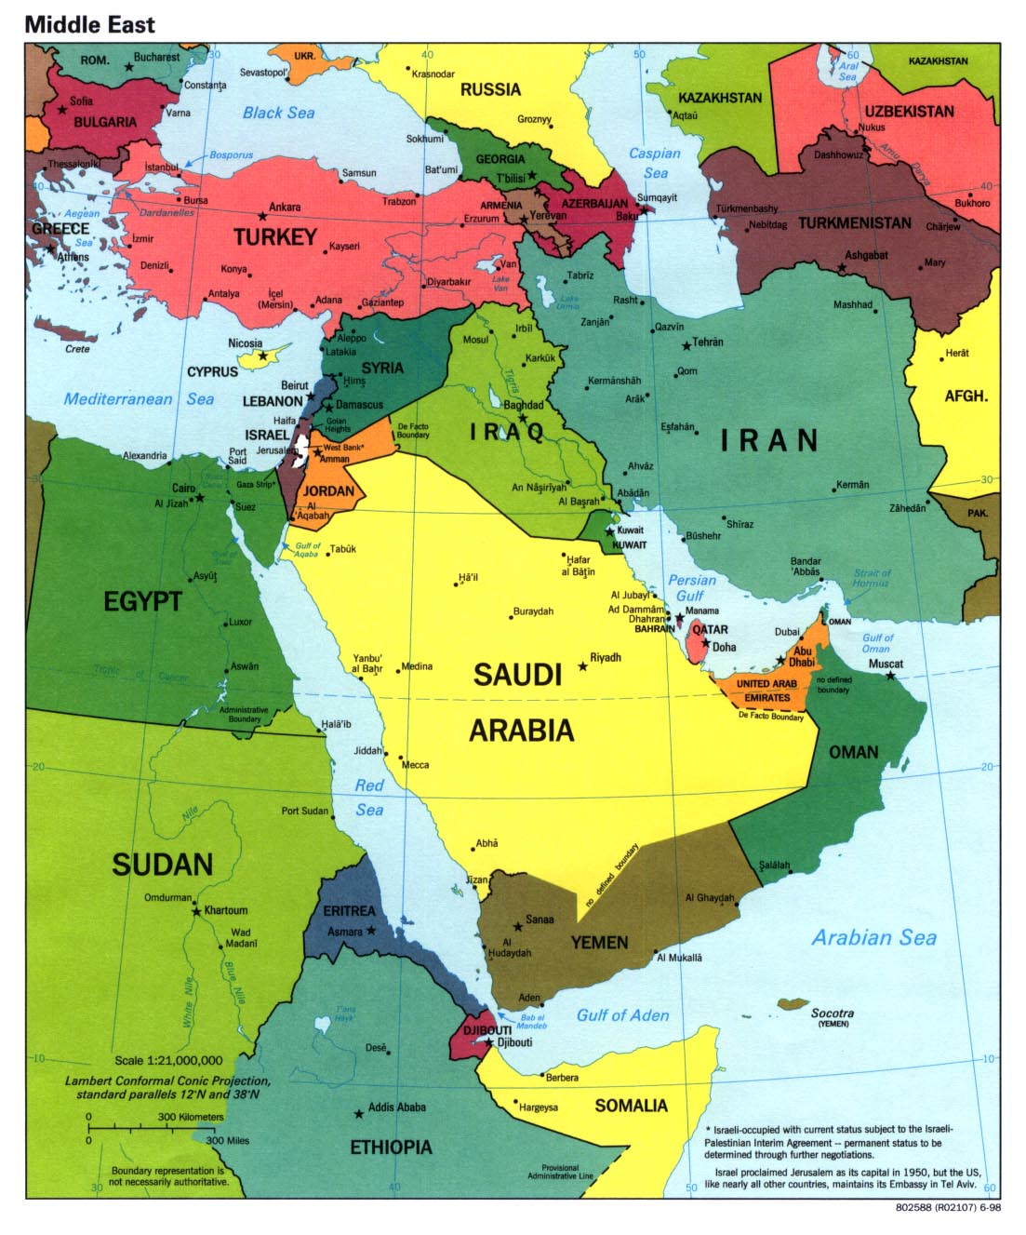
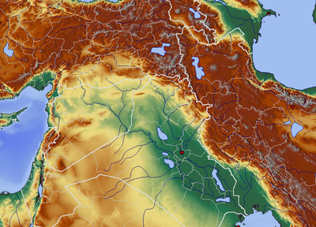
Rivers
The Tigris, Euphrates and Jordan River are essential for life in the Middle East.

Slide 10
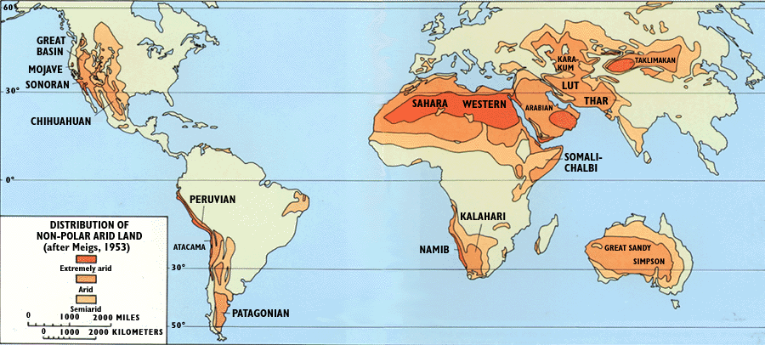
Notes:
Desert Map

