Slide 1
Historical Understandings →SS7H2
Explain how European partitioning in the Middle East after the breakup of the Ottoman Empire led to regional conflict.
b. Explain the historical reasons for the establishment of the modern State of Israel in 1948; include the Jewish religious connection to the land, the Holocaust, anti-Semitism, and Zionism in Europe.
c. Describe how land and religion are reasons for continuing conflicts in the Middle East.

Slide 2
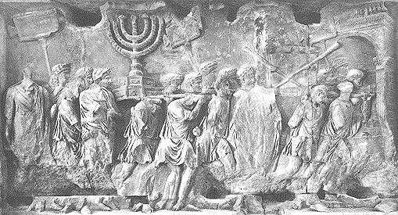
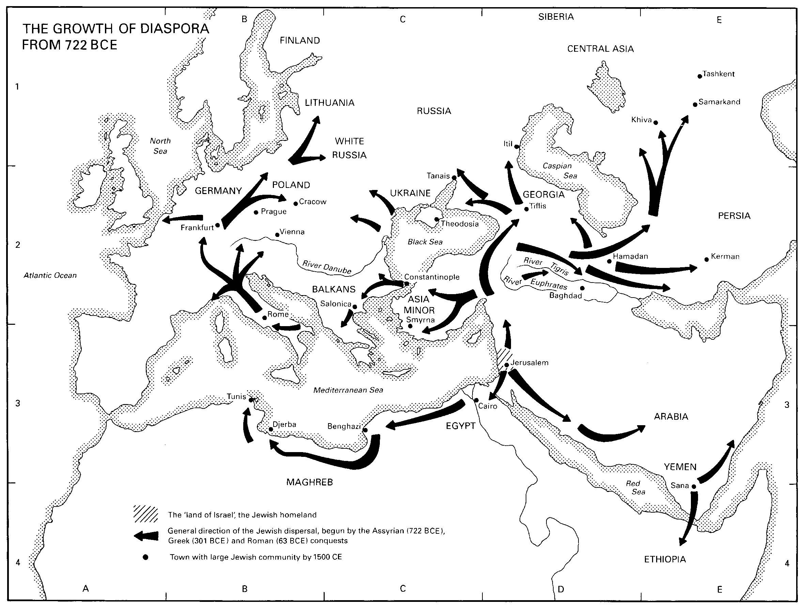
The Diaspora is when Jews were kicked out of Israel by the Romans and forced to live elsewhere. The Roman Arch of Titus shows historian when this happened.
Many Jews moved to live in Northern Africa, other parts of the Middle East, and Europe.

Slide 3
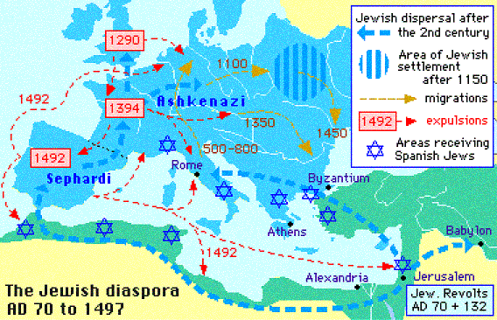


Slide 4
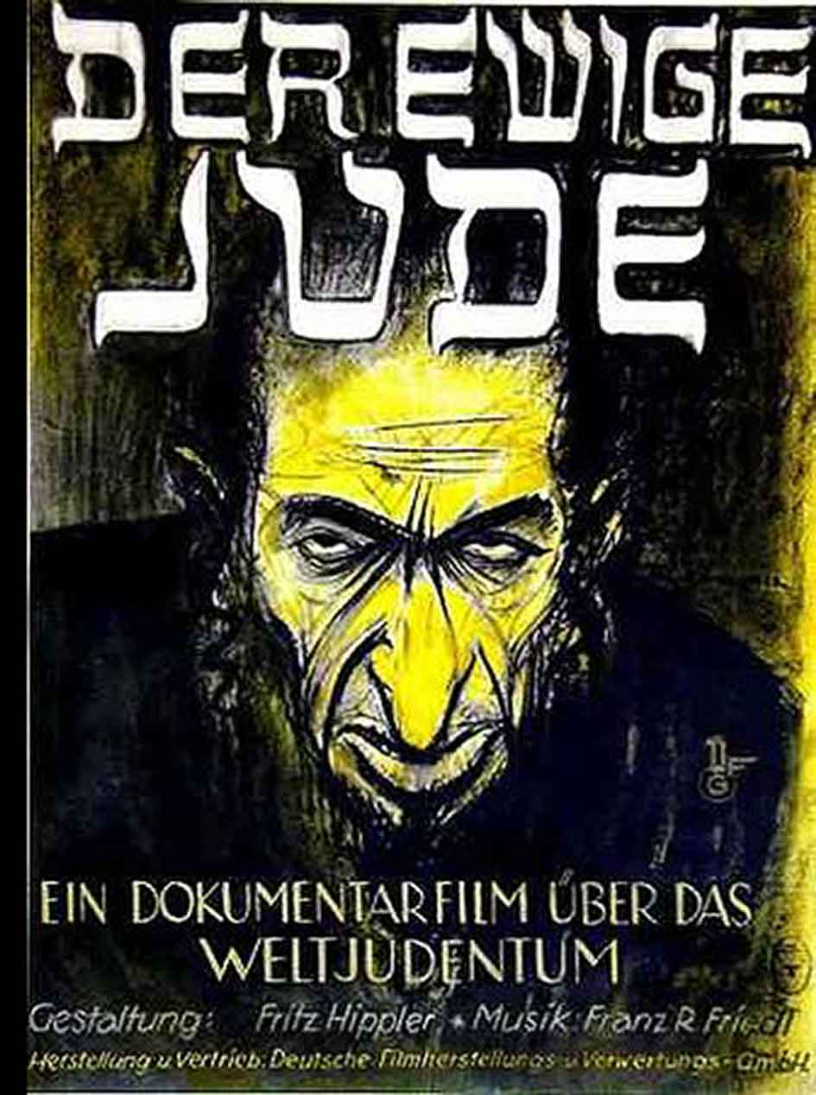
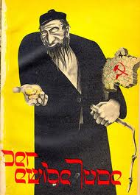
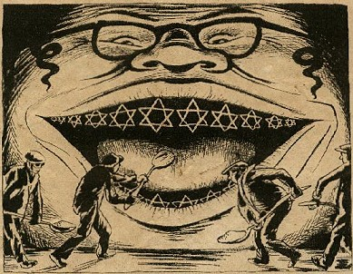
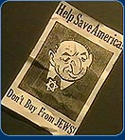
For centuries Jews faced Prosecution and discrimination in Europe called Anti-Semitism.
Anti-Semitism is the hatred of Jews simply because they practice Judaism.
These are actual images from Europe and America showing Anti-Semitism

Slide 5

Discrimination
There have been several times when Jews faced discrimination. One example is in 1492 when the Spanish kicked the Jews out of Spain.
Things began to get worse when Nationalism, or unifying a region based on language and other factors, became influential in Europe during the late 1800s.
One type of discrimination Jews faced was called Pogroms which were anti-Jewish mob attacks starting in 1881 in Russia, which spread throughout Europe.

Slide 6
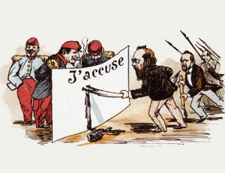
Another example of this discrimination was the Dreyfus Affair in France in the 1890s. The Dreyfus Affair was where a Jewish man, Alfred Dreyfus was arrested as a German Spy, because he was Jewish.
Riots chanting, “Death to the Jews” broke out Paris, France and reflected European Anti-Jewish feelings.

Slide 7

Zionism
Starting in the 1800s many Jews began to demand a “return to the Promised Land” or Israel.
People no longer felt safe in their homes and wanted their own land to practice Judaism.
The movement is called Zionism when Jews desire to return to Israel.
Jews believe God promised them Israel during the Exodus story.
After the Holocaust more Jews and non Jews start to believed in Zionism, or a creation of a Jewish Nation.

Slide 8

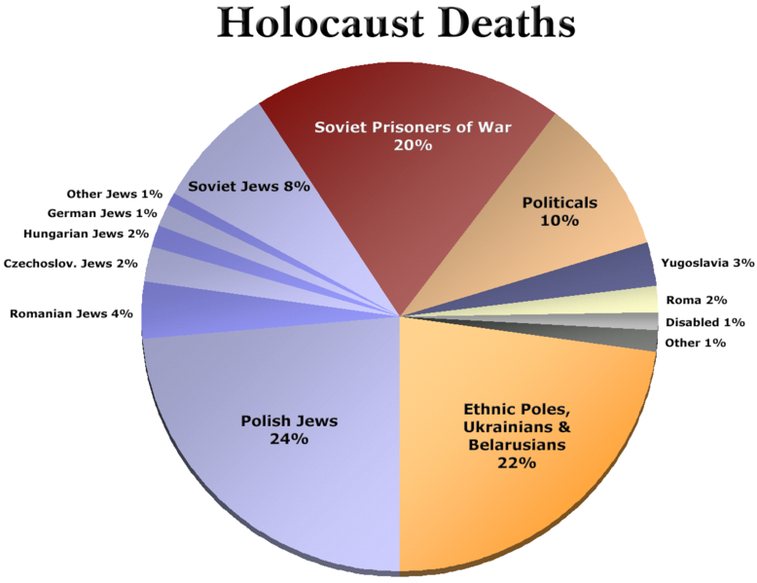
Holocaust
1939-1944
Mass killing of people in Europe by the Nazis
11 million people killed, 6 million of which were Jewish

Slide 9
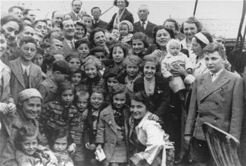
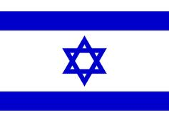
Zionism
After the Holocaust the even more Jews supported Zionism.
Europeans and Americans also felt like Jews deserved a homeland.
In 1948 the United Nations, the UN, gave Jews land to create the Modern Day State of Israel in Palestine.

Slide 10

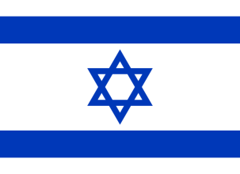



Palestine or Israel?
There were already people, called Palestinians, living in Israel.
Most Palestinians were Arabs and Sunni Muslims, but some were Jews and Christians.
Most Palestinians did not want to give up their homes and most Arab countries supported the Palestinians.
Israel was established, but many wars between Arabs and the Israel still exist, including acts of terrorism.
Deaths have occurred on both sides and both sides feel that they deserve to have the land.

Slide 11
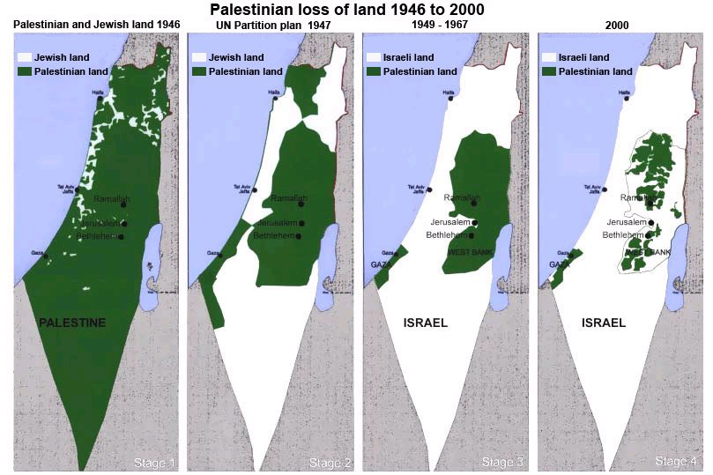
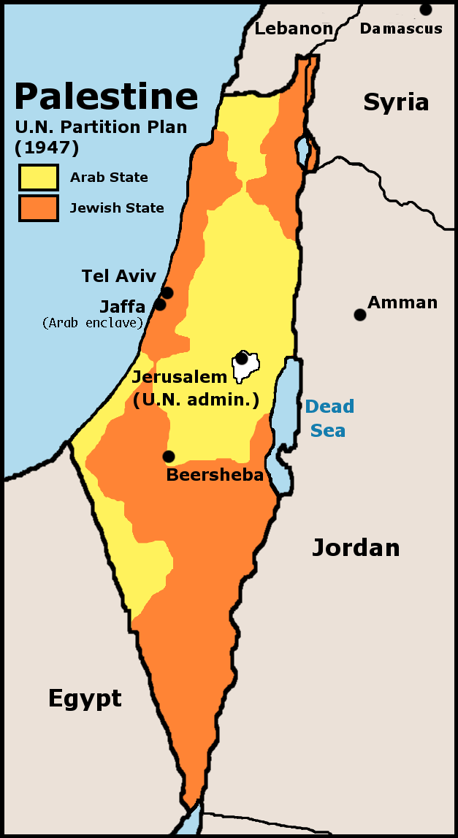
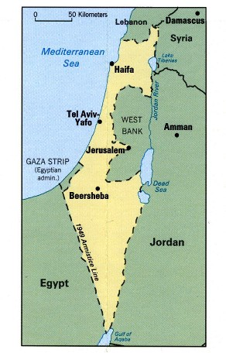
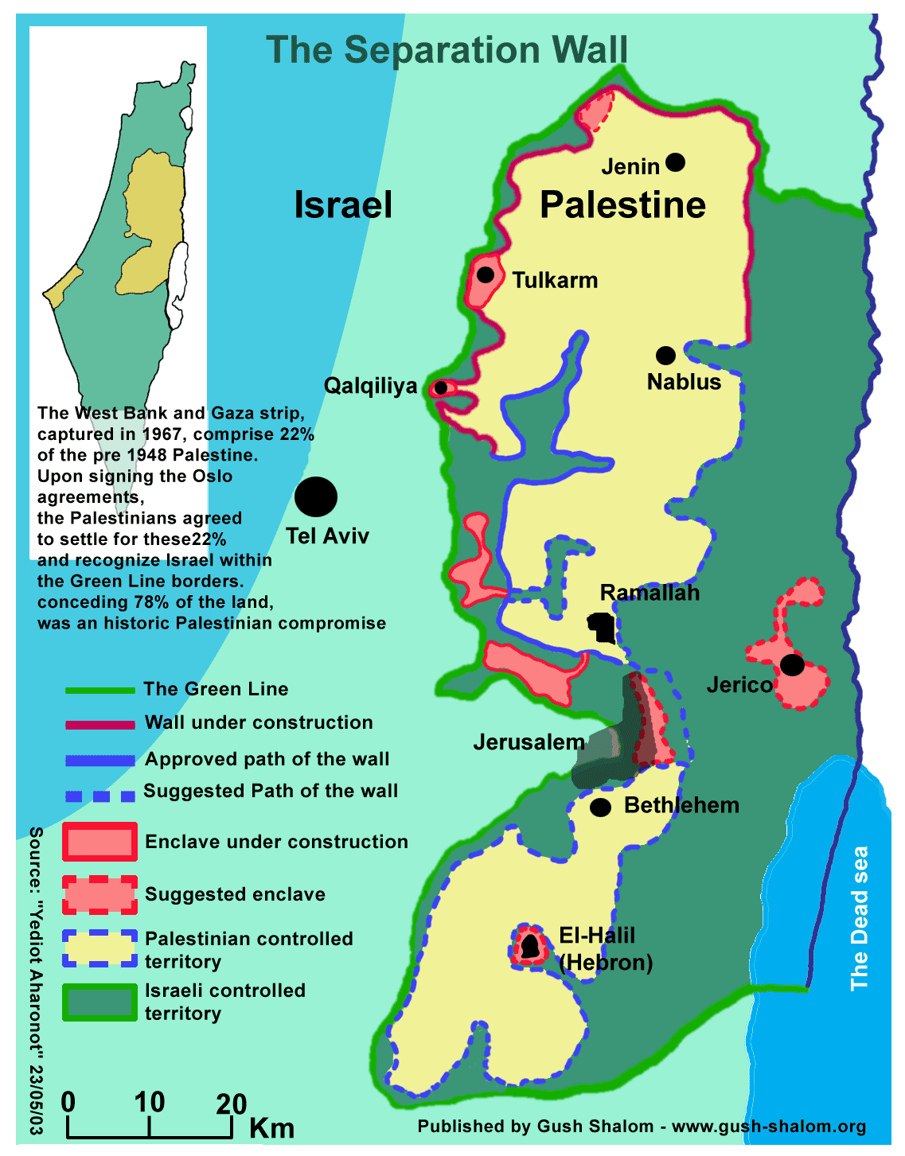
Since the creation of the State of Israel, Palestine has lost 78% of the land promised to them by the UN security consul. Since its creation the Israeli army and Palestine have been fighting. Some Palestinians have used Terrorist organizations, like Hamas, to help fight Israel. Hostility on both sides is not likely to be resolved anytime in the near future and all peace negotiations have failed.

Slide 12
Diaspora
Creation of the State of Israel
Holocaust kills
6 million Jews in Europe and 11 million people total
Europeans discriminate against Jews called
Anti-Semitism
Continual fighting between Jews and Palestinians over who has the right to the land
Jews leave Israel and move to other places in Northern Africa, Europe and The Middle East

