Slide 1
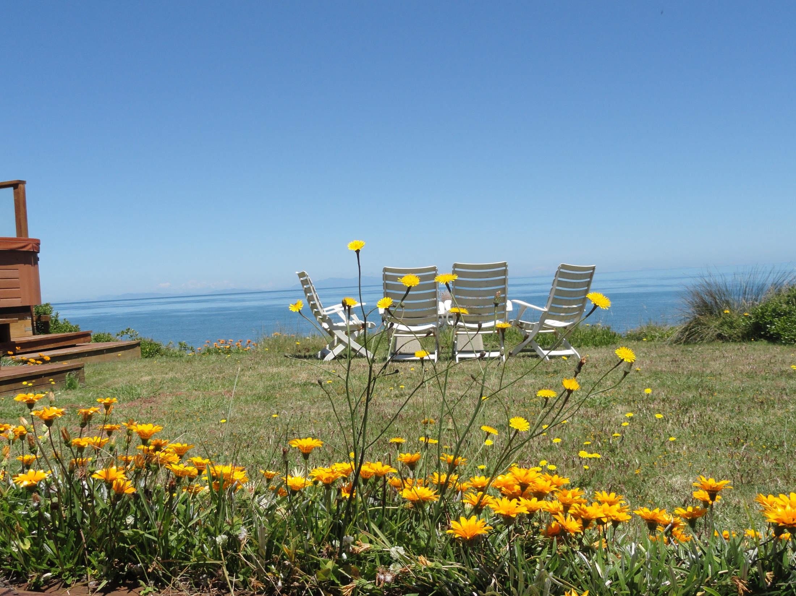
Ms. Knapp
Notes:
Welcome Parents I am Ms. Knapp!

Slide 2

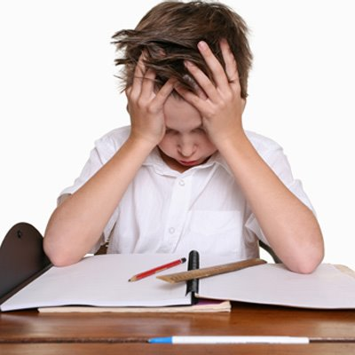




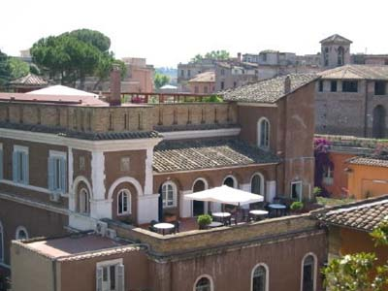
Notes:
Some things about myself are:
I have dyslexia. I struggled in elementary school and my parents had me tested and put into Atlanta Speech School. This was a wonderful opportunity for me to build my self confidence and learn to understand my disability. Having a disability myself, I think I am better able to relate to the needs of diverse learners and understand we don’t think the same way.
I went to Holy Innocents for Middle School and High School. After 3 years of Latin in High School I fell in love with Rome and decided after one year at UGA to move to Italy to finish college.
I went to John Cabot University in Rome and studied Italian and Humanities. It was the best experience of my life and an exception educational experience with classes of 4-20 students. With only 700 students, you were able to build unique academic relationship with the professors.
I returned to Atlanta to complete the MAT Secondary Social Studies. I have also taken 9 courses in a Master in World History.

Slide 3
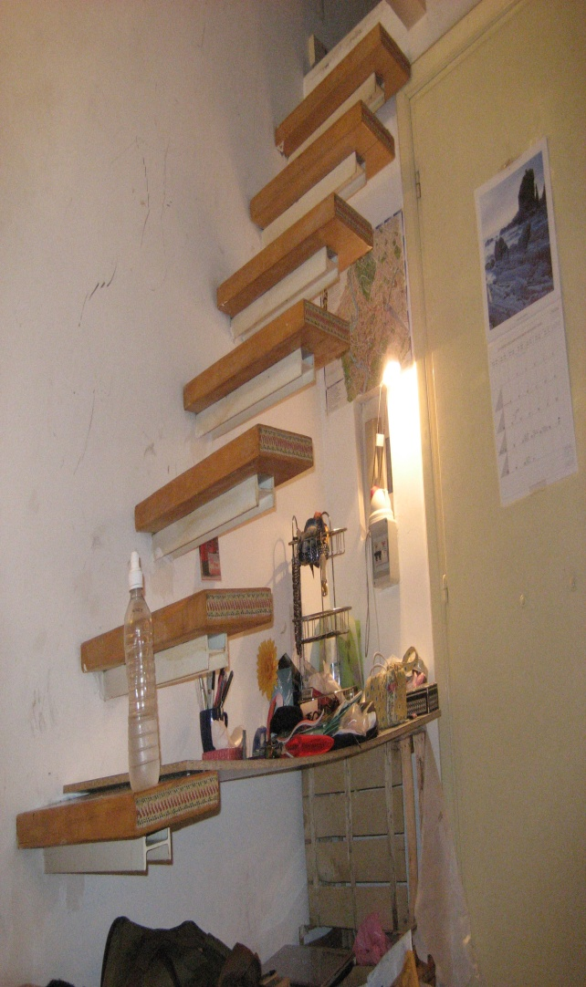
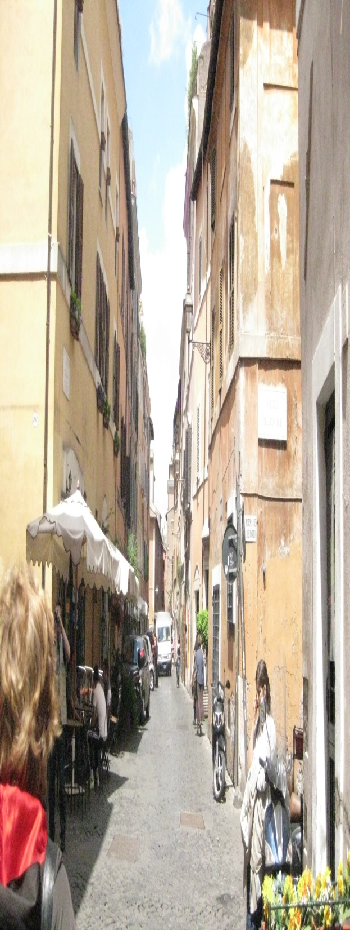
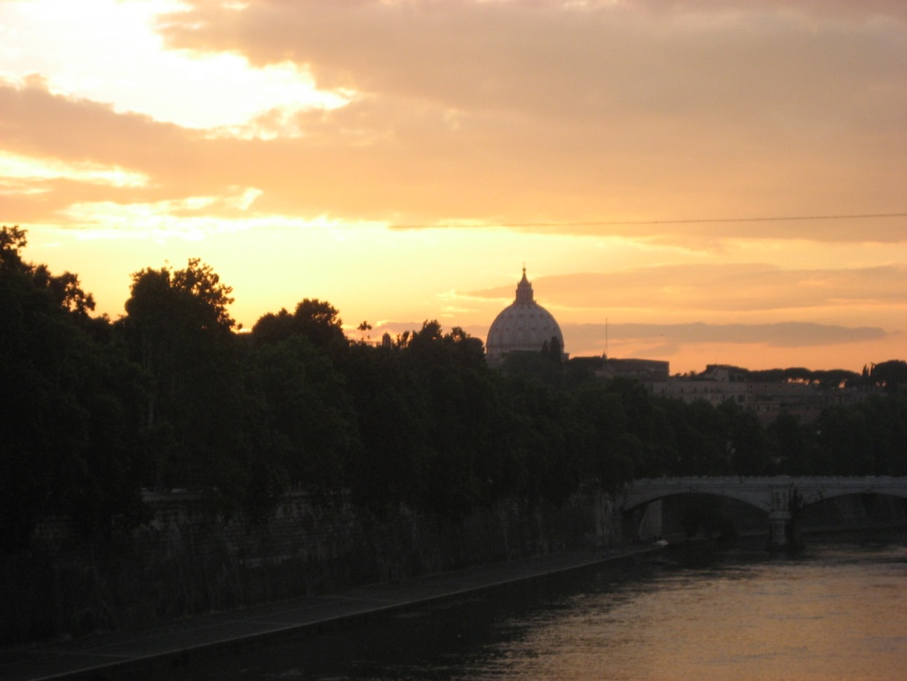
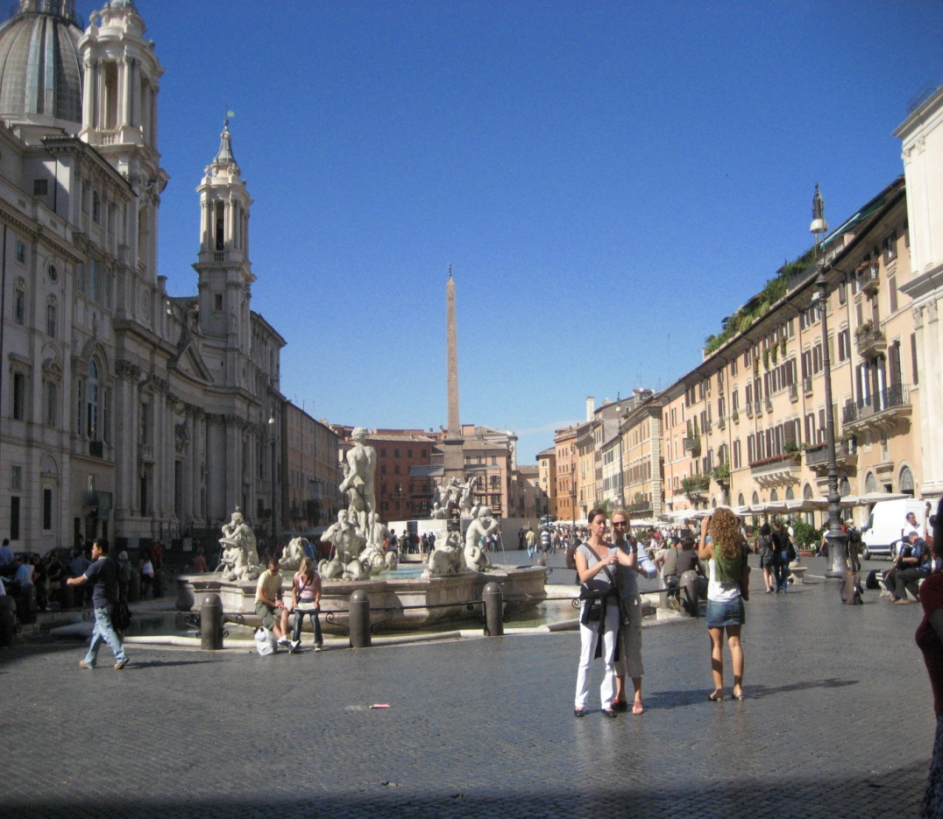
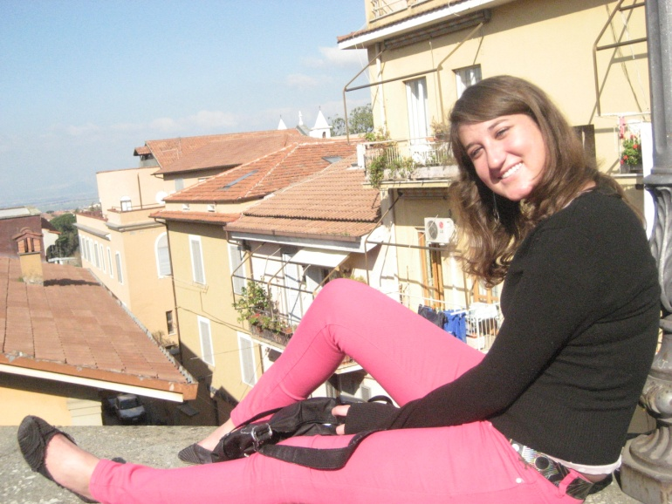
Notes:
Living in Rome changed my life and was the best experience of my life. Living in another culture truly changes how you see the world. Rome is also incredibly beautiful and full of 3000 years of history.

Slide 4
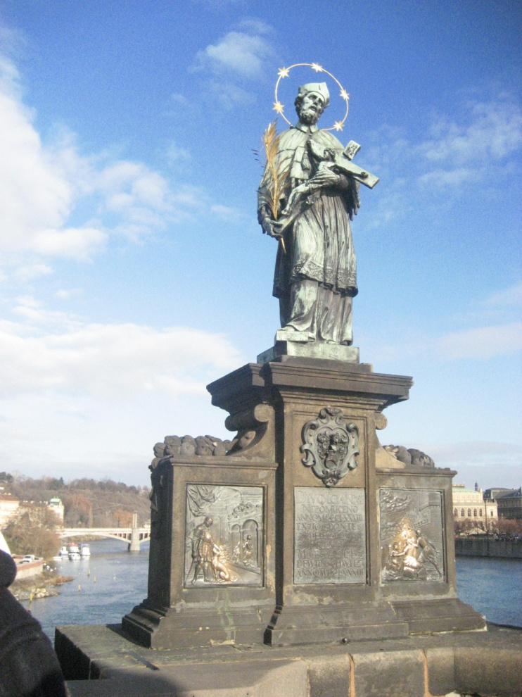
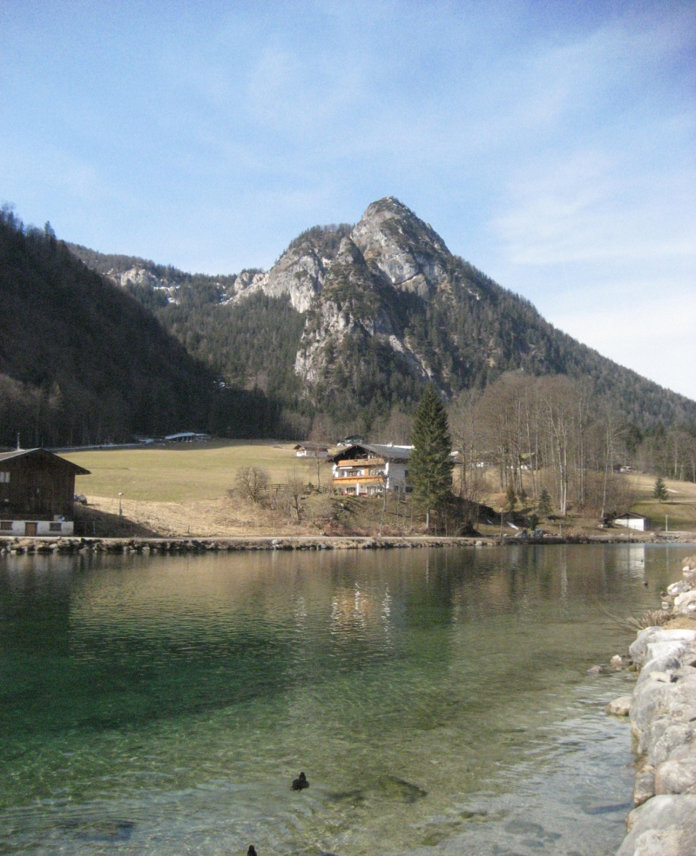
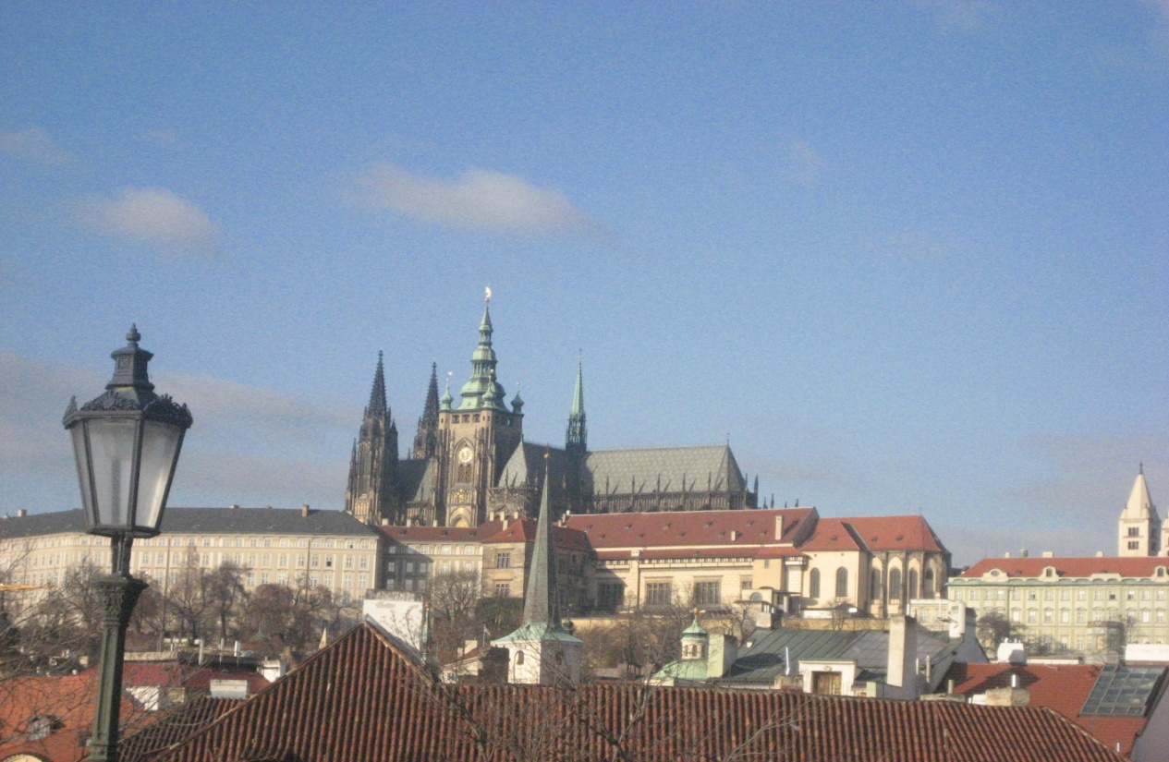
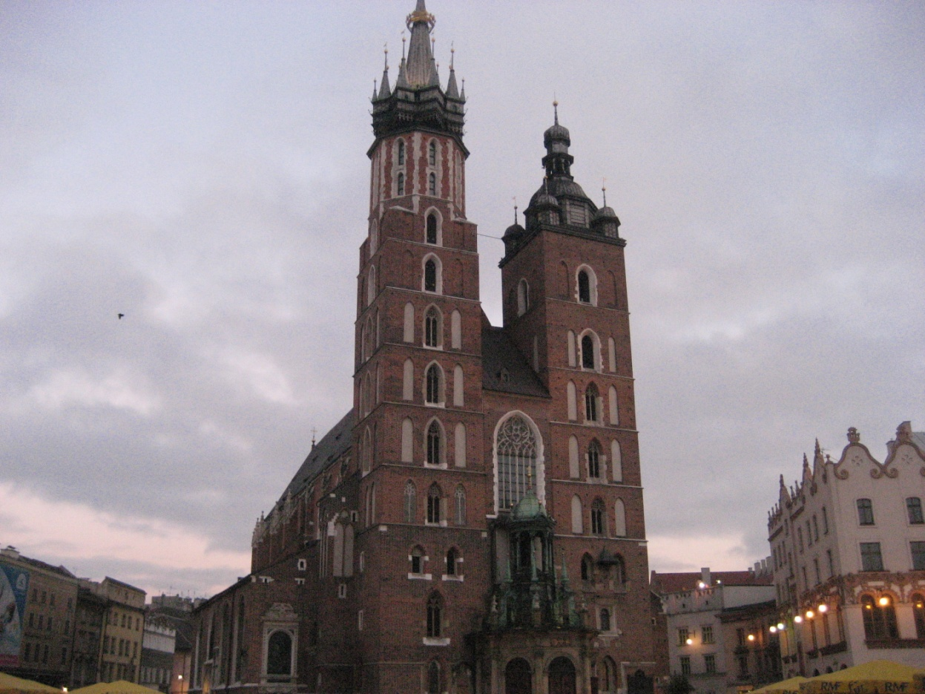
Notes:
Living in Rome also gave me the opportunity to travel many countries in Europe. I have been to Denmark, Sweden, Holland, France, England, Ireland, Spain, Switzerland, Germany, Austria, Germany, Poland, Czech Republic and a few other smaller countries.

Slide 5
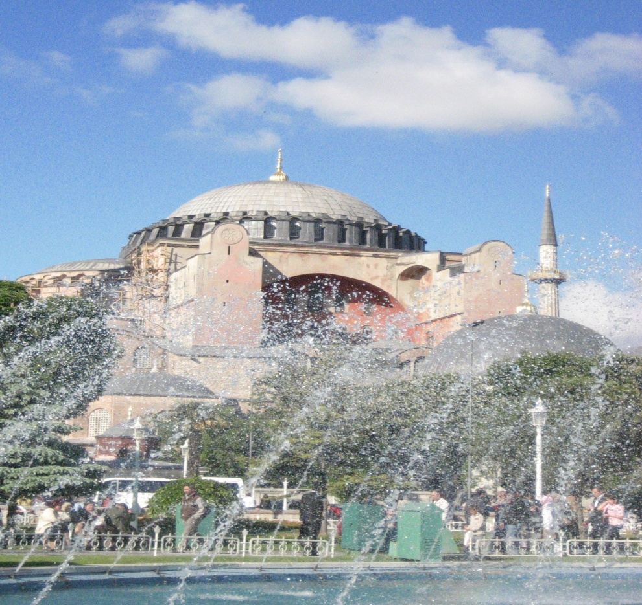
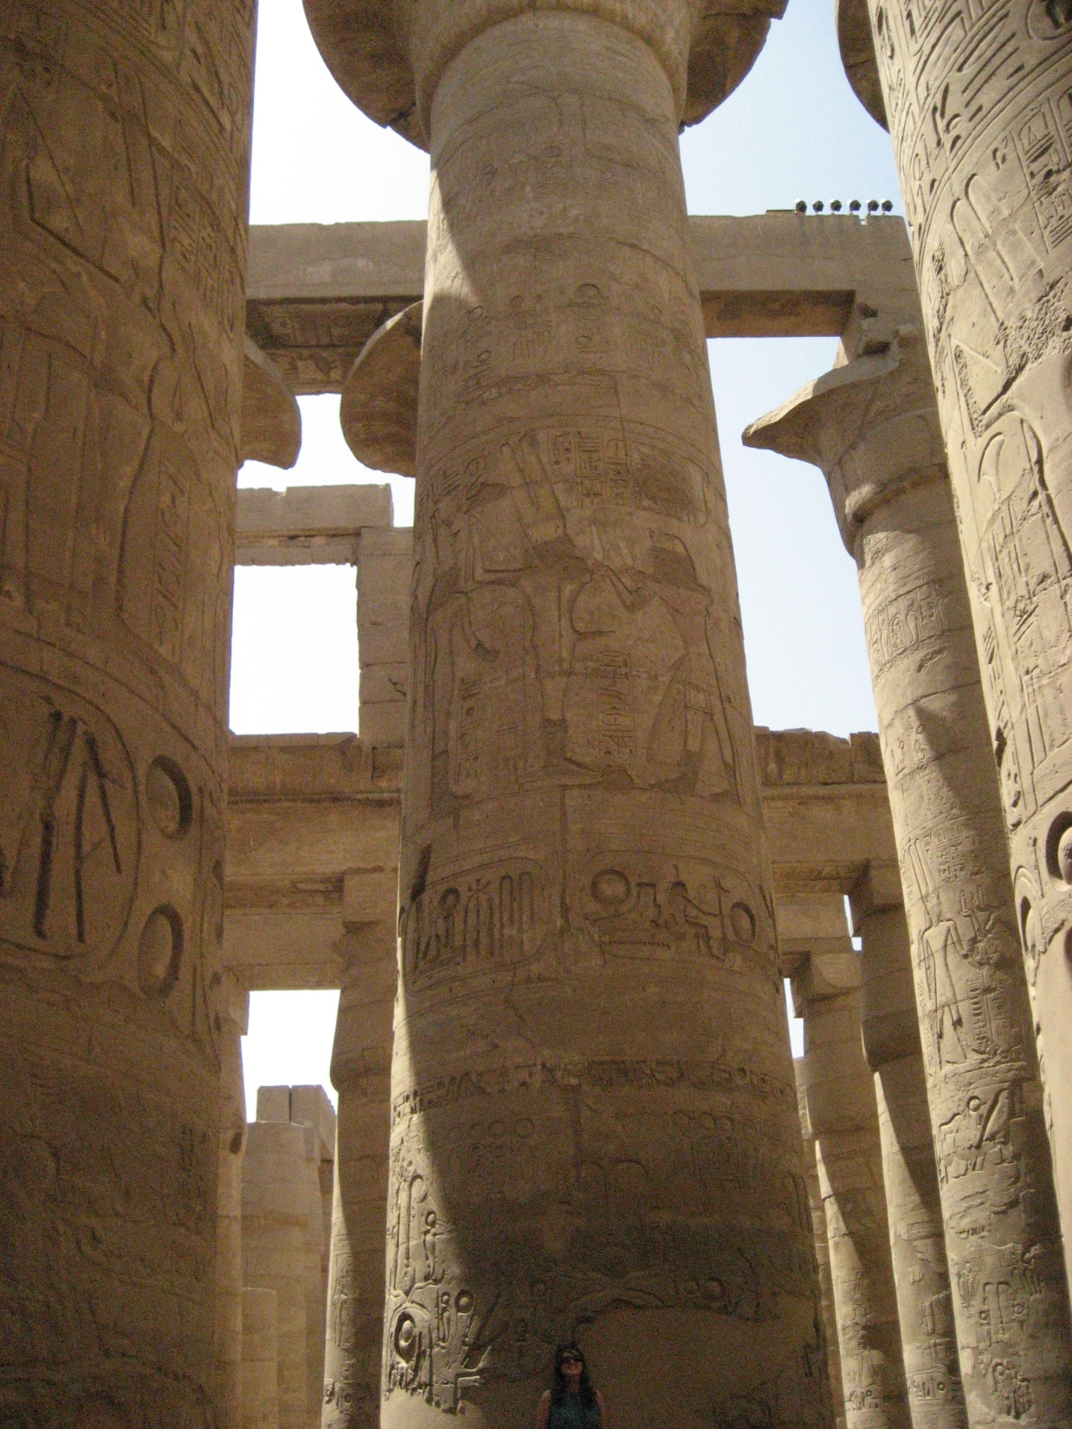
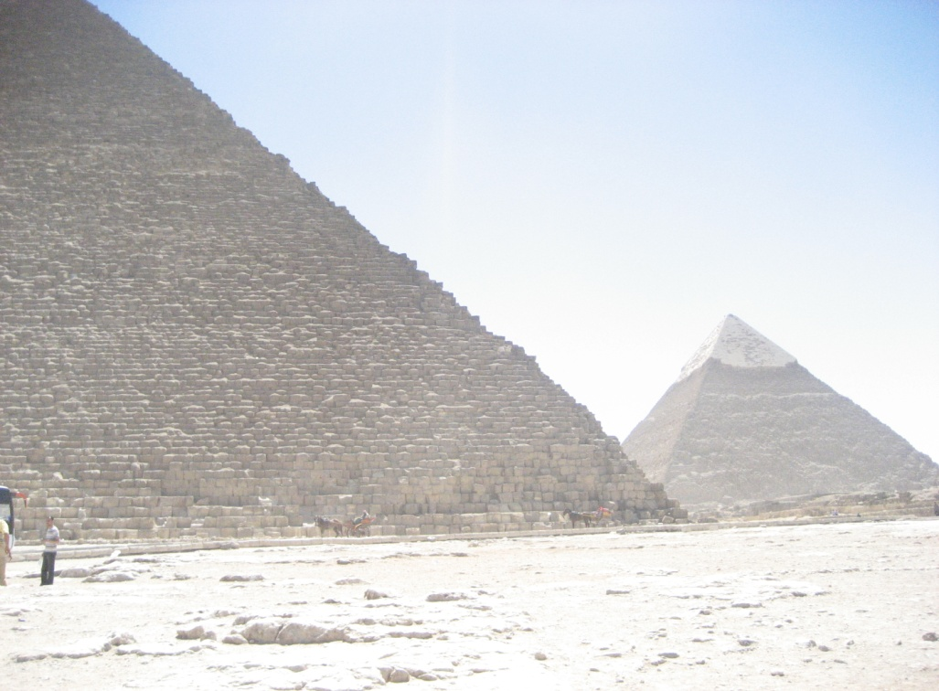
Notes:
I was also able to travel to Turkey and Egypt while living in Rome. Since college I have traveled to East Asia visiting South Korea, Japan, China, Laos, Cambodia, Thailand, Vietnam, and Indonesia.
Traveling is my passion. Culture and the world around us are my biggest joy. I love teaching social studies!

Slide 6
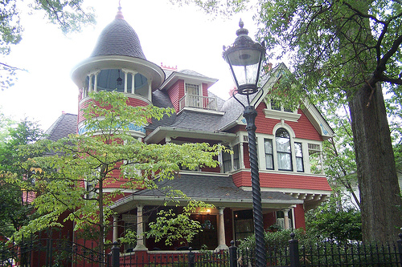
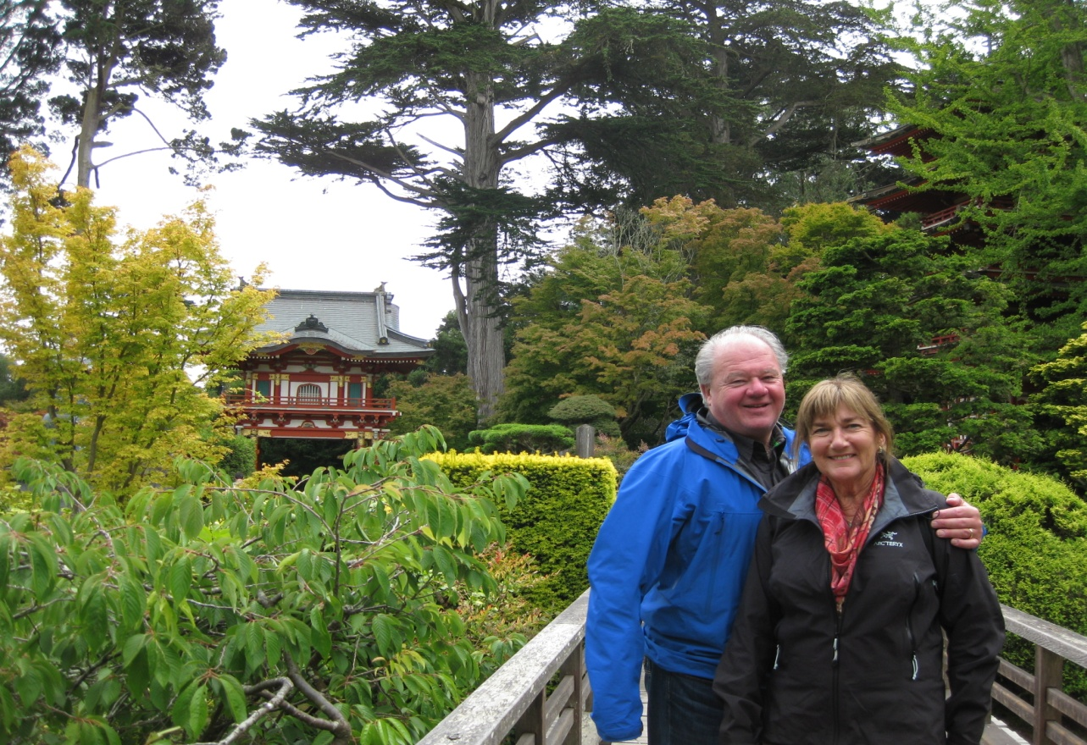
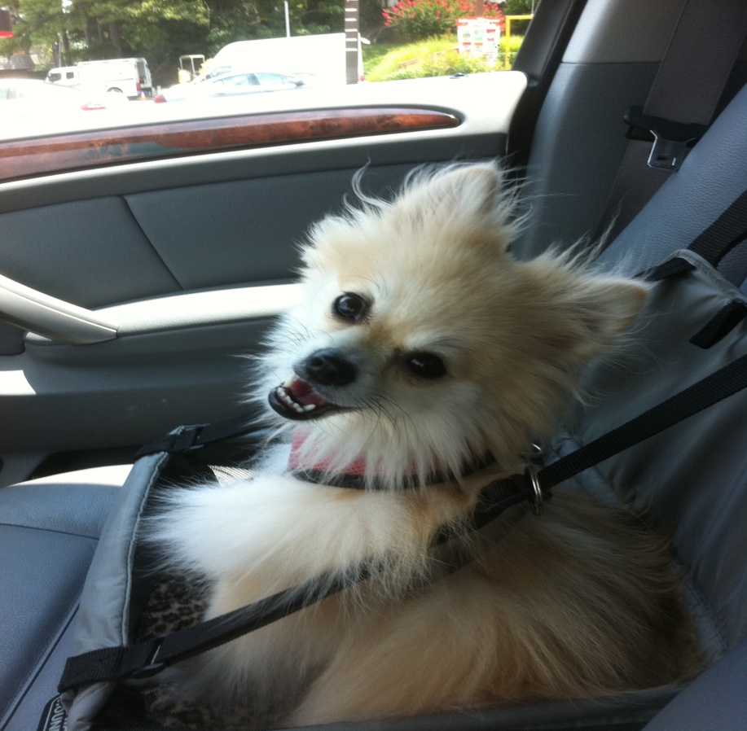
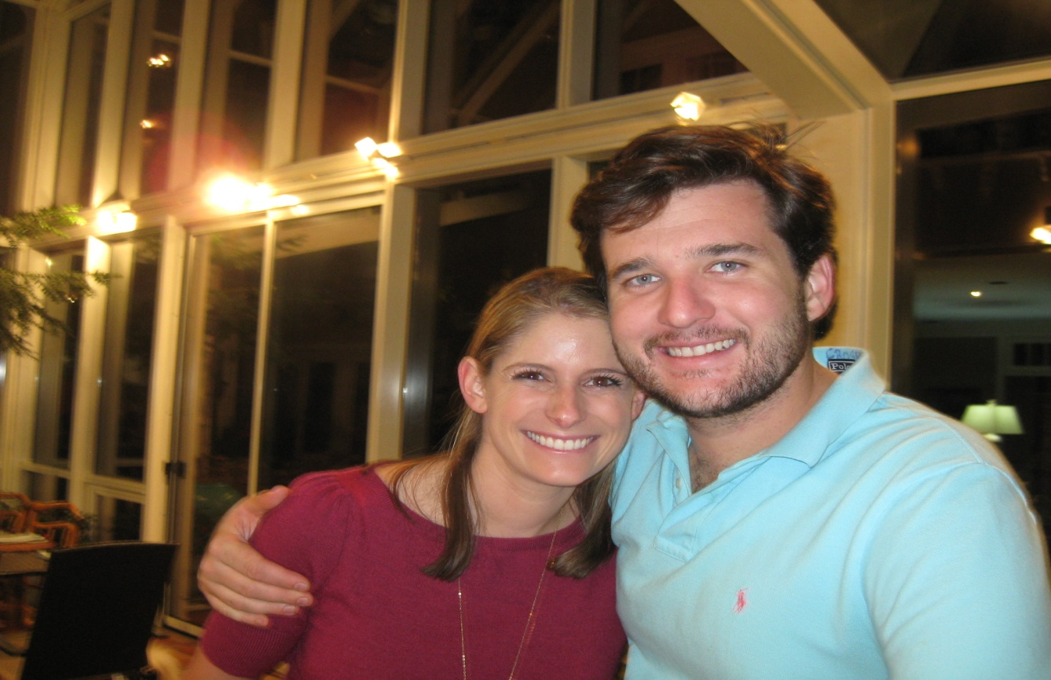
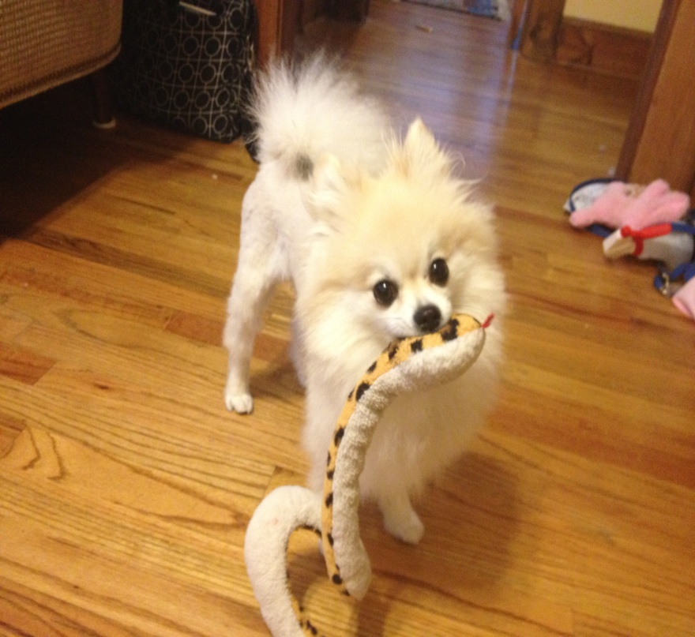
Notes:
I returned to Atlanta because my family lives here: Mom, Dad, Brother and Sister-in-Law. I also have Pomeranian named Bellina. I live in Inman Park, which I love because it is so beautiful!

Slide 7
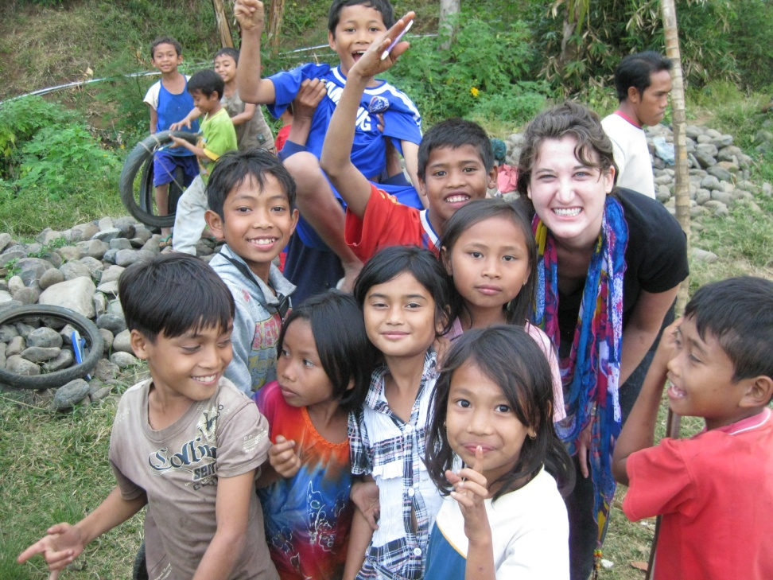
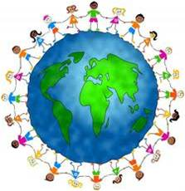
Ms Knapp:
Went to University in Rome
Has a Master’s From GSU
LOVES teaching
Is a Travel Addict
Encourages Global Citizenship
Is Dyslexic-pardon any typos
Is excited to be working with you this year!

