Slide 1
SS7G8 The student will describe the diverse cultures of the people who live in Southwest Asia (Middle East).
c. Compare and contrast the prominent religions in Southwest Asia (Middle East): Judaism, Islam, and Christianity.

Slide 2
Islam
People who believe that, “there is no God, but God and Muhammad is his prophet” are called Muslim or practice Islam.

Slide 3


Abraham
Isaac
Jews
Jesus Christ
Ishmael
Muhammad
Muslims
Christians

Slide 4
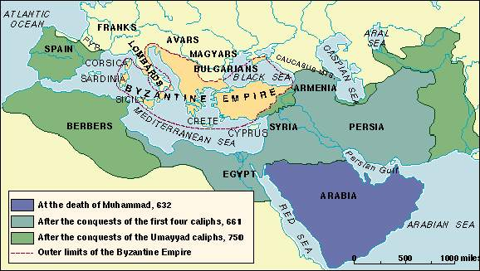
Islam developed in the Middle East around 622 CE. This means Islam is about 1,400 years old.
Abraham is considered the Patriarch of Judaism, Christianity, and Islam. And sometimes Judaism, Christianity and Islam are called the Abrahamic Religions.

Slide 5
Muslims believe in 560 Muhammad was born in city of Mecca in what is now the country of Saudi Arabia.
*Muhammad was a prophet who Muslims believe was visited by an Angel named Gabriel.
*The angel gave Muhammad the “word of God,” which became the Quran or Muslim Holy Book. Muslims also consider the Torah and Bible holy books
Torah
Bible
Quran
Islam

Slide 6

In order to be a Muslim or follower of Islam, you must follow the 5 pillars of Islam
Declaration of Faith: “There is no God, but God and Muhammad is his prophet.”
Prayer 5 times daily
Ramadan: Month long fast (no eating)
Alms giving (giving to poor every month)
Hajji: Trip to Mecca some time in life

Slide 7
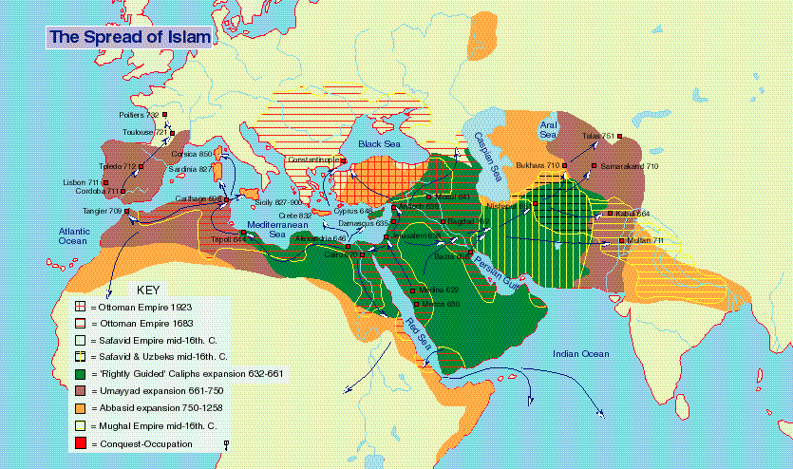

Slide 8

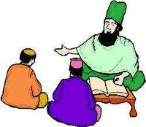
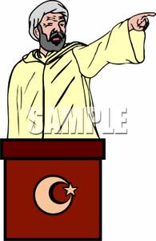
Sunni
Shia and Sunni Schism
(split)
.
Caliph: Is a leader in Islam.
Shia
Shai Muslims believe Ali, the grandson of Muhammad is the True Caliph, and all leaders must be descendants of Muhammad.
Sunni Muslims believes that the leader of Islam does not need to be related to Muhammad.

Slide 9
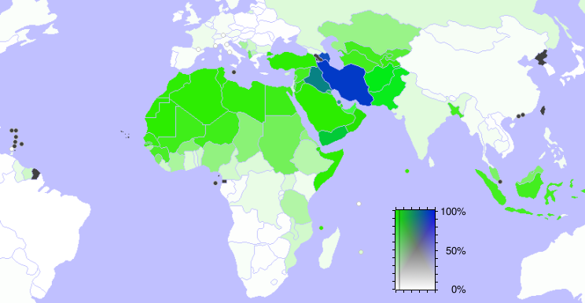
Sunni
Shia

