Slide 1
SS7G8 The student will describe the diverse cultures of the people who live in Southwest Asia (Middle East).
c. Compare and contrast the prominent religions in Southwest Asia (Middle East): Judaism, Islam, and Christianity.

Slide 2
Judaism
People who believe in Judaism are called Jews.

Slide 3
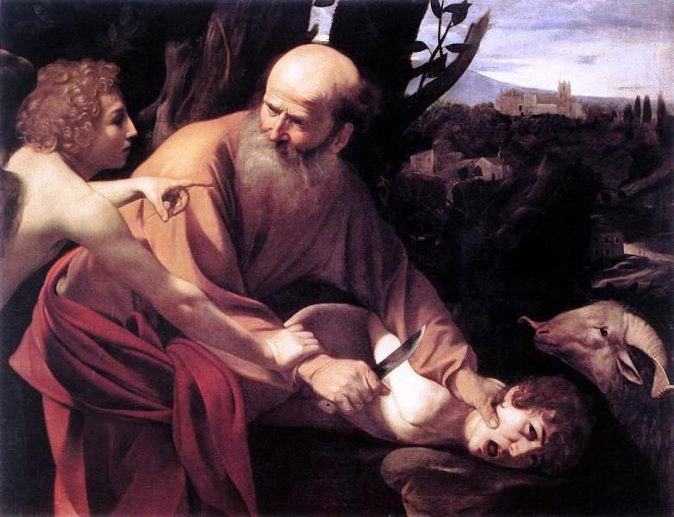
Jews Believe that Abraham is the Founder of Judaism.
Christians and Muslims also believe Abraham to be the founder of their religions, but they believe key people-Jesus or Mohammad-changed the religion to what we know today

Slide 4
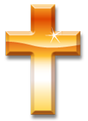

Abraham
Isaac
Jews
Christians
Ishmael
Muslims

Slide 5
Abraham is considered the Patriarch of Judaism, Christianity, and Islam. And sometimes Judaism, Christianity and Islam are called the Abrahamic Religions.
Judaism developed in the Middle East around 1800 BCE. This means Judaism is about 4,000 years old.

Slide 6
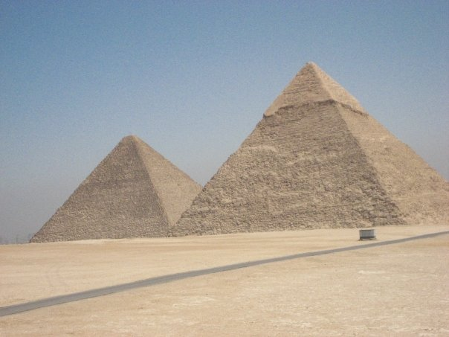
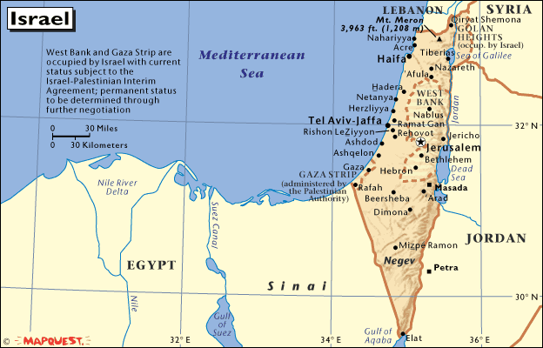
At sometime many Jews moved to live in Egypt. They believe that they were enslaved by the Egyptians and a Great leader named Moses freed the people from slavery in Egypt and led them to “the promised land” or Israel. This migration from Egypt to the Promised Land is called the Exodus.

Slide 7
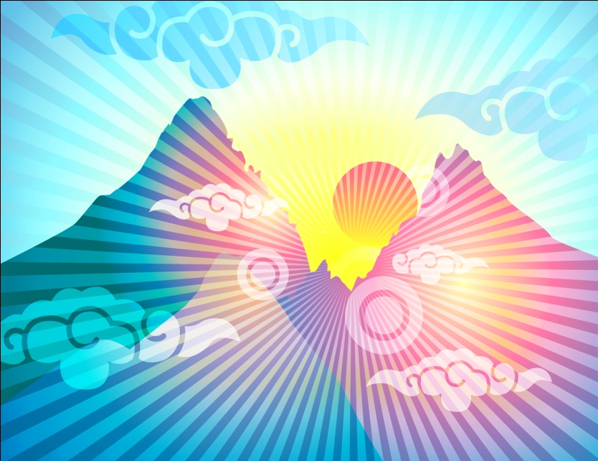

During the Exodus Jews believe God gave them a list of 10 rules to live by, called the Ten Commandments.
The first law is that Jews will only have one GOD. Jews are considered the first Monotheistic religion, or people who only believe in 1 God
Ten Commandments

Slide 8
Jews believe in order to be Jewish you must follow the 10 Commandments and the Torah, or the first 5 books of the Bible.

Slide 9
What does it mean to be Jewish?
Jews pray on Friday Night and Saturday (Shabbat)
Jews pray in a Synagogue
Some Jews just maintain an Ethnic identity, but do not pray
Some Jews only in certain foods (Kosher)
  They do not eat pork
  They do not eat Milk and Meat together
  They do not eat shellfish

Slide 10
Holidays | Meanings
Shabbat — The Sabbath | Friday Night and Saturday Morning Celebration. Part of 10 commandments.
Rosh Hashanah — The Jewish New Year | In September. God judges each person based on their deeds.
***Yom Kippur — Day of Atonement | A day to apologize and ask God and Friends for forgiveness for past misdeeds.
Hanukkah — Festival of Lights | Has become more popular in Western Society, because it coincides with Christmas.
Pesach — Passover | Honor’s the Exodus Story. Coincides with Easter.
Lunar Calendar | Holidays follow Moon cycles and are NOT the same day every year.

Slide 11
Types or Sects of Judaism
Reform: Most “liberal.” Have less strict interpretation of Rules
Orthodox: Strict following of Rules. Eat strict diet. Follow more laws from the Torah. Dress very conservatively
Conservative: In between Reform and Orthodox. Stricter than Reform, but not as strict as Orthodox. May follow diet and holidays.

Slide 12
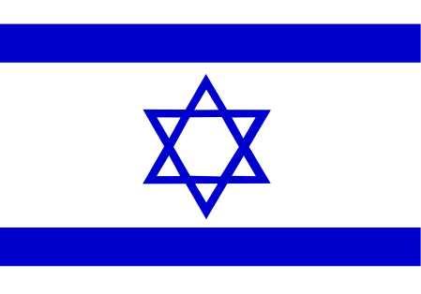
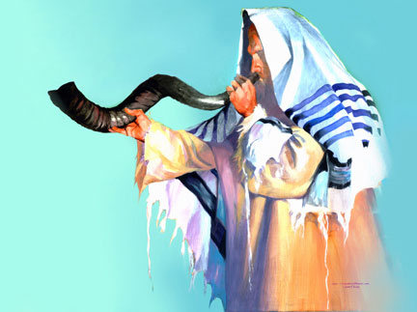
Many live in the USA, Israel, France, Russia, the Ukraine, and Canada
There are 3 main sects or types of Jews
Judaism Today
The Diaspora and Holocaust have spread Jews to many places around the World
Some Jews just identify Judaism as a Ethnic Group, but do not practice the religion

