Slide 1
Historical Understandings →SS7H2
Explain how European partitioning in the Middle East after the breakup of the Ottoman Empire led to regional conflict.
b. Explain the historical reasons for the establishment of the modern State of Israel in 1948; include the Jewish religious connection to the land, the Holocaust, anti-Semitism, and Zionism in Europe.
c. Describe how land and religion are reasons for continuing conflicts in the Middle East.

Slide 2
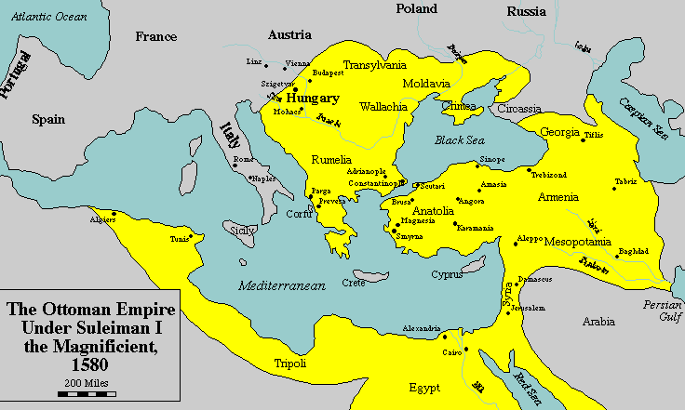
Ottoman Empire
Huge Muslim Empire headed in Istanbul
In power from 1299-1914
Tolerant of “People of the Book”

Slide 3
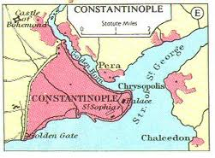
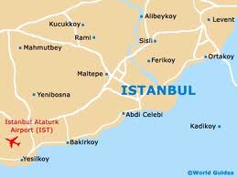
In 1300, a group of Muslim Warriors, called Turks, captured most of what is now Turkey. This becomes the Ottoman Empire.
The Ottoman Empire took their ancestors name, the Osmans.
In 1453, the Ottomans took over an Christian city named Constantinople .
Constantinople later got renamed to Istanbul.
TO

Slide 4



Istanbul in 1453 laid the foundation of the Empire, which was the major power in southeastern and Eastern Mediterranean.
In the 15th and 16th century, the Ottoman Empire entered a long period of conquest and expansion.
This long period of time was lead by Emperor Suleiman, who almost conquered Western Europe. He was defeated in the Battle of Vienna in 1683.
All three major Abrahamic religions Judaism, Christianity, and Islam lived in this Empire. Jews and Christians paid higher taxes, because Muslims paid 10% of their income as Alms, as required by the 5 pillars.
For most of its history, about 400 years, the Ethnic and religious groups lived in harmony which only small scale conflicts.

Slide 5
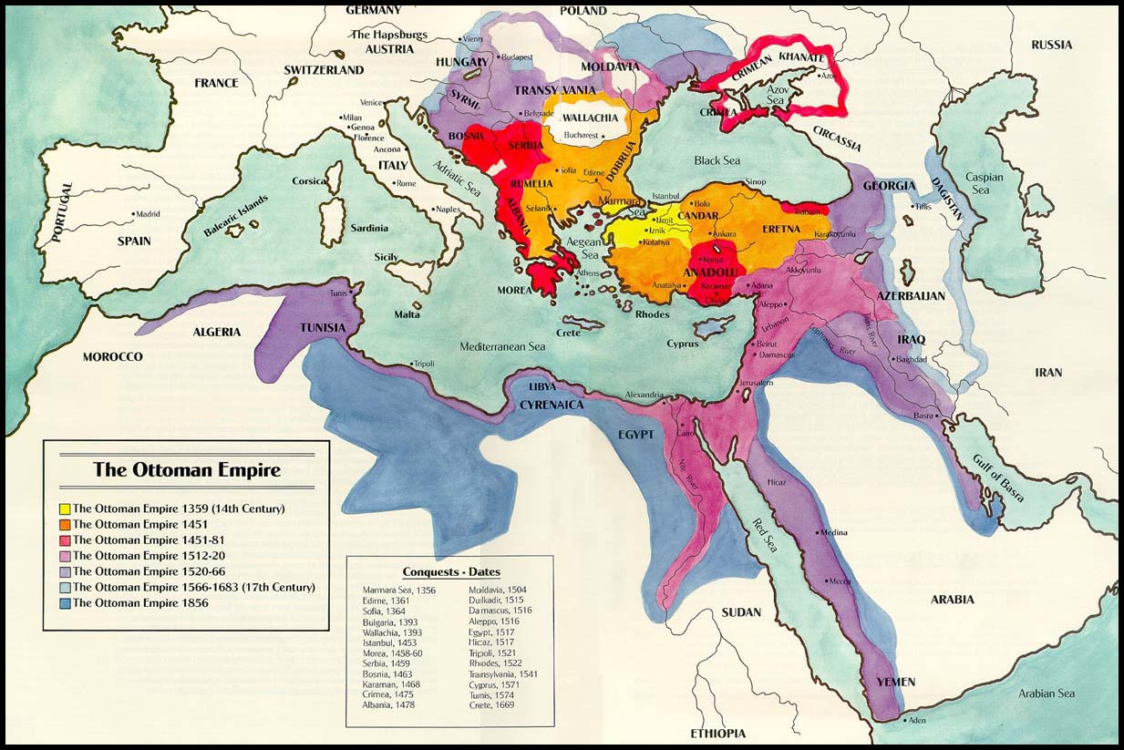
All three major Abrahamic religions Judaism, Christianity, and Islam lived in this Empire. Jews and Christians paid higher taxes, because Muslims paid 10% of their income as Alms, as required by the 5 pillars.

Slide 6
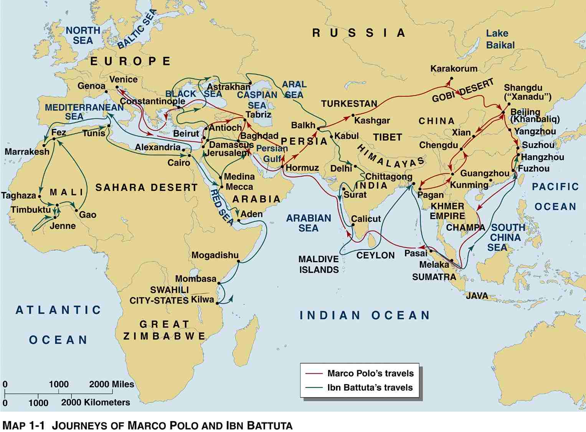

Slide 7
Decline
As Western Powers invested in longer sea travel and sailors began circumnavigating Africa the Ottoman Empire began to decline as a trade center. Explores like Columbus wanted to find other ways to Asia partially to bypass the Ottoman Empire and the taxes they had to pay.
The beginning of WWI created some problems for the Ottoman Empire. The Ottoman Empire fought on the losing side of WWI.
European Politicians partitioned the Ottoman Empire and many countries, like Turkey, Syria, Palestine (now Israel), and Lebanon were formed called Sanremo Agreement. The Ottomans lasted until about 1914 or 1922 depending on which end date you use.
European division created religious tension, by favoring some groups over others.
These countries are part of what is now modern day Middle East and Southwest Asia.

Slide 8
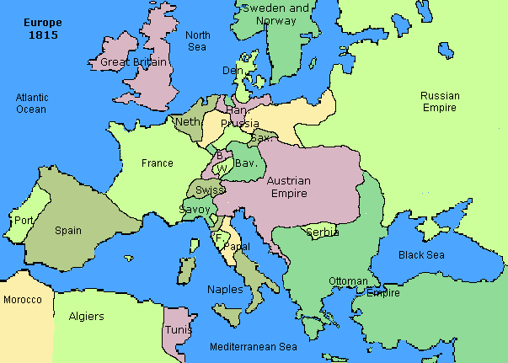
European Empires before WWI (1914-1919)

Slide 9
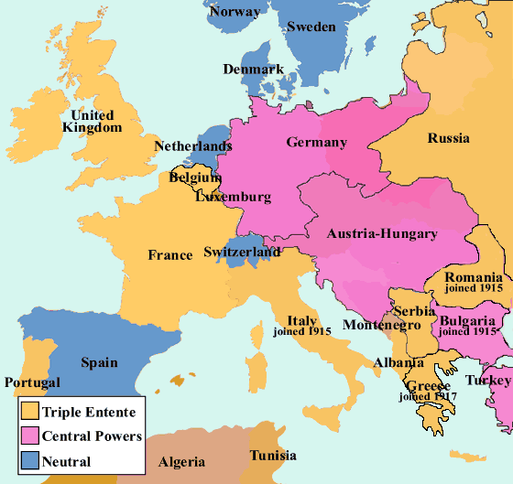
The Ottoman Empire fought on the wrong side in WWI and lost the war, because of this European Nations decided the new boundaries of the former Ottoman territories
Ottoman Empire Breaks up and becomes Turkey and other smaller Nations during WWI

Slide 10
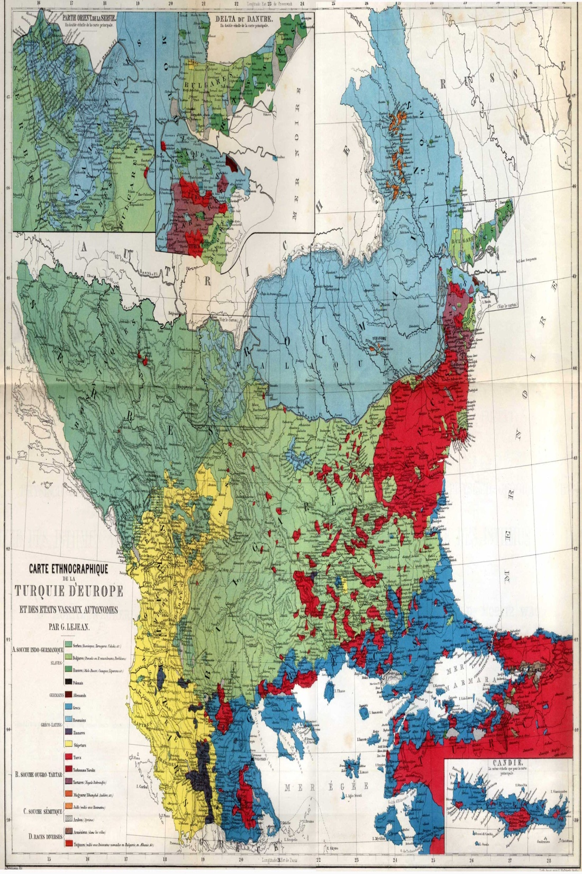
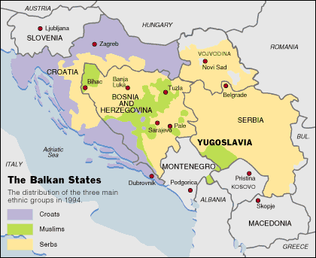
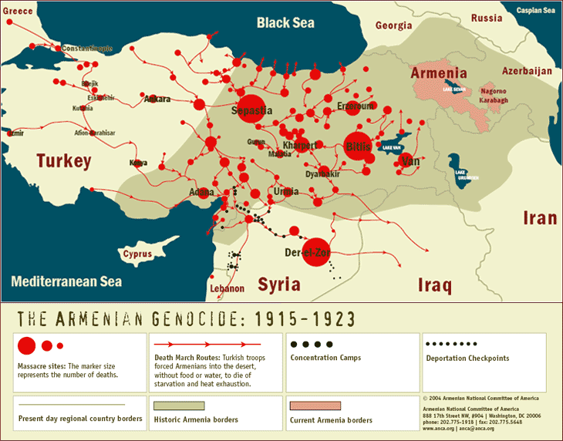
The Divisions of the Ottoman Empire were not done well.
Circassian's, Russian Muslims, fled Russia to live in the Ottoman Empire.
The Balkans split apart and people were forced to move for religious and ethnic reasons.
The Armenia Genocide forced Armenia Christians to move to Armenia. 1 million Armenians died during the forced migration.
Greek Orthodox living Turkey and Turkish Muslims living in Greece were forced to move in the hundreds of thousands. Thousands died.
Large number of Jews were moving to Palestine to escape religious conflicts in Europe. The desire to return to the Jewish Promised Land is called Zionism.

Slide 11
Ethnic And Religious Conflict as a result of the Ottoman Partitioning
Armenian Genocide
Mass Migrations of Muslims and Orthodox Christians from Turkey to Greece and Greece to Turkey.
Violent repression of the Kurdish ethnic groups.
Sectarian conflict in Iraq.
Jewish-Arab tension in Palestine, which is amplified with the creation of Israel.
Religious divisions of Syria and Lebanon.
Conflicts in the this area continue today.

Slide 12
Ottoman Empire
There has been nearly continuous religious or ethnic conflict in this region since WWI
Many Ethnic and Religious groups did not like the new countries boundaries
Europeans decide new countries boundaries
Becomes: Turkey, Greece, Iraq, Palestine, Syria, Lebanon, Armenia, and more
Becomes Turkey and Other Nations

