Slide 1
River Civilizations
SS7G7 The student will explain the impact of location, climate, physical characteristics, Distribution of natural resources and population distribution on Southwest Asia (Middle East).
SS7G8 The student will describe the diverse cultures of the people who live in Southwest Asia (Middle East).
SS7CG4 The student will compare and contrast various forms of government.
SS7H2 The student will analyze continuity and change in Southwest Asia (Middle East) leading to the 21st century.

Slide 2
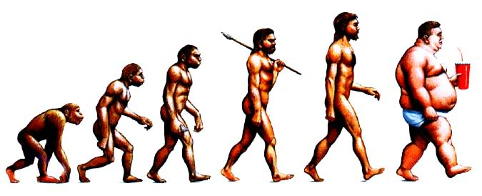
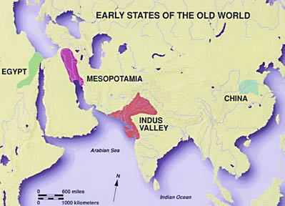
Today most of the world, about 2/3rds, lives in cities, but it hasn’t always been this way. Originally humans lived in small units and travelled finding food.

Slide 3

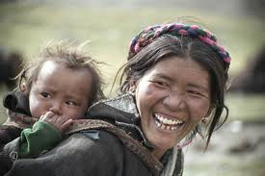
Nomads: People who are hunters and gathers and that move from place to place looking for food.
Early Humans were all Nomads and traveled from place to place, but did not settle until around 3,000 BCE or roughly 5,000 years ago.

Slide 4

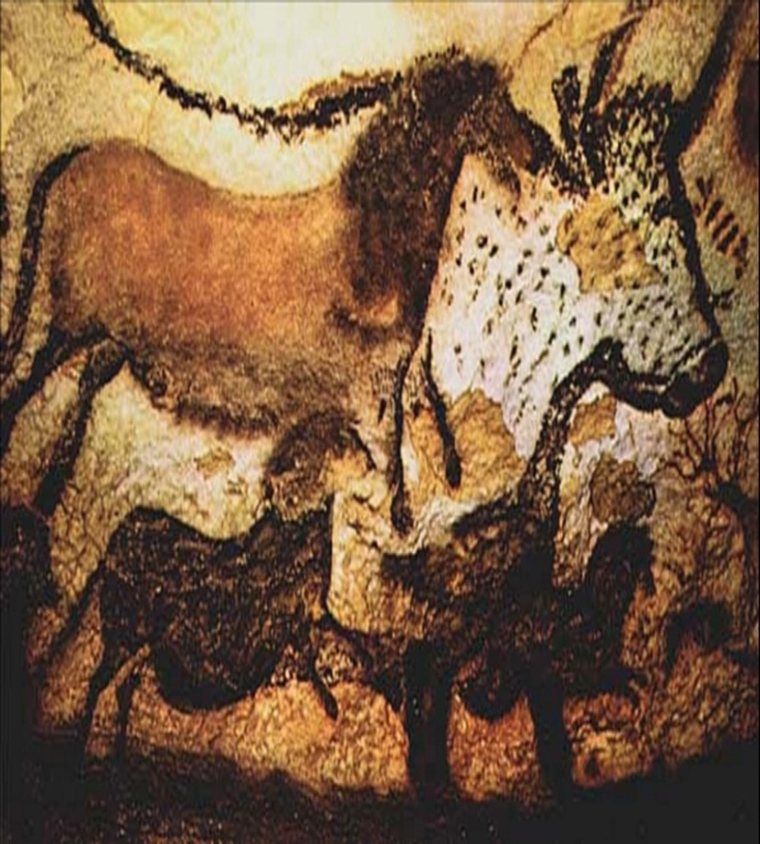
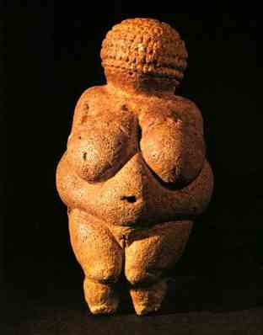
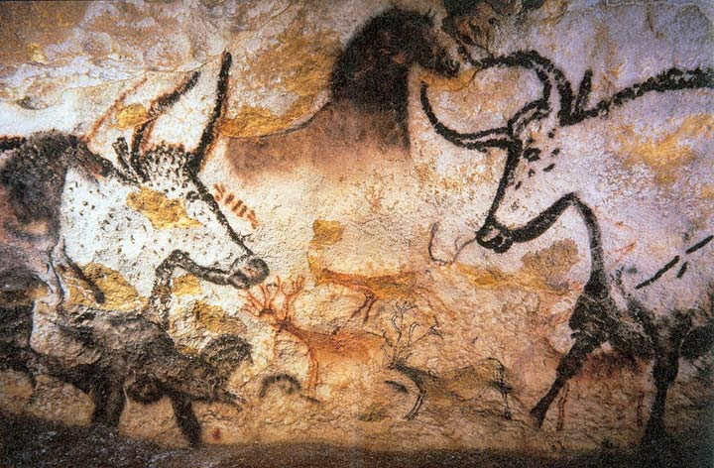
lascaux cave paintings

Slide 5

Irrigation: Irrigation is using canals or other methods to store and move water to grow crops.
This is extremely important in founding early society and is still very important in dry regions of the world, like the Middle East.
Agriculture: The process of growing crops in one place, a farm.

Slide 6

Civilization: When people come together to live together and make a society.
Early Civilizations grew by growing agriculture, by living near rivers and using irrigation to water their plants. Most people in the Middle East still live near rivers.
Notes:
End day one

Slide 7
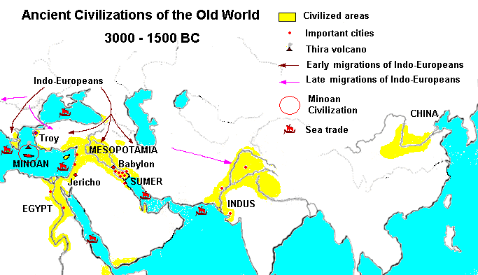
Notes:
Day two

Slide 8

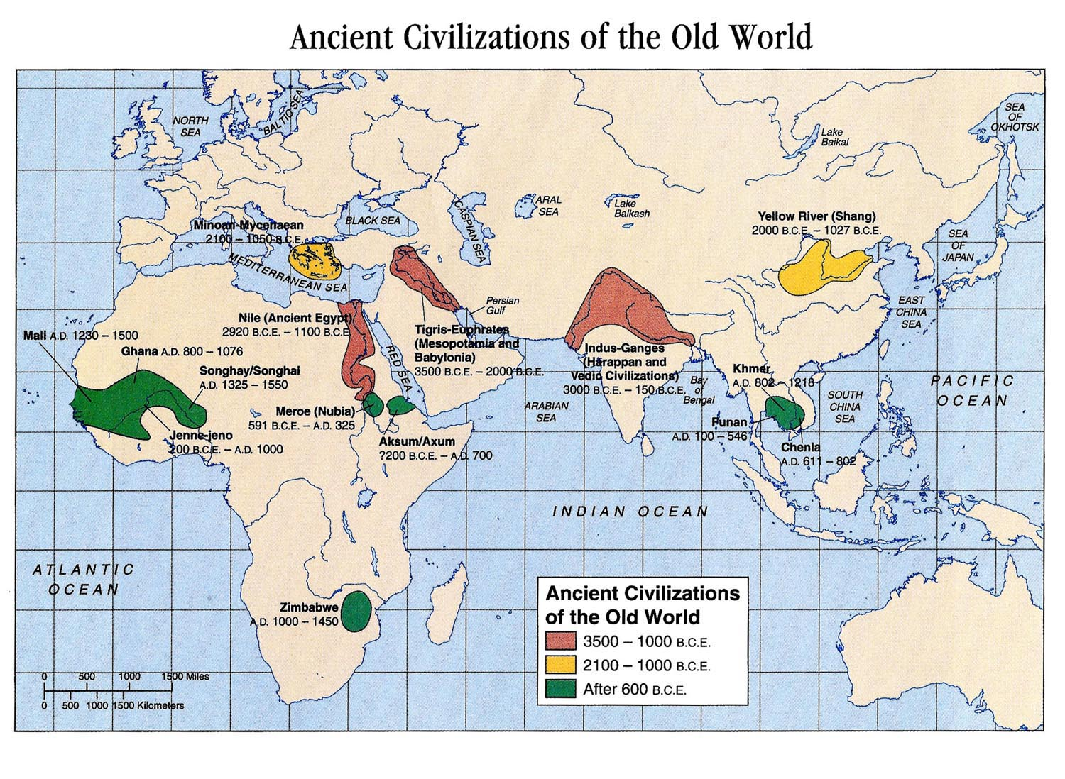
Mesopotamia and other ancient River Civilizations were founded on rivers and used irrigation to grow agriculture. All early civilizations were founded on major waterways. Why do you think that living close to a River would be even more important during early civilization or in Arid Regions?

Slide 9
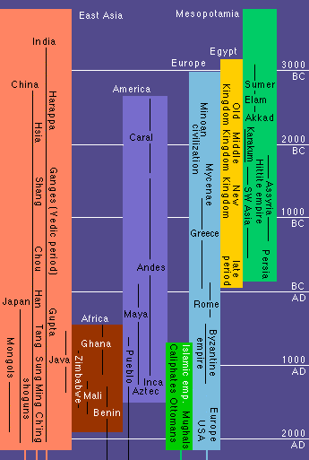
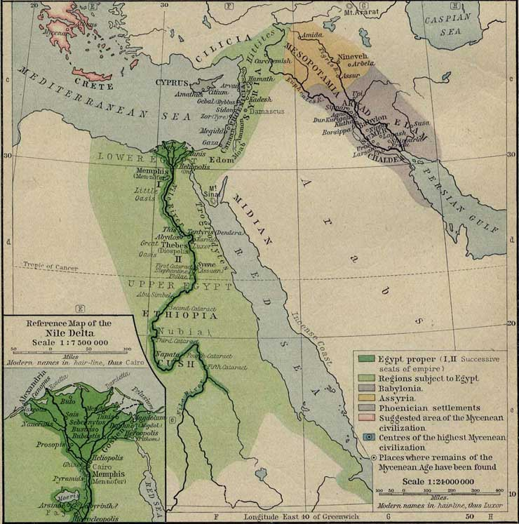

Slide 10
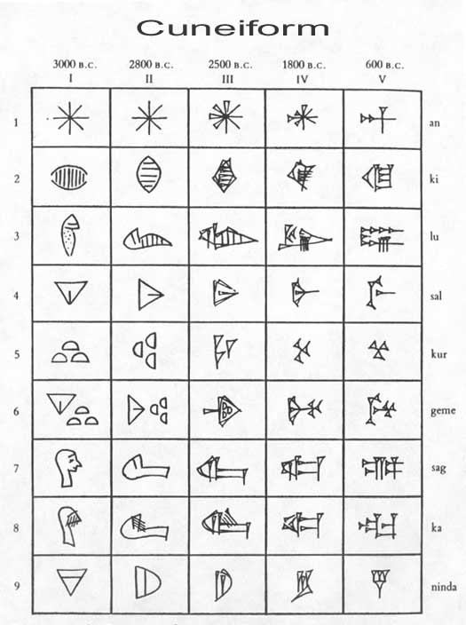
Mesopotamia: One of the first places in the world where early humans settled and made civilizations. It is the area in between the Tigris and Euphrates River, in what is now Iraq. The first form or writing, Cuneiform was invented here to codify law, called Hammurabi’s Code.
Cuneiform: The first written language. It was invented by the people of Mesopotamia and used symbols to express ideas.
Hammurabi and Code of Laws: The first written laws were made in Mesopotamia in Cuneiform.

Slide 11
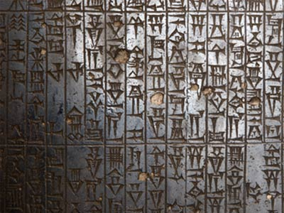
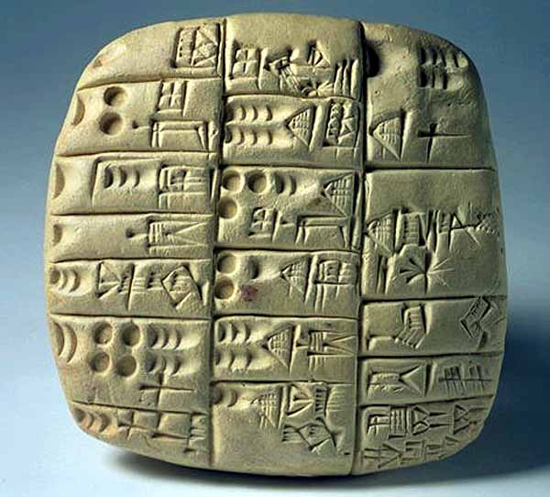
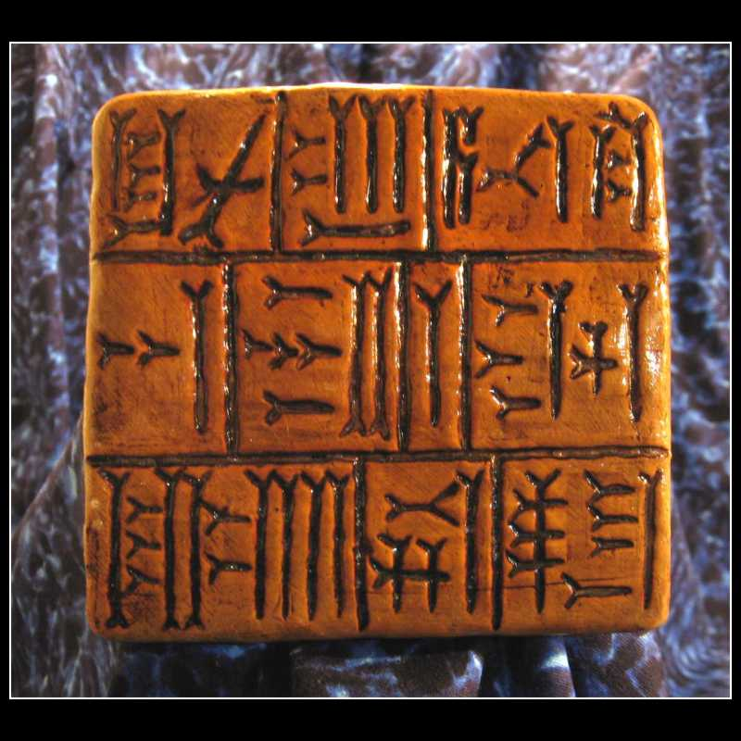
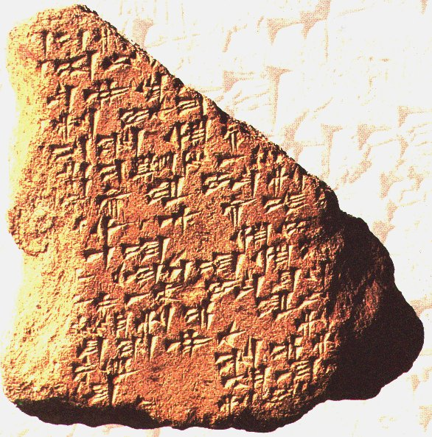

Slide 12
Think A bout it
Before Hammurabi's Code rules were oral. What is the difference between oral and written law? In oral or written law which is more likely to have the same punishments for the same crimes? How does written language help a society grow?
Notes:
End Tuesday

