Slide 1


CRCT Study Jeopardy

Slide 2
Rules
All Questions have an answer.
Maps- second slide will have all answers
Charts- second slide have all answers
Multiple Choice –answer will be underlined
Free response answer will pop up
The team with the most points wins!

Slide 3
Table of Contents
Warm Up | Maps | Geography | Culture and Religion | History | Government and Economics

Slide 4
Warm Up
Which country is least likely to have people using a traditional economy?
Kenya
Japan
Nigeria
Sudan
Which Southwest Asian Country is an autocracy?
Iraq
Israel
Turkey
Saudi Arabia

Slide 5
Warm Up
How did the “Four Modernizations” affect Chinese agriculture and industry?
farmers better seed and equipment
Factories more autonomy in what to produce
Which was one of the early goals of the Indian National Congress and the Muslim League?
Independence from Great Britain
Which leader used the Cultural Revolution?
Mao Zedong
Which best describes the religion of Arabs?
Most are Sunni Islam, but some are Christians and other faiths
The “Great Leap Forward” and the “Cultural Revolution were China’s attempt to
Improve the economy
India leads many other countries in the area of
Technology and service industry

Slide 6


One section down!

Slide 7
Geography & Environment | Culture & Religion | History | Government & Economics
African Countries | Abrahamic Religions-Judaism, Christianity, Islam | Ottoman Empire | Voluntary Trade
African Physical Geography | Middle East Cultures-Arab, Bedouins, Persian, Jews, Kurds | Israel and events leading to its creation | Similarities and differences in Democracies
Middle East Countries | African Cultures- Ashanti, Swahili, Bantu, Arab | USA presence in the Middle East (Gulf War, War on Terror, War in Iraq) | Countries areas of Specialization
Middle East Physical Geography | Asian Religions-Hinduism, Buddhism, Shintoism, Confucianism | European interest and partitioning in Africa | Literacy Rates and GDP
Asia Countries |  | Apartheid | Corruption
Asia Physical Geography |  | Communism in Asia-Chinese Revolution and Domino Theory | Resources-distribution and unequal distribution
Environment |  | Indian Independence

Slide 8
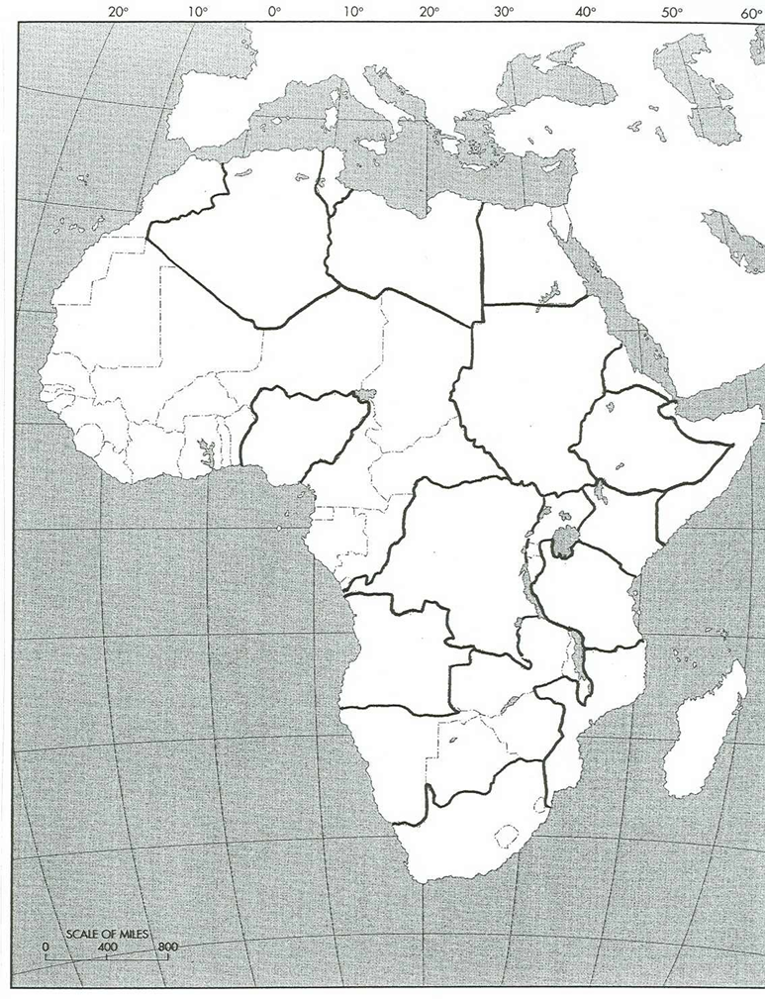
African Geography
3
B
A
4
1
5
C
6
2
D
E
7

Slide 9
African Geography
Egypt
Niger River
Nile River
Sudan
Nigeria
South Sudan
Congo River
Kenya
Democratic Republic of the Congo
Lake Victoria
Lake
Tanganyika
South Africa

Slide 10
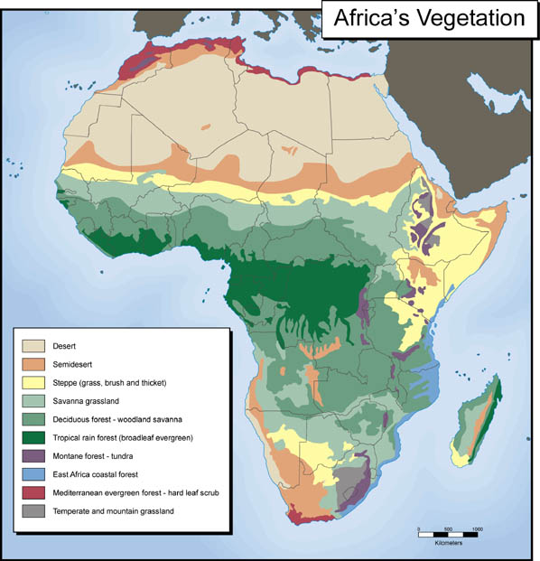
Africa Geography 2
the Sahara, Sahel, savanna, tropical rain forest, Congo River, Niger River, Nile River, Lake Tanganyika, Lake Victoria, Atlas Mountains, and Kalahari Desert
^^^ 1
^^^^^^
2
3
5
4
4
5
6
5
7

Slide 11
the Sahara, Sahel, savanna, tropical rain forest, Congo River, Niger River, Nile River, Lake Tanganyika, Lake Victoria, Atlas Mountains, and Kalahari Desert
^^^Atlas ^^^Mountains
^^^^^^
Sahara
Sahel
Savanna
Tropical Rain Forest
Savanna
Tropical Rain Forest
Lake Victoria
Desert
Semi desert
Savanna
Savanna grassland
Forest
Tropical Rain Forest
Montage forest
East Africa Coastal Forest
Mediterranean
Mountain Grassland
Savanna
Kalahari Desert

Slide 12
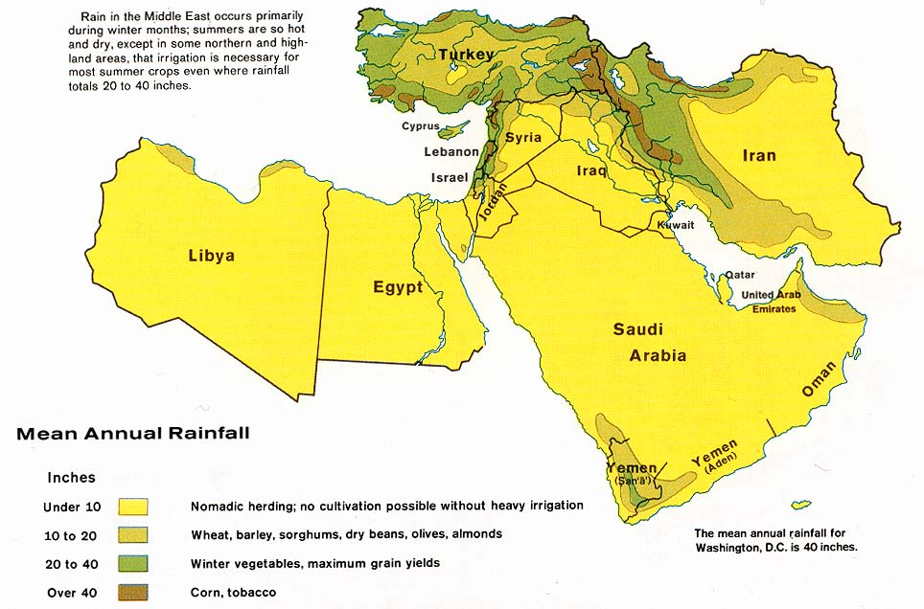
5
Middle East
Geography
8
4
6
3
7
1
2

Slide 13
←Euphrates
River
Tigers →
Afghanistan
Suez Canal
Jordan River
West Bank

Slide 14
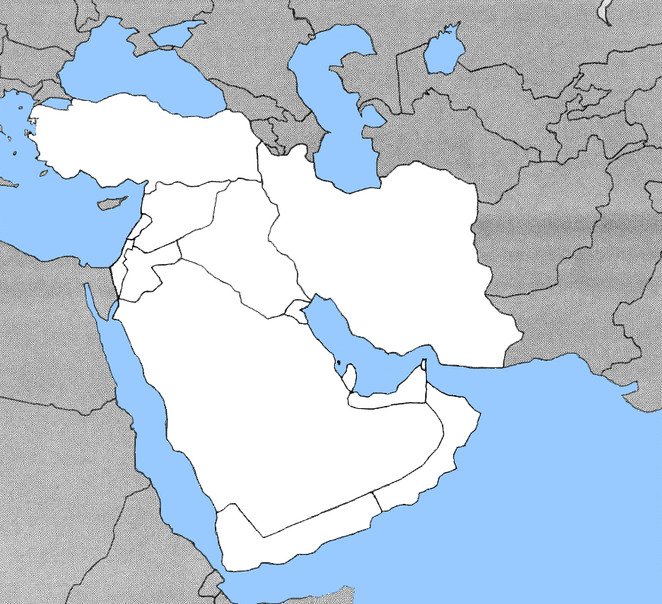
Middle East Geography 2
Middle East Geography 2
5
6
1
4
2
7
8
3
9

Slide 15
Middle East Geography 2
Middle East Geography 2
Euphrates River
Mediterranean Sea
Tigeris River
Jordan River
Suez Canal
Persian Gulf
Straits of Hormuz
3
Arabian Sea

Slide 16
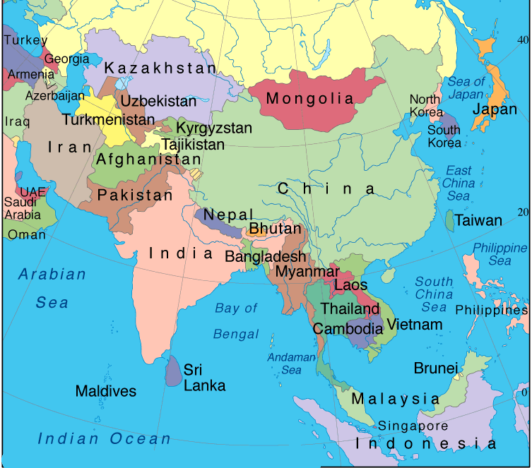
Asia Geography
←Euphrates
River
Tigers →
2
4
3
Suez Canal
Jordan River
West Bank
1
7
5
6

Slide 18
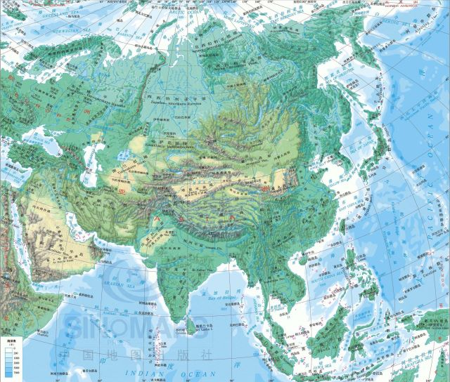
Asia Geography 2
4
6
13
12
7
14
3
8
5
1
2
10
9
11

Slide 19
Yellow River
Sea of Japan
Taklimakan Desert
Gobi
Desert
Yellow Sea
Himalayans
Tibetan Plateau
Yangtze
East China Sea
Indus
Ganges
Mekong
South China Sea
Bay of Bengal
11

Slide 20
One section down!

Slide 21
Geography
Which of these rivers flows into the Persian Gulf?
Nile
Yellow
Euphrates
Mississippi
Which of these is the name of a sea?
Indian
Euphrates
Red
Blue

Slide 22
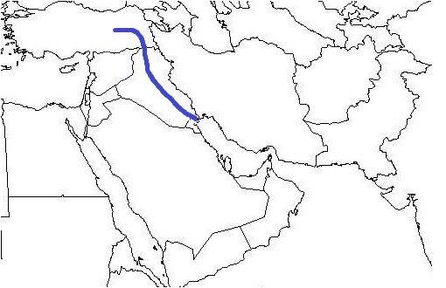
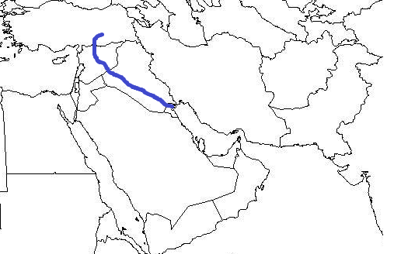
Geography
What river is this?
Tigris
Euphrates
Jordan
Nile
What river is this?
Tigris
Euphrates
Jordan
Red

Slide 23
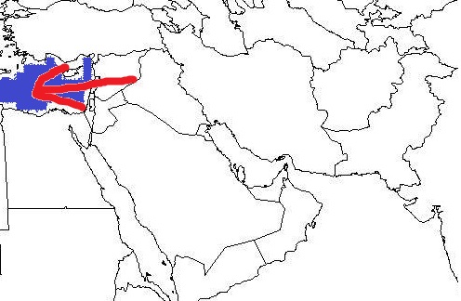
Geography
What body of water is this?
Caspian Sea
Arabian Sea
Dead Sea
Mediterranean Sea
Which of these bodies of water is attached to the Straits of Hormuz?
Persian Gulf
Red Sea
Suez Canal
Mediterranean

Slide 24
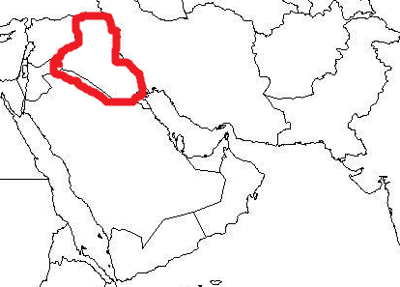
Geography
Which country is this?
Iraq
Iran
Saudi Arabia
India
The Suez Canal connects which two water sources?
Red Sea and Arabian Sea
Persian Gulf and Mediterranean Sea
Red Sea and Persian Gulf
Mediterranean Sea and Red Sea

Slide 25
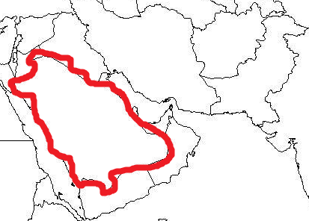
Geography
Which country is this?
Yemen
Saudi Arabia
Iran
Turkey
This peninsula is part of Egypt.
Arabian Peninsula
Iberian peninsula
Sinai peninsula
Egypt Peninsula

Slide 26
Geography
Which country is this?
Lebanon
Pakistan
Afghanistan
Jordan
Which one of these countries contains 1/5 of the worlds oil?
Lebanon
Iraq
Israel
Saudi Arabia

Slide 27
Geography
An area that receives less than 10 inches of rain annually is called
Semi-Arid
Tropical
Rainforest
Arid
An area near a certain sea has a moderate climate
Mediterranean
Arid
Semi-Arid
Arabian
List the major pollutants in the Ganges River
Industrial-Arsenic
Agricultural –Nitrogen from irrigation and fertilizers
Religious-Cremation
Human-Lack of sewage, litter and other human waste

Slide 28
Geography
What is the most valuable resource in the Middle East
Oil-makes country rich
Water allows for farming
Why is the Suez Canal so important to international Shipping?
It makes it possible to ship products from the Mediterranean (Europe) to Asia without sailing around Africa.
How has building dams creates issues for countries sharing rivers in Southwest Asia?
Dams limit water available to countries further downstream
How much of the world’s supply of oil is found in the Middle East?
50-60%

Slide 29
Geography
Name two problems with farmers using fertilizers
-salt build up in soil
-Nitrogen damages water supplies
Why aren’t desalinization and drip irrigation used more in Southwest Asia?
They are too expensive for most countries to afford
What are some of the biggest threats to the African Rainforest?
#1 Overpopulation
Deforestation
Over-cultivation
Overgrazing
What has prevented main African Nations from developing their resources to the greatest benefit?
Political Unrest
Poverty

Slide 30
Geography
Why do many governments in Africa and Asia ignore pollution in rivers
They want industries to be profitable
What is the “Green Line”
A line between cultivated irrigated land and desert
Why is farming in the Sahel so difficult?
Little Rainfall
Variable rainfall
Desertification
Overpopulation
What is an industrial pollutant found in water?
Arsenic
What is an Agricultural pollutant found in water?
Nitrogen from Fertilizers
What are causes of indoor and outdoor air pollution in Asia?
Indoor-biomass cooking and heating
Outdoor-factories and coal burning power plants

Slide 31
One section down!

Slide 32
Culture and Religion
The Five Pillars of Islam are…
The five basic obligations all Muslims should follow
  1. Declaration of faith
  2. prayer 5 times daily
  3. Alms
  4. Hajj
  5. Ramadan
The word sect means
Different groups within the same religion
The main reason for the Sunni and Shia division lies in the
Belief on the Caliph or who is qualified to rule the country
Sunnis believe the caliph should be
A strong religious leader
Shia believe the Caliph should be
Related to the prophet Muhammad
The most prominent religion in the Middle East is
Islam

Slide 33
Culture and Religion
What is the main difference in the belief in god between the Abrahamic religions and Hinduism?
Judaism, Christianity and Islam and monotheistic; Hinduism is polytheistic
What belief set Judaism apart from other religions in the Ancient world?
Monotheism
Why do Muslims call Jews and Christians people of the book?
Parts of the Torah (old testament) and Bible (new testament) are in the Qu’ran
The practice that the Golden Stool is an important symbol of power is practiced by the
Ashanti
Why are so many people in Africa part of the Bantu ethnic group?
The Bantu Migration covered large expanse of the African Continent
Ethnic groups is
People who share a language, history, and often religion
Why is learning Arabic important to Muslims?
The Qur’an, or Muslim holy Book is in Arabic.

Slide 34
Culture and Religion
Religion | Islam | Christianity | Judaism | Hinduism
Holy Book
Ethnic Group | Predominate Religion
Arab
Persian
Kurds
Jews
Ashanti
Bantu
Swahili
Kurds | Similarities | Persian

Slide 35
Culture and Religion
Religion | Islam | Christianity | Judaism | Hinduism
Holy Book | Qu’ran | Bible | Torah | Vedas
Arab | Sunni Islam
Persian | Shia Islam
Kurds | Sunni Islam
Jews | Jewish
Ashanti | Muslim, Christian and Shanti
Bantu | Muslim, Christian, and traditional religions
Swahili | Islam
Kurds | Similarities | Persian
Do not have their own nation Practice Sunni Islam | Have their own languages Practice Islam Live in parts of Iran and Iraq | Have their own nation-Iran Practice Shia Islam

Slide 36
Culture and Religion
Religion | Hinduism | Buddhism | Shintoism | Confucianism | Islam
Country of Origin
Holy Book
Things one should do
Mila | Similarities | Kami
Religion | Christianity | Islam | Judaism | Buddhism | Confucianism
Founder

Slide 37
Culture and Religion
Religion | Hinduism | Buddhism | Shintoism | Confucianism | Islam
Country of Origin | India | India | Japan | China | Saudi Arabia
Holy Book | Vedas | Pali Canon | None | None | Qu’ran
Things one should do | Live in a good way to have good Karma to be reincarnated in a higher caste | Follow the eightfold path and Middle Way | Pray at small alters in homes | Live an ethical and moral way.
Mila | Similarities | Kami
Part of Swahili’s belief that is mixed with Islam Practiced in East Africa | Spirits found in nature or people Important part of religion | Part of Shinto belief that spirits are in all things Found in Japan
Religion | Christianity | Islam | Judaism | Buddhism | Confucianism
Founder | Jesus of Nazareth | Prophet Muhammad | Abraham | Siddhartha Gautama | Confucian

Slide 38
Culture and Religion
What is the main difference in the belief in god between the Abrahamic religions and Hinduism?
Judaism, Christianity and Islam and monotheistic; Hinduism is polytheistic
What belief set Judaism apart from other religions in the Ancient world?
Monotheism
Why do Muslims call Jews and Christians people of the book?
Parts of the Torah (old testament) and Bible (new testament) are in the Qu’ran
The practice that the Golden Stool is an important symbol of power is practiced by the
Ashanti
Why are so many people in Africa part of the Bantu ethnic group?
The Bantu Migration covered large expanse of the African Continent
Ethnic groups is
People who share a language, history, and often religion
Why is learning Arabic important to Muslims?
The Qur’an, or Muslim holy Book is in Arabic.
How did Confucianism start playing a major role in Chinese society?
In 121 BC the Han dynasty had Confucian Scholars help put Confucianism into the government

Slide 39
Culture and Religion
Why is Confucianism more a philosophy than religion?
It is an ethnical way to live, but does not discuss religious ideas
What is reincarnation?
The Hindu belief the body returns to another body after death
What is Karma?
Hindu belief one’s action determine one’s fate
What is the Caste System?
Division of people into hereditary social classes
What does Buddha mean?
Enlightened One
Oldest Monotheistic religion in the world is
Judaism
What is an important mind set Buddhist need to be happy
The Middle Way
Christian’s belief in Jesus differs from Islam and Judaism in the sense that Christians believe Jesus is the
Son of God / Messiah /Savior of Man

Slide 40
One section down!

Slide 41
History
What event led to the end of the Ottoman Empire?
Being on the losing side of WWI
What was a result of the end of the Ottoman Empire?
It became many other nations like Turkey, Palestine, Syria and many more
How did European Involvement in Southwest Asia impact the region?
Europeans participated the Ottoman empire without consideration of the history, ethnic and religious groups.
The Ottoman Empire was mainly ________ religion.
Islam
Anti-Jewish sentiment is called
Anti-Semitism
Anti-Jewish riots are called
Pogroms
What is it called when the Romans kicked the Jews out of Israel in 70 AD?
Diaspora
What is the biggest reason for Arab-Jewish conflict over the land of Israel?
Belief over who has religious right to the land
What was the USA main interest in Southeast Asia?
Containing communism during the Cold War

Slide 42
History
What story tells Jewish connection to the land of Israel?
Exodus , where Jews believe Moses was promised the land by God
What world organization created Israel and what year?
United Nations in 1948
Following what world event did the United Nations decide to create Israel?
WWII and the Holocaust where 6 million Jews were killed
What is Zionism?
Belief Jews should return to Israel and have their own country
Who were the Taliban?
A group of radical Muslims who were the government of Afghanistan
In 1979, the Islamic revolution overthrew the monarchy of which country?
Iran
Why did the USA bomb and invade Afghanistan in 2011?
They believe the government was offering aid to the Al-Queda the organization the attacked the USA on September 11th.
What is Nationalism?
Strong loyalty/pride to group who shares language, region, history and may be religion

Slide 43
History
Why did the USA invade Iraq in 2003?
They believed they were working on weapons of mass destruction and wanted to put a stop to the program. They also believe Saddam Hussein was a threat to the region.
Which ethnic group is sympathetic to the concerns of the Palestinians and why?
Arabs, because they share a language and religion with most Palestinians
What does the word refugee mean?
Someone forced to leave their home, normally as a result of War, Natural Disaster, Ethnic and religious tensions, or other reasons.
Who did India want independence from?
Great Britain
What two groups fought for Indian Independence and what religion did they follow?
Indian National Congress (Hindu) and Muslim League (Islam)
Who used Non-Violent protest to fight for Indian Independence?
Mahatma Gandhi
Who used Non-Violent protest to fight for equality between Blacks and Whites in South Africa?
Nelson Mandela
What conflict occurred after Indian Independence?
India and Pakistan split on religious lines

Slide 44
History
One type of Non-violent protest used in Indian independence was ________________ or disobeying unfair laws.
Civic Disobedience
What group was Mandela a part of to fight for greater civil rights for Blacks?
African National Congress or ANC
Who was the president of Apartheid that repealed unjust laws and was the President when Apartheid was outlawed?
F.W. De Klerk
Who was the first president after Apartheid ended and the first democratically elected president?
Nelson Mandela
What is Apartheid?
Legal separation of races and the government of South Africa until 1991
What is the Domino Theory?
The belief if one Asian Country became communist others would quickly follow.
What two countries did the USA get involved in because of the Domino Theory?
Vietnam and Korea
What is the outcome in those two countries today?
Vietnam is reunited and is communist
North Korean is communist and South Korea is Democratic

Slide 45
History
The Domino Theory was part of a great ideological battle between the Soviet Union and the USA called the
Cold War
What were the reasons for European interest in Africa?
Secure Trade Routes (to Asia)
Slave Trade
Natural Resources
Imperialism/Colonization
After what world event did African nations demand independence?
WWII
The ________ ___________ fought for independence in Kenya.
Mau Mau
What was a problem with the lines Europeans drew in Africa that still creates conflict today?
They did not consider the ethnic, religious and history of the people living there.
__________ is using local leaders and chiefs to rule for you. This was done by the Europeans in Africa.
Indirect rule
Why is there still fighting between the northern part of Nigeria and the southern part of Nigeria and Sudan and South Sudan?
The Muslims in the North and Christians in the South don’t always get along
There are many different ethnic groups that live there

Slide 46
History
Explain the following in relationship to the Chinese Revolution:
Long March | Great Leap Forward | Cultural Revolution | Tiananmen Square
Leader | Ho Chi Minh | Mao Zedong | Mahatma Gandhi
Country/movement

Slide 47
History
Explain the following in relationship to the Chinese Revolution:
Long March | Great Leap Forward | Cultural Revolution | Tiananmen Square
6,000 mile march Mao Zedong and communist are forced to take to avoid capture in 1929 | Economic policy of collective farming that resulted in widespread famine in China in the 1950s and 1960s | Policy started in the 1966s to arrest/kill any who disagreed with Mao Zedong and the Communists | 1989 student protest where hundreds were killed and arrested
Leader | Ho Chi Minh | Mao Zedong | Mahatma Gandhi
Country/movement | Leader of Vietnamese Communist Party | Leader of Chinese Communist Party | Leader of Indian Independence Movement who used non-violent protest

Slide 48
Government and Economics
What is the USAs main Economic Interest in Southwest Asia?
Oil
What generalization can you make about the relationship between GDP and literacy?
Literacy is usually higher in countries with a higher GDP.
Which BEST describes the government of Saudi Arabia?
Monarchy
Which branch of government is responsible for making and carrying out the laws in a parliamentary system of government?
The legislature
In a presidential system of government, how is a president chosen?
In a separate vote from the one that chooses the legislature
Directly by the people
Why do most economies in the world today operate somewhere in between a market economy and a command economy?
Most countries have found they need a mix of free market and government control to be successful and protect consumers
How has Israel made up for its lack of natural resources?
They have developed a strong technology sector of their economy.

Slide 49
Government and Economics
What World Organization helps control the price of oil?
OPEC-the Organization of Petroleum Exporting Countries
What is the definition of economic specialization?
Producing those goods a country can make most easily so they can trade them for goods made by others that cannot be produced locally
The economy of Saudi Arabia is based on which of the following?
Oil and natural gas
How does a Democratic government differ from an Oligarchic government?
Role of the Citizen
In a parliamentary government system, the head of the government belongs to which branch?
Legislature
Who takes on the financial risk in starting a new business in a market economy?
Entrepreneurs
Why is Iran sometimes called a theocratic republic?
Both an elected parliament and powerful religious leaders lead Iran’s government.
Saudi Arabia’s literacy rate increased from approximately 48% in 1980 to over 78% by 2009. Why is this important for Saudi Arabian economy?
It helped to increase the country’s GDP

Slide 50
Government and Economics
Fighting between one or more groups with in a county is called
Civil War
A government where religion and government are separate is called
Secular
What was the purpose of China’s Four Special Economic Zones?
To act as centers for global trade
What was the main difference in China’s Economic Policies of the Great Leap Forward and The Four Modernization?
The Great Leap Forward was NOT successful- 45 million died of starvation
The Four Modernization was Successful
___________Lead the Chinese Revolution
Mao Zedong
____________lead the Vietnamese Nationalist /independence Movement
Ho Chi Minh
________________ Lead the USA post WWII rebuilding in Japan.
Douglas MacArthur
Both the Chinese Revolution and the Vietnamese independence movement were lead by ____________ political party
Communist
The name for the Indian movement to improve farming by using better seeds and fertilizers
Green Revolution

Slide 51
Government and Economics
What is an Ayatollah?
A Christian priest
A Shia religion leader
The title of a local governor
A leader of a Jewish organization
In a parliamentary system, who is the head of government?
Monarch
Dictator
President
Prime minister
Who is the most powerful elected official in Iran?
Electorate
President
Supreme leader
Head of the judiciary
In Iran, the economy is highly centralized and there are a lot of regulations about private individuals (entrepreneurs) opening and operating businesses. However, Saudi Arabia has made owning and operating business very easy compared to the world average. What impact does this have on the role of entrepreneurs in both countries?
Entrepreneurs are not affected by government regulations.
It will limit efforts entrepreneurs in both Iran and Saudi Arabia.
Entrepreneurs will be able to make significant contributions to Saudi Arabia’s economy but not to Iran’s economy.
Both Iran and Saudi Arabia will benefit greatly from the efforts of entrepreneurs.

Slide 52
Government and Economics
After the Persian Gulf War, The United Nations imposed an embargo on Iraq. What would be the reason an embargo was used by the United Nations?
To control the Iraqi economy after the war.
To restrict trade with Iraq until they met UN requirements
To increase the cost of Iraqi products to help Iraqi’s economy
To protect Iraq’s domestic industry so it would grow after the war
What is Shariah Law?
Laws made by the king alone
Laws based on parliamentary democracy
Laws based on the teachings of the Quran
Laws calling for a separation of church and state
In which of these countries would the leader have to be a direct descendant of the prior leader of the country?
Iran
Israel
Saudi Arabia
Afghanistan
Oil is the major export of Saudi Arabia to many different countries. Saudi Arabia’s international trade in oil is made much easier by
Use of the world wide currency
A system to exchange currency between countries
Trading only with countries that have the same currency
Trade of oil for other needed goods so currency is not needed

Slide 53
Government and Economics
Use the passage to answer the next 2 questions:
The OPEC nations control about 40% of the world’s oil output. The OPEC countries work together to control prices for oil and to keep profits flowing to their countries. One way that they control prices is to limit production. Each member country is given a maximum amount of oil they can sell in a given time.
What describes the limit that OPEC puts on its members’ production of oil?
Quota
What happens to the price of oil when OPEC countries decide to reduce production of oil?
Prices rise

Slide 54
Government and Economics
Country | Saudi Arabia | Israel | Nigeria | South Africa | Japan
Main resource/ area of specialization
Lots of people have power (vote) | Few people have power | One person has power
Local Power | Shared Power | Central Power

Slide 55
Government and Economics
Country | Saudi Arabia | Israel | Nigeria | South Africa | Japan
Main resource/ area of specialization | Oil | Technology | Oil | Gold and Diamonds | Technology
Lots of people have power (vote) | Few people have power | One person has power
Democracy | Oligarchy | Autocracy
Local Power | Shared Power | Central Power
Confederation | Federation | Unitary

Slide 56
Government and Economics
Specialization
Quota
Entrepreneur
Tariff

Slide 57
Government and Economics
Specialization | Producing goods that a country can easily making and trading for goods a country cannot easily make.
Quota | Limit to the amount of goods a country can buy or sell.
Entrepreneur | Someone who takes on financial risks to start a company
Tariff | Taxing goods entering a country to protect local production

Slide 58
Finished!
Do You want to play again?

