Slide 1
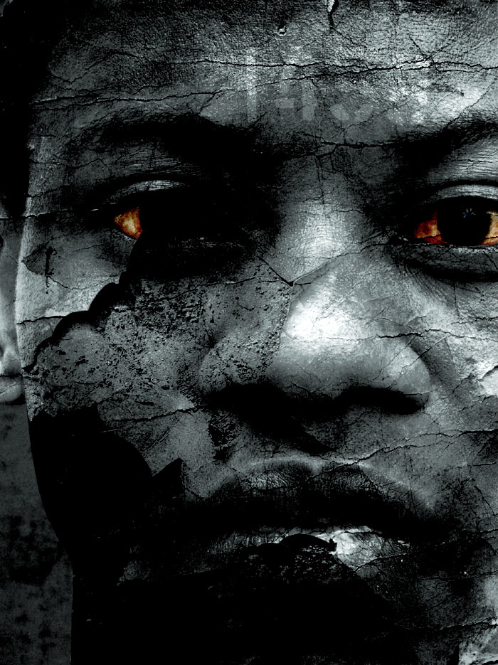
Understanding the History of
South Africa & Apartheid

Slide 2
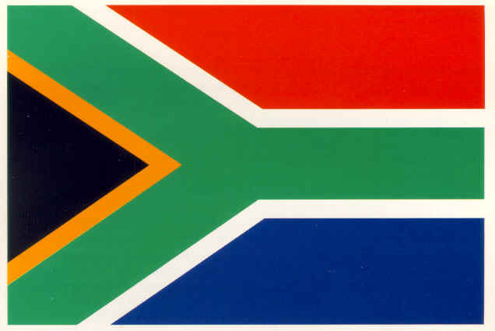
Early History
A Time Line
South Africa was important location for global trade & location allowed for naval protection
Dutch settled here first.
Boer War between Dutch and British
1806 – British seize Cape of Good Hope from the Dutch!
1867 – Discovery of Gold
The Zulu Nation Temporarily Defeated the British
1886 – Discovery of Diamonds
1889 – 1902 – The Boer War (British and Dutch settlers)
1948– (post WWII) The beginning of apartheid
1990’s – The end of apartheid
Notes:
The discovery of diamond and gold increased wealth of new settlers and increased immigration to the area. The discovery also intensified subjugation of native inhabitants.
After the Boer War, the Union of South Africa was created and operated under a policy of apartheid.

Slide 3
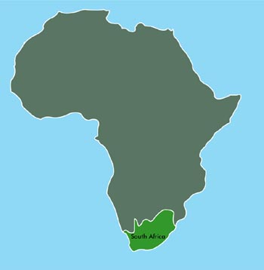
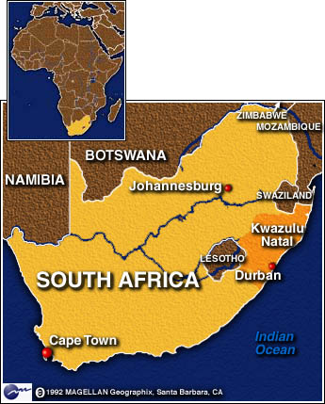
South Africa
Twice the size of Texas

Slide 4
Population by Race
“Colored” is a term used for mixed black, Malayan, and white descent
Asian population is mainly Indian ancestry

Slide 5
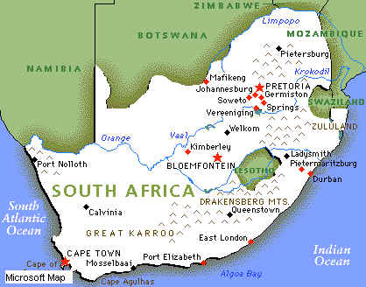
South African Cities
Capitals
  Pretoria
  Cape Town – legislative center
  Bloemfontein – judicial center

Slide 6
Languages / Provinces
LANGUAGES
Afrikaans
English
Ndebele
Pedi
Sotho
Swazi
Tsonga
Tswana *
Venda
Xhosa
Zulu
PROVINCES
Eastern Cape
Free State
Gauteng
Kwa Zulu – Natal
Limpopo
Mpumalanga
North-West
Northern Cape
Western Cape

Slide 7
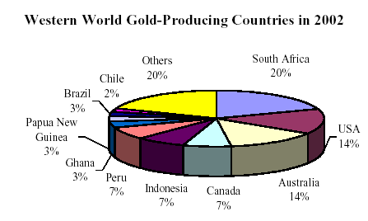
World’s Largest Producer…
Gold
Platinum
Chromium
Diamonds

Slide 8
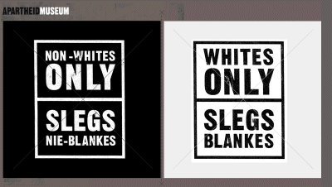
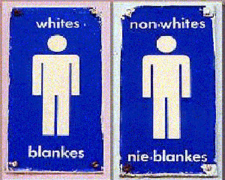
Apartheid
Apartheid = “Separateness”
The separation of races
Apartheid required segregation in housing, education, employment, public accommodations, and transportation.
It segregated not only almost all whites from nonwhites, but also major nonwhite groups from each other.

Slide 9
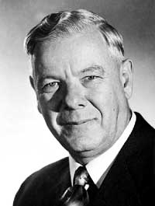
Hendrick Verwoerd
Prime Minister of South Africa 1958-1966
Architect of apartheid
Started “separate development”
The cornerstone of apartheid was the Population Registration Act of 1950 -all South Africans were classified according to race.
The government established separate schools, universities, residential areas, and public facilities for each racial group.
Blacks could only work/live in certain areas

Slide 10
What was the population demographics of South Africa?
13% of S. Africa’s land = HOMELANDS for over 85% of the population
The remaining 80% = major mineral areas and cities were left for whites-13% of the population

Slide 11
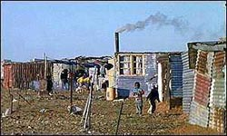
Homelands
“Reservations” or “Bantustans”
Verwoerd established 9 African groups
  Each was to become a nation within its own homeland
  Africans had rights and freedoms
  Outside the homelands, treated as aliens
Poor quality land with erosion
Completely incapable of supporting large populations

Slide 12
4 Major Racial Groups under Apartheid
White
Colored or people of mixed descent
Bantu or black Africans
Later Asians, or Indians and Pakistanis, were added as a fourth category.
The laws determined where members of each group could live, what jobs they could hold, and what type of education they could receive. Laws prohibited most social contact between races, authorized segregated public facilities, and denied any representation of nonwhites in the national government.

Slide 13
The Pass Book
Non-whites over 16 had to carry one. The card identified what racial group they belonged to.
Lived in Townships (the city’s perimeter)
Curfew regulations
Passbook raids
Failure to meet curfew or have passbook = subject to arrest

Slide 14
Rural vs. Urban
Group Acts of 1950 & 1986 assigned racial groups to different residential and business sections in urban areas.
What might have been the motive for this?
The law was to exclude non-Whites from living in the most developed areas. It caused many non-Whites to have to commute long distances from their homes in order to be able to work.
1.5 Million Africans were forced from urban areas to rural reservations.
1961 – Pressure from UN caused South Africa to withdraw from the Commonwealth of Nations

Slide 15
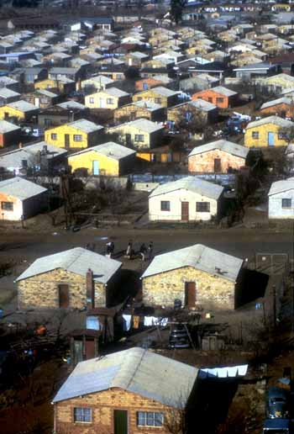
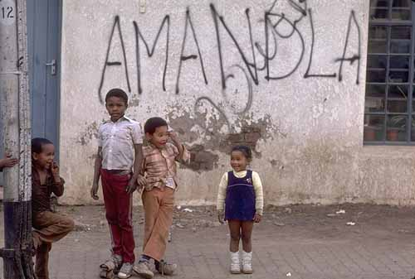
Houses in Soweto, a black township.

Slide 16
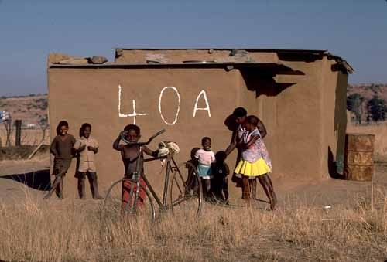
Umbulwana, Natal in 1982.
Called "a black spot" because it is in a "white" area.
Eventually demolished and the inhabitants forced to move to identically numbered houses in "resettlement" villages in their designated "homelands.“
Millions of black South Africans were forcibly "resettled" in this way.

Slide 17
Apartheid
No Rights for Non-whites
No right to vote
No ownership of land
No right to move freely
No right to free speech
No right to protest the government

Slide 18
Images of Apartheid

Slide 19
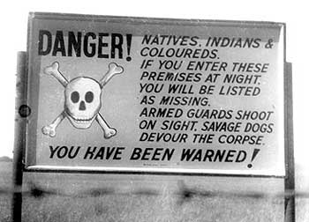
Images of Apartheid

Slide 20
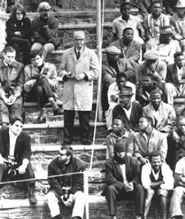
Apartheid separated
the whites from
the non-whites

Slide 21
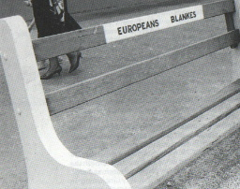

Slide 22
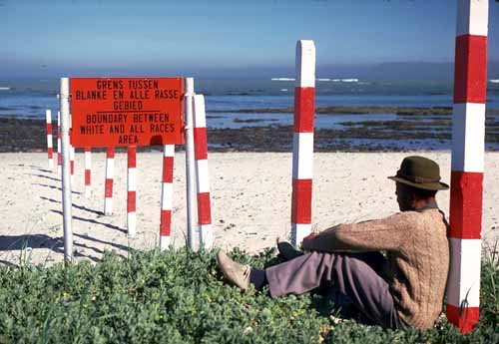

Slide 23
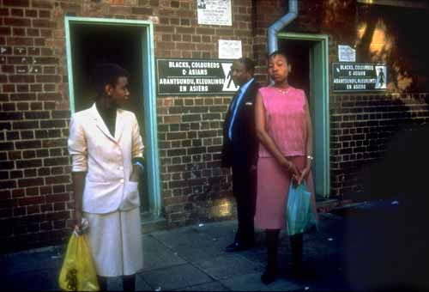

Slide 24
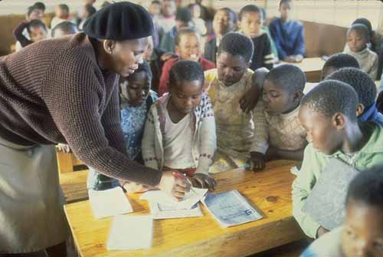

Slide 25
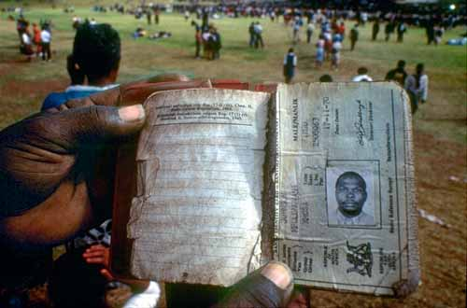

Slide 26
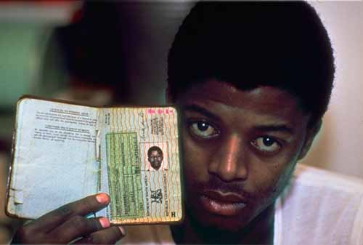

Slide 27
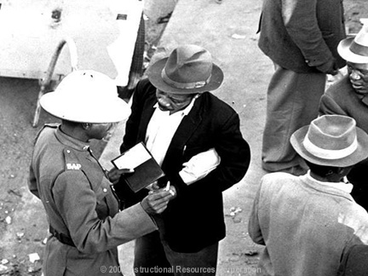

Slide 28
Resistance and Protests
Apartheid is Challenged

Slide 29
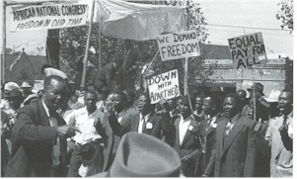
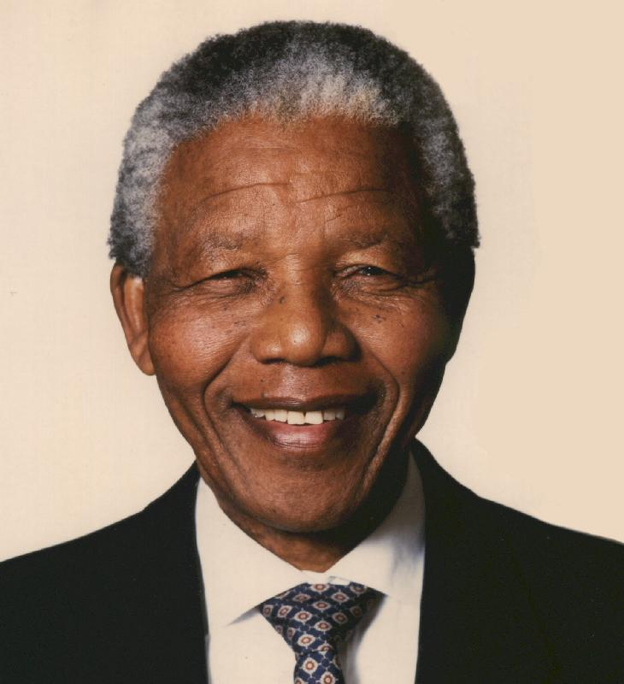
Nelson Mandela
Nelson Mandela peacefully fought to end apartheid. He served 27 years in prison for such “treason.”
Mandela was released from prison in 1990 and became the country’s first democratically elected president.
He was also the country’s first black president.
Thousands of other South African non-whites were imprisoned and executed for their resistance against apartheid.

Slide 30
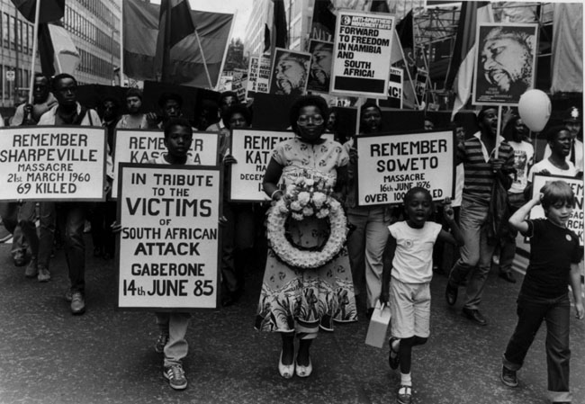
1960 Sharpeville Massacre
In 1960, during a peaceful protest in the city of Sharpeville, 69 people were killed
This massacre ignited additional demonstrations and protests against the unfair treatment of non-whites

Slide 31
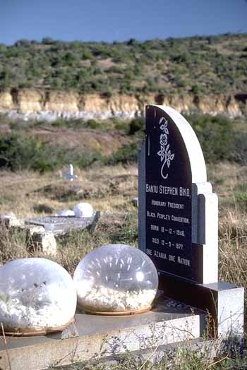
Steve Biko
A young Black leader
Grave in King Williams Town, South Africa.
Died in police detention in 1977. During the inquest into his death, strong evidence was presented that he suffered violent and inhumane treatment during his detention.

Slide 32
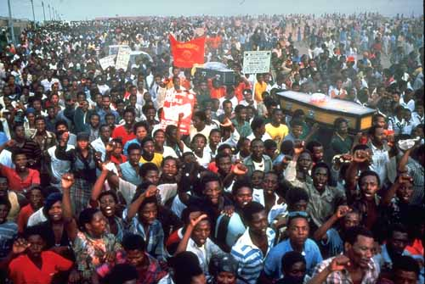
1985 Demonstration
In 1985 an International Day for the Elimination of Racial Discrimination was organized.
The demonstration was held to commemorate the anniversary of the March 21, 1960 massacre.

Slide 33
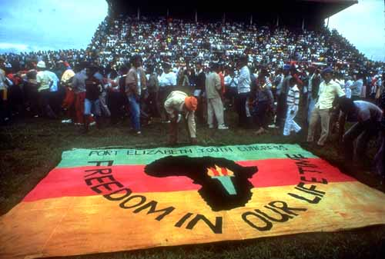
1985 Demonstration
The message was simple:
“Freedom in Our Lifetime!”

Slide 34
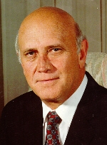
Frederik Willem de Klerk
President of South Africa from 1989 – 1994
Granted the release of Nelson Mandela from prison in 1990
Helped end apartheid in South Africa
Shared the Nobel Peace Prize with Nelson Mandela in 1993 for his role in ending apartheid

Slide 35
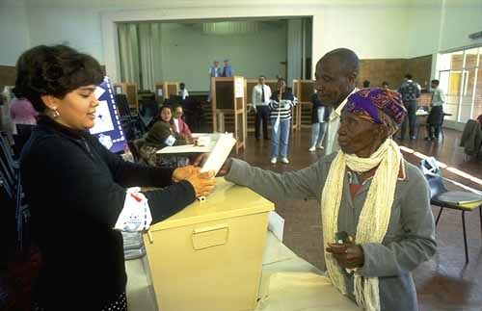
International pressure finally ended apartheid in 1994
Bantustans abolished and territories reabsorbed into the nation of South Africa
Apartheid caused major economic hardships on South Africa
  International sanctions
  Decreased labor force
  Cut investments from countries like U.S.A.
First multiracial election
Nelson Mandela elected president of South Africa (1994 – 1999)

Slide 36

South Africa Today
1994 – The end of Apartheid
Presidents serve 5 year term
Today the President is Jacob Zuma

