Slide 1
SS7G8 The student will describe the diverse cultures of the people who live in Southwest Asia (Middle East).
a. Explain the differences between an ethnic group and a religious group.

Slide 2
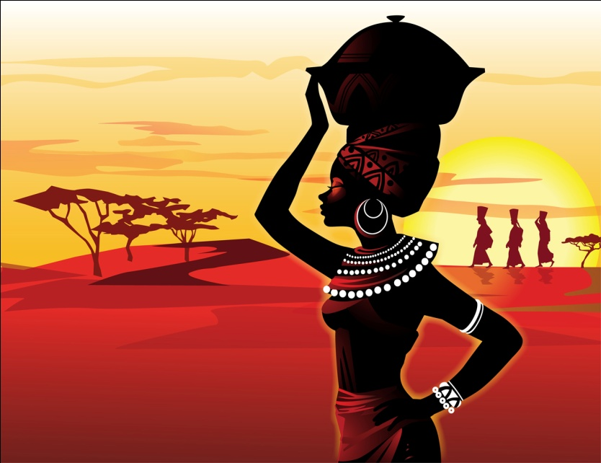
What do you
look like?
Arab
Japanese
Bedouin
Is your
Ethnicity
Jewish
Maasai

Slide 3

What do you say?
Language is your Ethnicity

Slide 4
How Do you Pray?
Is your Religion
Judaism
Islam
Christianity
Confucianism
Buddhism
Hinduism

Slide 5
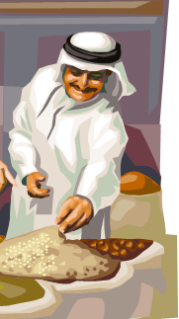
What you eat, where you buy it and what you do not eat?

Slide 6
Ethnicity or Religion is your…
View on Education?
Role of people in government?
Influence on Nation?

